Slide 1
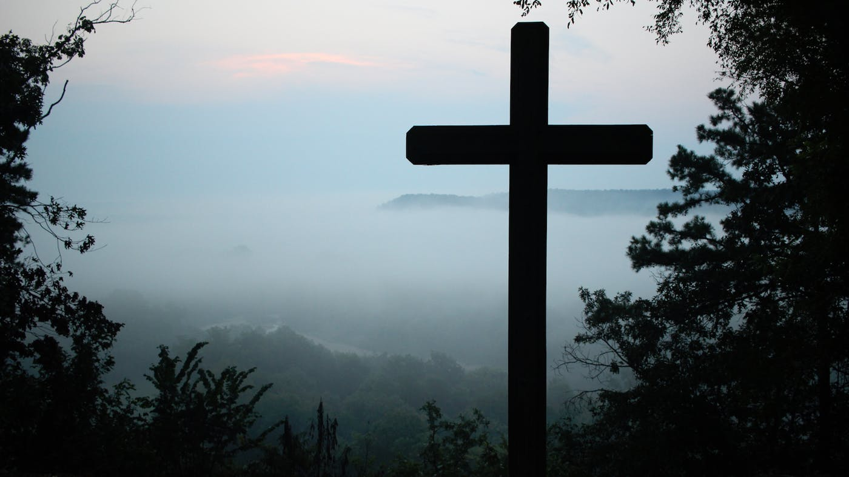
Crucifixion of Christ
An Islamic-Biblical Academic Study
- Moneeb Minhas -

Slide 2
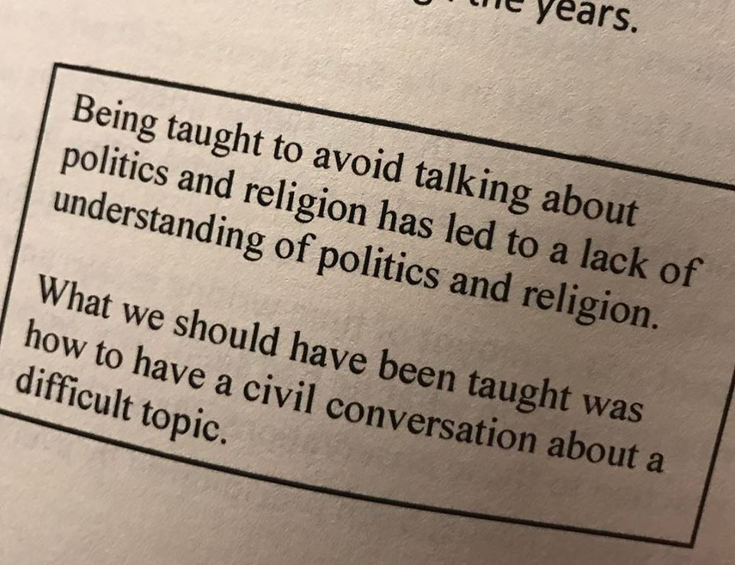

Slide 3
Similarities and differences on Christ
The only Relgion on earth other than Christianity that makes it an article of faith to believe in Jesus is Islam.
Christianity
Jesus is divine (God or Son of God)
Jesus was crucified and resurrected after 3 days
Islam
Jesus is not divine but one of the mightiest Messengers of God.
Jesus was not crucified nor resurrected.

Slide 4
What Islam/Quran says about Jesus’ Crucifixion
“They (Jews) said (in boast), "We killed Christ Jesus the son of Mary, the Messenger of Allah";
― but they killed him not, nor crucified him, but so it was made to appear to them and those who differ therein are full of doubts, with no (certain) knowledge, but only conjecture to follow, for of a surety they killed him not.―
Nay, Allah raised him up unto Himself; and Allah is Exalted in Power, Wise.
Holy Quran Surah An Nisa
(Chapter of The Women)
(4:157)

Slide 5
Two most famous opinions
1. Jesus taken up before crucifixion and another person (Judas) instead was crucified in his place. So the betrayer was crucified instead of Jesus.
(some Christians sects/denominations hold this opinion – they call it the substitution theory)
2. Jesus was put on the cross but did not die (escaped death) - not killed. Similar more to a resuscitation rather than a resurrection.
(Some Christian sects/scholars/denominations hold this opinion)

Slide 6
Definition of “Crucifixion”
  “the execution of a person by nailing or binding them to a cross.” – Oxford Dictionary
  “the death of Jesus Christ on a cross” – Biblical Dictionary
  “a method of putting to death by nailing or binding to a cross, normally by the hands and feet, which was widespread in the ancient world” – Collins Dictionary

Slide 7
Definition of “Resurrection”
a supposed act or instance of a dead person coming back to life - Collins Dictionary
In Christian belief, the Resurrection is the event in which Jesus Christ came back to life after he had been killed. – Collins Dictionary
To revive (bring back) something that is inactive (dead) – Oxford Dictionary

Slide 8
Importance of Crucifixion for Christians
Paul says:
  "If Christ be not risen from the dead, then our preaching is vain, and your faith is also vain." (1 Corinthians 15:14)
Jesus said:
  “If you want eternal life (salvation), keep the commandments.” - Matthew 19:17

Slide 9
Biblical requirements of Resurrection
Paul says:
  “It is sown in weakness it is raised in power. It is sown a natural body, it is raised a spiritual body” - 1 Corinthians 14:17
Jesus says
  “and the resurrection from the dead, neither marry, nor are given in marriage: ³⁶ Neither can they die any more: for they are equal unto the angels; and are the children of God, being the children of the resurrection.” - John 20:35-36

Slide 10
Gospel writers were not eye-witnesses
“Then they all forsook him and fled”. - Mark 14:50

Slide 11
Study of the Crucixion
PART 1
Pre-Crucifixion
PART 2
Crucifixion
PART 3
Post-Crucifixion
PART 4
Prophecy study

Slide 12
Part 1
Pre-Crucifixion

Slide 13
1. Jesus reluctant to die
Jesus says:
  "When I sent you without purse, and scrip, and shoes, lacked ye anything?" And they said, "Nothing." Then said he unto them, "But now, he that hath no purse, let him take it, and likewise his bag; and he that hath no SWORD, let him sell his garment and buy one!.. . . Lord, behold, here are two SWORDS." And he said unto them, "It is enough"." - (Luke 22:35-36)

Slide 14
At the Garden of Gethsemane
Jesus Says:
  “Sit ye here, while I go and pray yonder”. – Matthew 26:36
  “…stay here and watch with me”. – Matthew 26:38

Slide 15
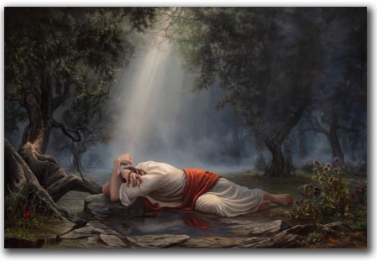
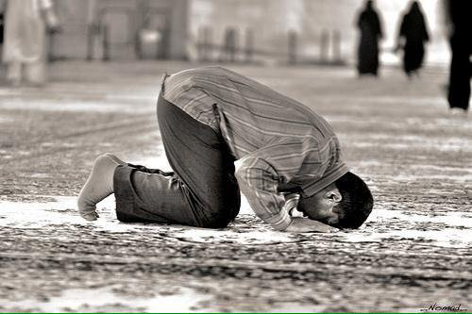
2. Jesus Prays for Rescue
". . . and began to be sorrowful and very depressed. Then saith he unto them, 'my soul is exceedingly sorrowful, even unto death' . . ."
"And he went a little further, and fell on his face (Exactly as the Muslim does in prayer), and prayed, saying, 'O my Father, if it be possible, let this cup pass from me; nevertheless, not as I will, but as thou wilt'.“
(Matthew 26:37-39)

Slide 16
Jesus prays more
"And being in an agony, he prayed more earnestly; and his sweat was, as it were, great drops of blood falling down to the ground.” - (Luke 22:44)

Slide 17
Deuteronomy prophecy about Prophets
“But a prophet who presumes to speak in my name anything I have not commanded, or a prophet who speaks in the name of other gods, is to be put to death.”
21You may say to yourselves, “How can we know when a message has not been spoken by the Lord?” 22If what a prophet proclaims in the name of the Lord does not take place or come true, that is a message the Lord has not spoken. That prophet has spoken presumptuously, so do not be alarmed.

Slide 18
3. God hears his prayer
⁷ Ask, and it shall be given you; seek, and ye shall find; knock, and it shall be opened unto you:
⁸ For every one that asks, receives; and he that seeketh findeth;….how much more shall your Father which is in heaven give good things to them that ask him?
Matthew 7:7-11
“During the days of Jesus’ life on earth, he offered up prayers and petitions with fervent cries and tears to the one who could save him from death, and HE WAS HEARD because of his reverent submission.”
Hebrews 5:7

Slide 19
4. God strengthens Jesus with an Angel
“…An angel from heaven appeared to him and strengthened him.”
Luke 22:43

Slide 20
Disciples fight soldiers
“…one of them struck the servant of the high priest and cut off his right ear.” Luke 22:49

Slide 21
Jesus Trialled Falsely
Jews had already made up their mind:
  ". . . it is expedient for us that one man die for the people, and the whole nation perish not.” – John 11:50
They question Jesus:
  “…About his doctrine” - John 18:20-23
  “Are you the son of God”. - Luke 22:70
Found guilty by the Jews
  "What need have we for any further witnesses? And they all condemned him to be guilty of death." - (Mark 14:63-64).

Slide 22
Jesus trialled by Romans
Jews have no power for capital punishment so take him tom Romans:
  "It is not lawful for us (Jews) to put any man to death". - (John 18:31).
Jews change the charge:
  ". . . We found this fellow perverting the nation, and forbidding to give tribute to Caesar, saying that he himself is Christ, a king." (Luke 23:2)
Pilate finds him not guilty
  ". . . I FIND IN HIM NO FAULT AT ALL!" (John 18:38)

Slide 23
5. Pilate’s wife has a dream
While the trial was under way, Pilate's wife sends him a message: "Have thou nothing to do with that just man (Jesus); for I have suffered many things this day in a dream because of him." - (Matthew 27:19).

Slide 24
Part 2
The Crucifixion

Slide 25
6. Jesus was only on the cross for a few hours
According to the Gospel writers, the Jews and the Romans managed to have Jesus on the cross by the 6th hour, that is by 12 noon; and by the 9th hour, that is, by 3 o'clock he had given up the ghost - he had died.
According to the footnote (commentary) of RSV Bible scholars on John 7:8 that states he was on the cross from 12 (noon) till the 9th hour (which in Jewish timings is 3pm).
Only 3 hours

Slide 26
7. The cross mates of Jesus were still Alive.
Encyclopaedia Biblica says ALIVE on cross.
  The Encyclopaedia Biblica, under the Article “Cross” Column 960 says when the spear was thrust into Christ, he was ALIVE. – Written by Christian Scholars of the highest eminence.

Slide 27
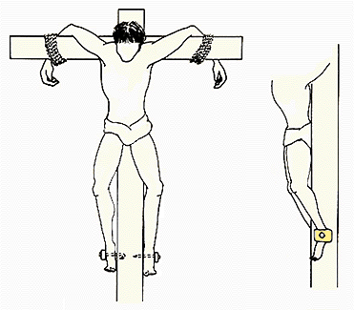
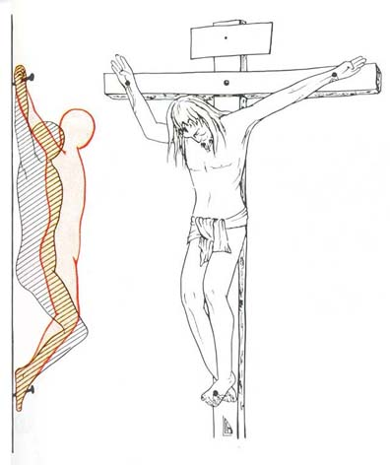
It is possible he was tied not nailed to the cross.
NOTE: Due to the uncertainty of this I am not including it as one of the points

Slide 28
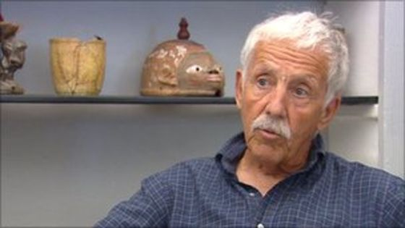
Was Jesus nailed or tied to the cross - Joe Zias
Joseph E. Zias, most commonly cited as Joe Zias, was the Curator of Archaeology and Anthropology for the Israel Antiquities Authority from 1972 until his retirement in 1997,^{[1]} with responsibility for items such as the Dead Sea Scrolls,
“Zias said the question of whether Jesus was nailed to the cross or simply tied to it remains a mystery. “The Gospels say he was crucified and leave it at that.”

Slide 29
8. When Speared, Came there out blood and water
". . . FORTHWITH came there out blood and water." - (John 19:34)
Encyclopaedia Biblica as explained before supports this.

Slide 30
Blood Does Not Flow From a Dead Body – says Professional Doctors
The Gospel of John, however, reports that only the two other men crucified with Jesus had their legs broken, whereas Jesus did not (John 19:33). “But when they came to Jesus and saw that He was already dead, they did not break His legs. But one of the soldiers pierced His side with a spear, and immediately blood and water came out.” (John 19:33-34) Therewith is actual proof of Jesus’ aliveness contained in the Bible, even after He officially ‘gave up the Ghost’. Dr. W. B. Primrose (former Chief of Anesthesiology at the Glasgow Royal Infirmary) wrote to author Reban: “… the circumstance of death does not permit bleeding.”
For him, John’s account is proof that “there was still blood circulation after the piercing with the spear, since active bleeding ends with the heartbeat.”
Source: https://www.facts-are-facts.com/article/jesus-didnt-die-on-the-cross

Slide 31
9. Legs were not broken – Fulfilment of Prophecy
“…Saw that he was dead already, they brake not his legs". - (John 19:33)
Fulfilment of Prophecy:
  "He keepeth all his bones, not one of them is broken.“ - (Psalm 34:20)

Slide 32
10. Thunderstorm, Earthquake and darkening of the sun
From Matthew 27 we know that an earthquake took place.
(Luke 23:49 / John 19:25) – States that Mary Magdalene, Josheph of Arimathea and a the other Mary are left to deal with the body of Christ.

Slide 33
11. Pilate is amazed when he finds out that Jesus is dead
"Pilate marvelled if he were already dead, and calling to him the centurion, he asked him whether he had been any while dead." - (Mark 15:44)

Slide 34
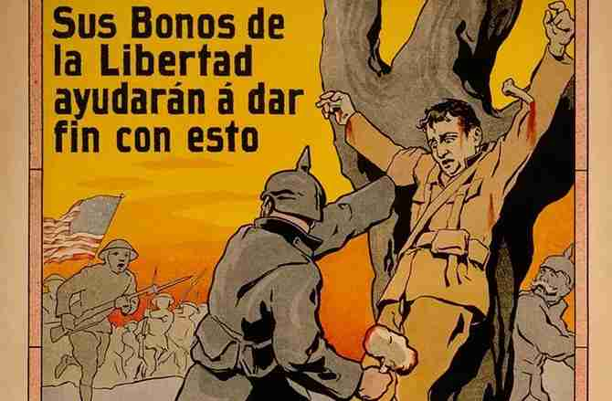
Man survives after being on Cross for 65 Hours
While rumors abounded that during World War I German soldiers crucified a Canadian soldier on a tree, it is certain the brutal execution was used in World War II by Japanese soldiers. The best documented case is that of three Australian prisoners of war who were bound to trees by the Japanese for killing cattle. One of them, Herbert James "Ringer" Edwards, survived being crucified for 63 hours. Edwards became the inspiration for the character Joe Harman in Nevil Shute's novel, "A Town Like Alice."
Source
https://www.seeker.com/was-jesus-really-nailed-to-the-cross-1771107612.html

Slide 35
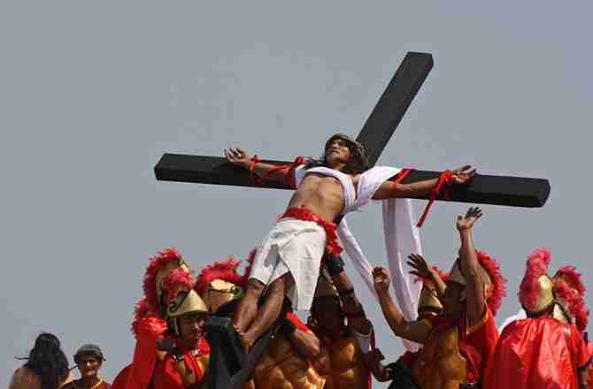
So many reports of Survivors from being Crucified.
This year on Good Friday, 55-year-old carpenter and sign maker Ruben Enaje will be nailed to a cross for the 30th time in the city of San Fernando, in the the Philippines. Enaje has been nailed to a cross every Good Friday since 1985 as an act of thanks for surviving a fall from a three-story building. Some 20,000 spectators are expected to attend the crucifixion reenactment, which is not encouraged by the Catholic Church for the use of nails, albeit sterilized.
Source
https://www.seeker.com/was-jesus-really-nailed-to-the-cross-1771107612.html

Slide 36
12. Tomb or Sepulchre of Christ
Why such a large tomb??
  Jim Bishop (a Christian authority of note), in his book "The Day Christ Died", gives the dimensions as 5 feet wide by 7 feet high by 15 feet deep, with aledge or ledges inside,

Slide 37
13. Jews worried that he may still be alive
"Now the NEXT day . . . the chief priests and Pharisees came together unto Pilate, Saying, Sir, we remember that that deceiver said “After 3 days I will rise”. Command, therefore, that the sepulchre be made sure until the third day, lest . . . the LAST error shall be worse than the FIRST (error)." - (Matthew 27:62-64)

Slide 38
Jewish errors
His legs not broken, whereas those of his "crossmates" were!
Not made sure of his death
The tomb within easy reach for the disciples
Helping hands of his "secret" disciples straight away.
His "crossmates" still alive.
Quick and easy permission granted by Pilate to obtain the body of Jesus. – Remember Pilate didn’t want the death of this man on his hands in the first place.
They realise the NEXT DAY, by then it is too late.

Slide 39
They plan but God is a greater planner
The Jews planned to kill him but look how many mistakes they made.
Jesus slips through them.
Their plan starts failing.

Slide 40
Part 3
Post-Crucifixion

Slide 41
14. Mary visits Christ to anoint/massage him.
According to Mark 16:9 and John 20:1 Mary visits the tomb alone Sunday morning.
"TO ANOINT HIM“ - Mark 16:1
Not a known or common act in Jewish tradition at all.

Slide 42
15. Stone removed – Sheets unwound and folded up.
“and seeth the stone taken away from the sepulchre...”
“…And the napkin, that was about his head, not lying with the linen clothes, but wrapped together in a place by itself.”
(John 20:1-7)
All this was only necessary if he was ALIVE.

Slide 43
16. Testimony of men around the Tomb claim he is ALIVE
“…Why do you seek the LIVING, among the dead” - Luke 24:5

Slide 44
17. Testimony of angles
“…angels who had said that he was ALIVE!” – Luke 24:23

Slide 45
18. Mary sees Jesus and he is in DISGUISE.
Jesus comes to her and taunts Mary:
  "Woman, why weepest thou? Whom seekest thou? - (John 20:15).
"She, supposing him to be the gardener, saith unto him".

Slide 46
19. Mary wants to take Him away
Mary says:
  "Sir, if you have taken HIM hence, tell me where have you laid HIM so that I may TAKE HIM AWAY.” (John 20:15)

Slide 47
20. Mary realises its Jesus but he forbids her to touch him
"Touch me not. For I am not yet ASCENDED unto my Father." – John 20:17

Slide 48
21. Jesus says “Not YET ASCENDED unto my Father”
“…For I am not yet ASCENDED unto my Father." – John 20:17
In the language of the Jew it means “I AM NOT DEAD” or “I HAVE NOT DIED/PASSED AWAY YET”.

Slide 49
22. Mary NOT AFRAID on recognising Jesus.
Mary says “Master” in excitement and tries to touch Jesus.
Jews were known to kiss their masters hands, so we say she was trying to kiss his hands.
All these things show that she was not afraid!

Slide 50
23. Disciples did not believe Mary.
"And they (the disciples), when they heard that he was ALIVE, and had been seen by her (Mary Magdalene), they BELIEVED NOT." - (Mark 16:11)

Slide 51
24. Journey to Emmaus – proves his great disguise
^{“13} And, behold, two of them went that same day to a village called Emmaus, which was from Jerusalem about threescore furlong…”
“…And it came to pass, as he sat EATING with them, he took bread and blessed it, and broke it, and gave it to them…their eyes were opened" - (Luke 24:30)
"And they went and told it unto the residue (of the disciples), NEITHER BELEIVED they them." - (Mark 16:13)

Slide 52
25. Disciples petrified on seeing Jesus
The two from Emmaus, "rose . . . and returned to Jerusalem, and found the ELEVEN gathered together, and those who were with them” - (Luke 24:33).
Then "Came Jesus and stood in their midst" - (John 20:19).
"Peace be unto you"(Note: this is also the Islamic greeting), he cried; but his little lambs "were terrified!" – Luke 24:36
"But they were terrified and affrighted and supposed that they had seen a SPIRIT” - Luke 24:37
Asalamu alaikum = Peace be unto you

Slide 53
26. Jesus EATS FOOD again and again to prove he is ALIVE!
"Behold (have a look at) my hands and my feet, that it is I myself (I am the same fellow, man!): handle me and see; for A SPIRIT has no flesh and bones, AS YOU SEE ME HAVE. . . And he showed them his hands and his feet."
- Luke 24:39-40
"Have you here any meat" i.e. anything to eat? "And they gave him a piece of broiled fish and of a honeycomb, and he took it, and ATE before them."
– Luke 24:41

Slide 54
Part 4
Prophecy

Slide 55
27. The Prophecy (only miracle) according to Jesus.
"Master, (Hebrew - Rabbi, meaning Teacher) we want to see a sign (miracle) from you." – (Matthew 12:38)
Jesus replies with: ". . . An evil and adulterous generation seeketh after a sign (miracle), and there shall no sign (miracle) be given to it, but the sign (miracle) of the prophet, Jonah."

Slide 56
LIKE JONAH
"For as Jonah was three days and three nights in the whale's belly; so shall the son of man be three days and three nights in the heart of the earth.“
- (Matthew 12:40)

Slide 57

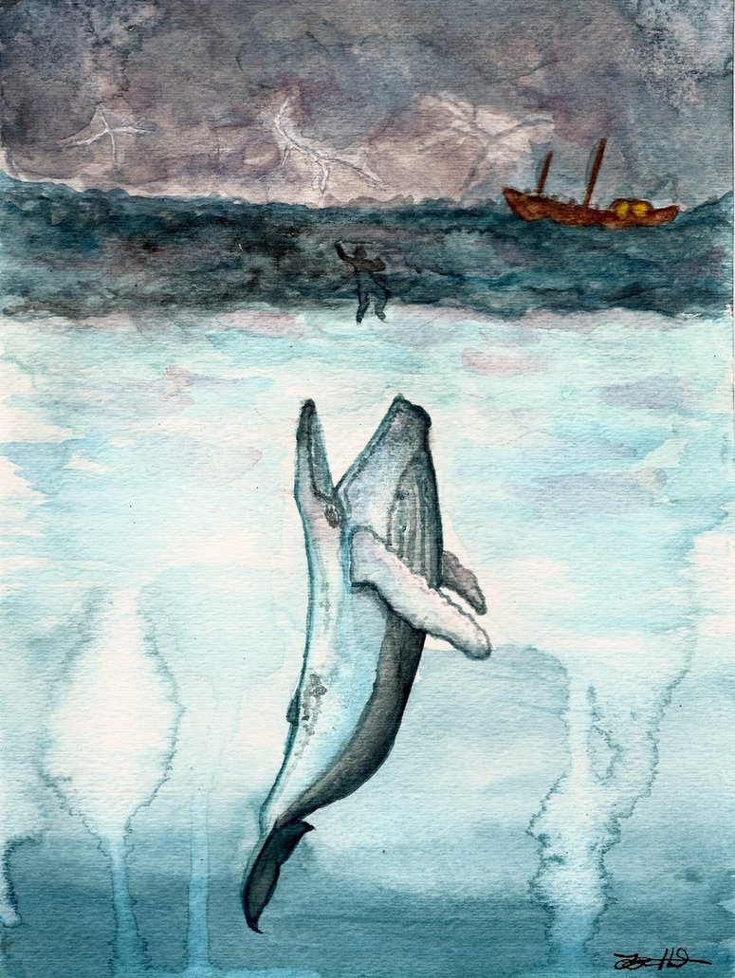
What is the sign of Jonah?

Slide 58
MIRACLE…MIRACLE…MIRACLE!!!!!
MIRACLE 1:
  Jonah is Alive before being tossed over as he volunteers. They do not need to kill him to throw him overboard. He survives
MIRACLE 2:
  A fish (whale) comes and gobbles him up . Again Jonah survives – another miracle
MIRACLE 3:
  In the belly of a fish Jonah spends 3 days and 3 nights (no food, no drinkable water, suffocating. Jonah still survives.
MIRACLE 4:
  The whale then spits him out onto shore and Jonah survives yet again and makes his way to Nineveh.

Slide 59
Jesus prophesised…
Jesus says: “AS JONAH WAS so SHALL THE SON OF MAN BE”. (Matthew 12:40)
He MUST be in the condition of being ALIVE if the prophecy is to be fulfilled.
If he is dead in his tomb then the prophecy remains unfulfilled. – Would mean Jesus lied?

Slide 60
Is this LIKE Jonah or UNLIKE Jonah
Jesus | Christianity | Islam
Before being put on the Cross | ALIVE | ALIVE
On the cross | DEAD | ALIVE
In the Tomb | DEAD | ALIVE
After the Tomb | RESURRECTED | ALIVE

Slide 61
Summary of points
1. Jesus reluctant to die
2. Jesus Prays for Rescue / Sobs for his people
3. God hears his prayer
4. God strengthens Jesus with an Angel
5. Pilate’s wife has a dream
6. Jesus was only on the cross for a few hours
7. The cross mates of Jesus were still Alive.
8. When Speared, Came there out blood and water
9. Legs were not broken – Fulfilment of Prophecy
10. Thunderstorm, Earthquake and darkening of the sun
11. Pilate is amazed when he finds out that Jesus is dead even though his legs were not broken as well.
12. The tomb of Christ

Slide 62
Summary of points
13. Jews worried that he may still be alive
14. Mary visits Christ to anoint/massage him
15. Stone removed – Sheets unwound and folded up.
16. Testimony of men around the Tomb claim he is ALIVE
17. Testimony of angles
18. Mary sees Jesus and he is in DISGUISE.
19. Mary wants to take Him away
20. Mary realises its Jesus but he forbids her to touch him
21. “Not YET ASCENDED unto my Father”
22. Mary NOT AFRAID on recognising Jesus.
23. Disciples did not believe Mary.
24. Journey to Emmaus – proves his great disguise
25. Disciples petrified on seeing Jesus
26. Jesus EATS FOOD again and again to prove he is ALIVE
27. The Prophecy (only miracle) according to Jesus

Slide 63
Misconcpetions
It’s a misconception that all the Christians have only one view that Jesus Christ (Peace Be Upon Him) was really crucified.
Contemporary Christian scholars as well as early Christian sects differ on the Crucifixion and some hold the same opinion as the Islamic view:

Slide 64
Non-Canonical Gospels of Early Christian Writings

Slide 65
Non-Canonical Gospels of Early Christian Writings
Non-Canonical means Gospels that exist but are not part of the book we call Bible today.
The Bible we have today especially that of the Catholics was agreed by the Council of Nicaea
  4th Century Roman Constantine brought about bishops and scholars at the time and wrote down what the religion of Christians (Pauline Christians) should be. Then he went out and killed off all the other sects calling them heretics.

Slide 66
Non-Canonical Gospels that allege Jesus was not Crucified.
The Gospel of Barnabas
The Acts of John
The Second Treatise of the Great Seth
The Apocalypse of Peter
The Gospel of Thomas
6. Gospel of Judas
7. Two Books of Jeu
8. Codex Sinaticus
9. Najah Hammadi
Source where you can obtain info on all the ancient scriptures and when they were written.
http://www.earlychristianwritings.com/index.html

Slide 67
Opinions of some early sects/denominations of Christendom

Slide 68
Early sects that had similar view
In early Christianity there are no less than five sects which believed that either Jesus was not crucifed or that somebody else was put on the cross instead of him:
  Basilinians
  The Nazoreans/Nazarenes – Most Earliest Christians
  Corinthians
  Docetism
  Ebionites – Most Earliest Christians

Slide 69
Opinions of other Christians

Slide 70
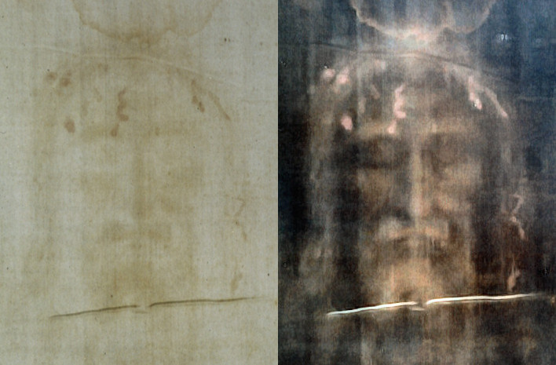
Christian Medical opinion - Shroud of Turin
Dr. J. G. Bourne, head of the Department of Anaesthesia and Resuscitation at St. Thomas’s Hospital in London also emphasised in 1965: “Jesus survived in a death-like condition, awoke and revived in the sepulchre.”
The nature of the bloodstains on the shroud is further proof that Jesus was still alive: visible around the edges of the stains is a kind of border caused by the blood serum, which occurs only in living blood.
Source: https://www.facts-are-facts.com/article/jesus-didnt-die-on-the-cross

Slide 71
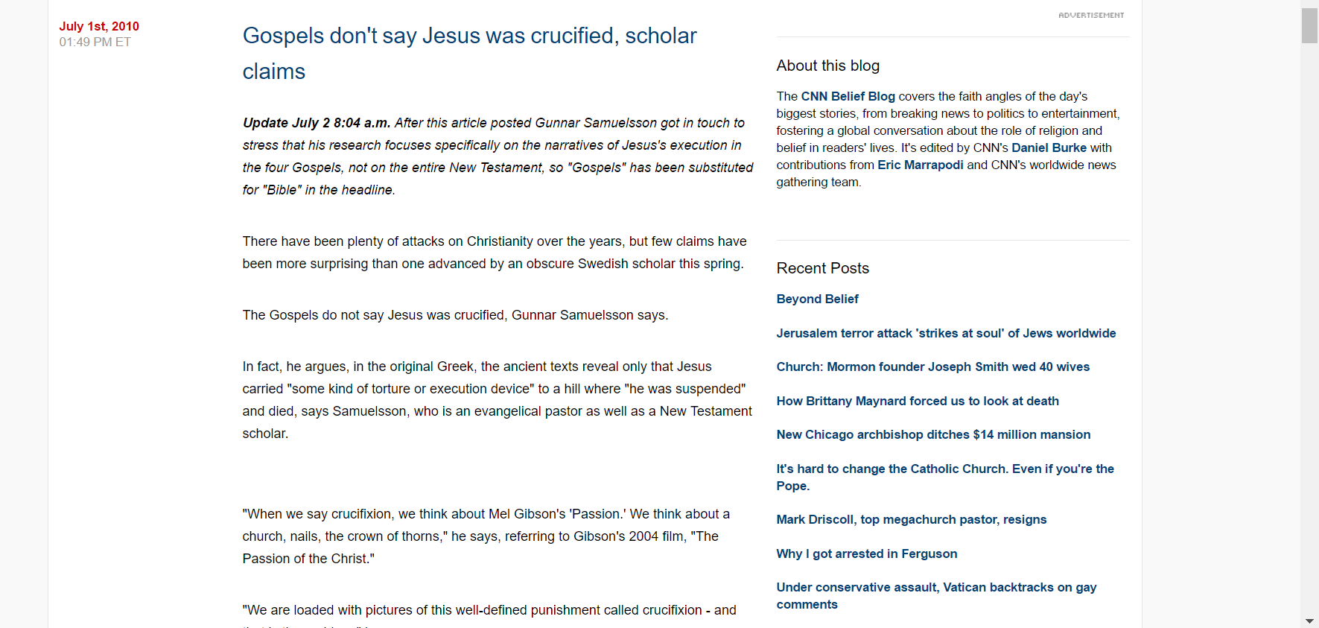
CNN report
http://religion.blogs.cnn.com/2010/07/01/bible-doesnt-say-jesus-was-crucified-scholar-claims/

Slide 72
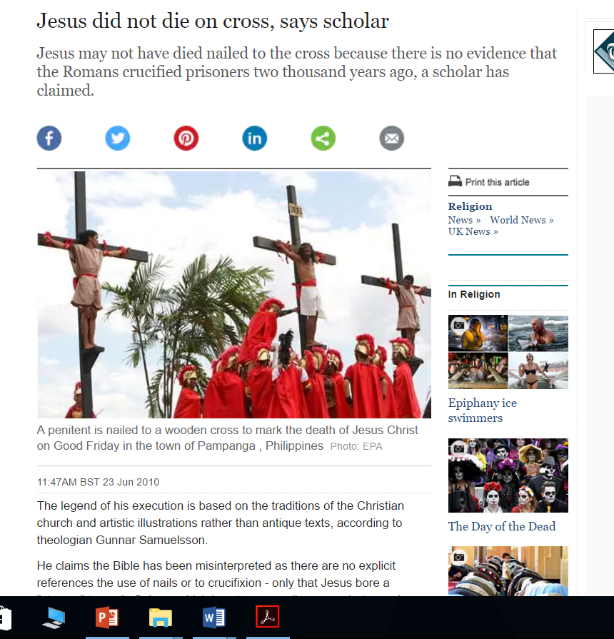
Telegraph article
http://www.telegraph.co.uk/news/religion/7849852/Jesus-did-not-die-on-cross-says-scholar.html

Slide 73
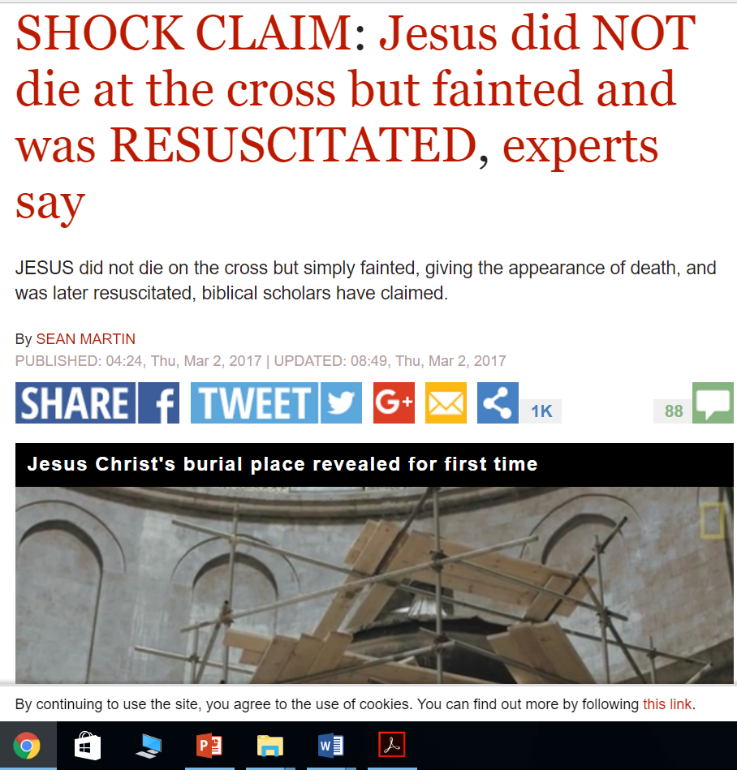
http://www.express.co.uk/news/science/773739/Jesus-did-NOT-die-cross-crucifixion-bible

Slide 74
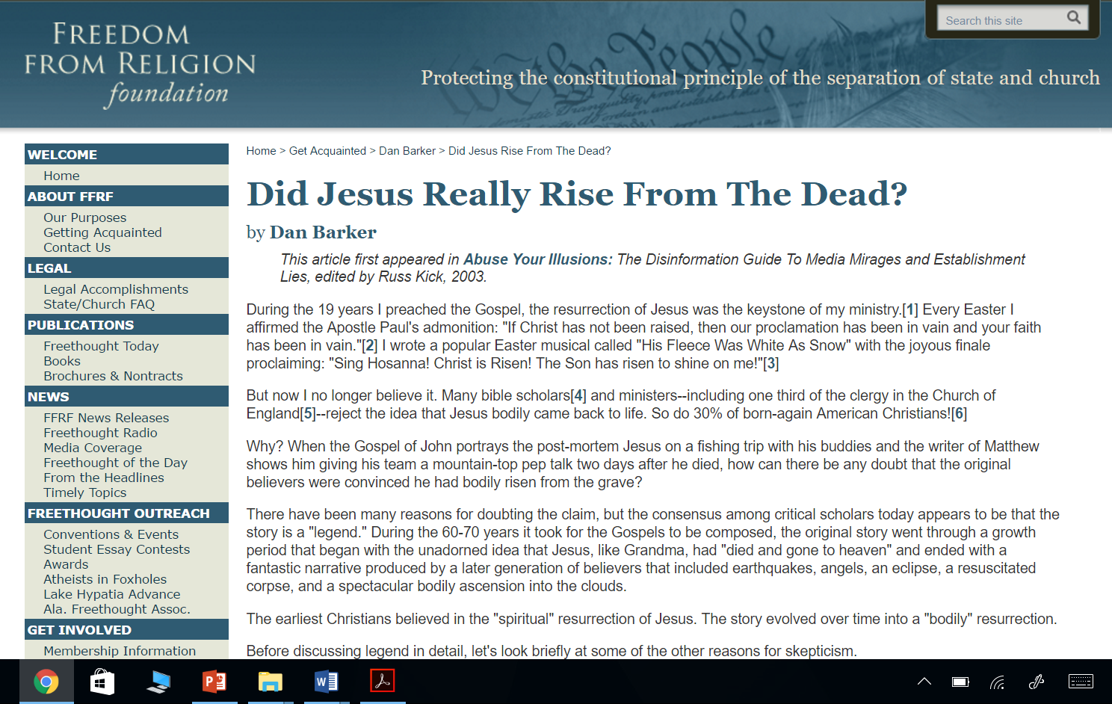
Article by Dan Barker
https://ffrf.org/legacy/about/bybarker/rise.php

Slide 75
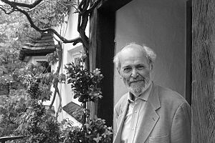
Geza Vermes
as a British scholar of Jewish Hungarian origin—one who also served as a Catholic priest in his youth—and writer on religious history,
He wrote about the Dead Sea Scrolls and ancient works in Aramaic such as the Targums, and on the life and religion of Jesus.

Slide 76
Why sign of Jonah cannot mean Time factor?
Easter Week | DAYS in Tomb | NIGHTS in Tomb
FRIDAY | Nil | 1 night
SATURDAY | 1 day | 1 night
SUNDAY | Nil | Nil
Total | 1 day | 2 nights

Slide 77
References
Online Resources
http://www.newworldencyclopedia.org/entry/Ebionites
http://www.scripture4all.org/OnlineInterlinear/Greek_Index.htm
http://www.ntslibrary.com/PDF%20Books%20II/The%20Septuagint.pdf
http://corpus.quran.com/translation.jsp?chapter=3&verse=31
https://www.biblestudytools.com/dictionary/trinity-1/
http://biblehub.com/
https://www.biblegateway.com/passage
www.answering-islam.org/
http://www.answering-christianity.com
https://bible.knowing-jesus.com/
http://catholic-resources.org/Bible/Christological_Titles.htm
Books:
Is Jesus God – Ahmed Deedat
Christ in Islam – Ahmed Deedat
What did Jesus say really say – By Misha’al Al-Kadhi
Holy Quran
Holy Bible – Various versions
“Jesus a Prophet of Islam,” by Muhammad `Ata ur-Rahim,
Dr Shabbir Ally Lectueres
Shaikh Ahmed Deedat Lectures
Shaykh Atabek Shukurov Lectures

Slide 78
End of presentation

