Slide 1
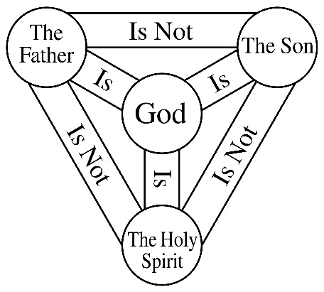
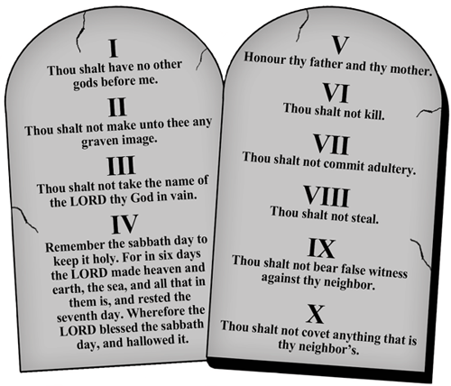
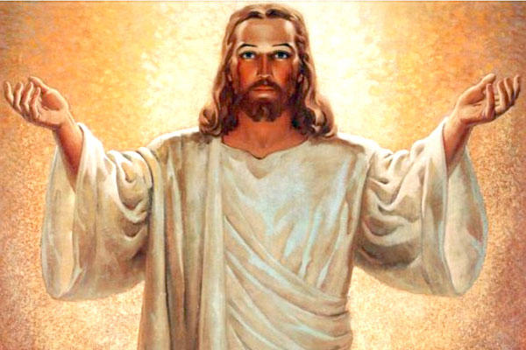
The divinity of Jesus (peace be upon him)?
A Christian and Islamic Perspective
By Moneeb Minhas
“For there are three that bear record in heaven, the Father, the Word, and the Holy Spirit: and these three are one.”
1 John 5:7
“The first of all the commandments is, Hear, O Israel; The Lord our God is One Lord:”
Mark 12:30

Slide 2
Disclaimer
This lecture is in no means to convert or put my opinion on someone else.
This lecture is not a debate, or in any way to put down any other opinion, but merely an academicals study of biblical texts from the different perspectives.
Those present are here voluntarily and have the right to leave whenever they will.
This lecture was requested from a Christian audience, merely out of curiosity on “how Muslims prove or come to the conclusion that Jesus is not divine according to the Biblical texts”.
We acknowledge that Christians and Muslims differ on certain views and this should not instil hatred or intolerance for one another, but rather as teachers, academics and humans we should practice, preach and promote tolerance, love and respect for one another.
Within Christianity there are many views on Christ. Some sects say he is God, some the “Son of God”, some a Man of God, Some say he holds a combination of all of the former. There are some sects (many if not all of which have now died out) like the Muslims believe Jesus was not divine but a Prophet of God. As a result the Muslim perspective is just another perspective or opinion on the personality of Christ. This is how it should be treated.

Slide 3
Topics covered in the lecture
PART 1
Quran/Islamic Perspective of Christ and Christians
(Similarities and differences between Islam and Christianity on Christ)
PART 2.1
Jesus’ claim to being Divine “God” or to “worship him”?
PART 3.1
Jesus’ claim to being Divine “God” or to “worship him”?
PART 2
Christian-Biblical Perspective
An analysis of the divinity of Christ
PART 2.2
Jesus’ claim of being the begotten Son of God?
PART 3.2
Jesus’ claim of being the begotten Son of God?
PART 3
Islamic-Biblical Perspective
An analysis of the divinity of Christ
PART 2.3
Trinity in the Bible
PART 3.3
Trinity in the Bible

Slide 4
PART 1
Islamic perspective of Christ and Christians

Slide 5
Reverend R. Maxwell King said:
“I have read in Moslem writings such deep and tender expressions of respect and reverence for Jesus that for the time I almost forgot, I was not reading the words of a Christian writer. How different, it is sad to say, has been the way in which Christians have spoken and written of Muhammad. Let us put it down to it’s true cause, ignorance”
Reverend R. Maxwell King

Slide 6
Quran’s view on Christians

Slide 7
Quran says Christians are the closest in love and kindness to Muslims.
“..and nearest among them (mankind) in love and kindness to the believers (Muslims) will you find those who say 'we are Christians': because among these are men devoted to learning (priests) and men who have renounced the world (monks), and they are not arrogant”.
Quran - 5:82.

Slide 8
Quran (Islam) calls Christians and Muslims to find common grounds (similarities)
“Say: O People of the Scripture. Come to common terms between us and you: that we shall worship none but God, and that we shall ascribe no partners unto Him, and that we shall not take each other for lords beside Him.”
Quran – 3:64

Slide 9
Muslims advised not to argue with the People of the book and that we all follow the same God.
“And argue not with the people of the book (Jews and Christians) unless it be in (a way) which is better (than mere arguing), except with such of them that do wrong, and say (to them): ‘We believe in that which has been revealed to us and revealed to you, and our God and your God is One, and to Him we have submitted”
Quran - 29:46

Slide 10
Quran’s view on Jesus Christ

Slide 11
According to Quran
Jesus was a High esteemed Prophet/Messenger/Messiah (Christ)
Islam’s view of Jesus Christ
Jesus was a High esteemed Prophet of God
“And the angles said ‘O Mary, Allah gives you glad tidings of a Word from Him, his name is Messiah, Jesus son of Mary, High honored in this world and the next, of those near to God.”
Qur’an - 3:40

Slide 12
Both Jesus and his Mother Mary were high esteemed HUMANS
Islam’s view of Jesus Christ
Jesus was a High esteemed Prophet of God
Mary and Jesus were both Humans
“The Messiah, son of Mary, was only a messenger, messengers (the like of whom) had passed away before him. And his mother was a saintly woman. They both used to eat (earthly) food. See how we make the signs clear for them, then see how they are
deluded!”
Qur’an - 56:75

Slide 13
His birth was a miraculous (virgin) birth.
Islam’s view of Jesus Christ
Jesus was a High esteemed Prophet of God
Mary and Jesus were both Humans
He was born Miraculously
She (Mary) said: "O my Lord! How shall I have a son when no man has touched me?" He said: "Even so: Allah creates what He wills: When He has decreed a plan, He but says to it, 'Be,' and it is!
Qur’an - 3:40

Slide 14
He was similar to Adam who was born without mother and father.
Islam’s view of Jesus Christ
Jesus was a High esteemed Prophet of God
Mary and Jesus were both Humans
He was born Miraculously
Similar to Adam who was born without mother or father
“The similitude of Jesus before Allah is as that of Adam, he created him from dust,then said to him: 'Be' and he was”
Qur’an - 3:59

Slide 15
He was NOT God or divine
Islam’s view of Jesus Christ
Jesus was a High esteemed Prophet of God
Mary and Jesus were both Humans
He was born Miraculously
Similar to Adam who was born without mother or father
He was Not god
Nor the Son of God
“Or have they chosen other gods besides Him, say: Bring your proof (of their godhead), this is the reminder of those with me and those before me, but most of them know not the truth so they are averse (to it). And we sent no messenger before you but we inspired him (saying): There is no god save Me (Allah) so worship Me.
And they say: The Beneficent (God) has taken unto himself a son. No! but (they) are but honoured servants. They speak not until He has spoken and they obey His command.”
Quran – 21:20-21

Slide 16
He is not part of a “Trinity/Trio/Three in one”
Islam’s view of Jesus Christ
Jesus was a High esteemed Prophet of God
Mary and Jesus were both Humans
He was born Miraculously
Similar to Adam who was born without mother or father
He was Not god
Nor the Son of God
No Trinity
“O People of the Book! Commit no excesses in your religion: Nor say of Allah aught but the truth. Christ Jesus the son of Mary was (no more than) a messenger of Allah, and His Word, which He bestowed on Mary, and a spirit proceeding from Him: so believe in Allah and His messengers. Say not "Trinity" : desist: it will be better for you: for Allah is one Allah: Glory be to Him: (far exalted is He) above having a son. To Him belong all things in the heavens and on earth. And enough is Allah as a Disposer of affairs.”
Quran – 4:171

Slide 17
Jesus was given a Gospel (Injeel) and taught the knowledge of the scripture
Islam’s view of Jesus Christ
Jesus was a High esteemed Prophet of God
Mary and Jesus were both Humans
He was born Miraculously
Similar to Adam who was born without mother or father
He was Not god
Nor the Son of God
No Trinity
Given a Gospel or scripture
“And He will teach him (Jesus) writing and wisdom and the Torah and the Gospel”
Quran 3:48
“Say (O Muhammad): We believe in Allah, and that which is sent down unto us, and that which was revealed unto Abraham, and Ishmael, and Isaac, and Jacob, and the sons of Jacob, and that which was revealed unto Moses and Jesus and the Prophets from their Lord. We make no distinction between any of them and unto Him we have surrendered.”
Quran – 3:84

Slide 18
………
Islam’s view of Jesus Christ
Jesus was a High esteemed Prophet of God
Mary and Jesus were both Humans
He was born Miraculously
Similar to Adam who was born without mother or father
He was Not god
Nor the Son of God
No Trinity
Given a Gospel or scripture
“O ye who believe! Believe in Allah and His messenger, and the Scripture (Qur'an) which he has revealed unto His messenger, and the Scripture which He revealed aforetime. Whosoever disbelieveth in Allah and His angels and His Scriptures and His messengers and the last day, he verily has wandered far astray.”
Quran – 4:138

Slide 19
He performed miracles by God’s permission: Spoke while a baby
Islam’s view of Jesus Christ
Jesus was a High esteemed Prophet of God
Mary and Jesus were both Humans
He was born Miraculously
Similar to Adam who was born without mother or father
He was Not god
Nor the Son of God
No Trinity
Given a Gospel or scripture
Miracles: spoke while a baby
"He shall speak to people while still in the cradle, and in manhood, and he shall be from the righteous."
Quran – 3:46

Slide 20
Performed Miracles:
Bringing life to man-made things / Healed blind / Cured sickness / Raised people from the dead / Inform of the unseen
Islam’s view of Jesus Christ
Jesus was a High esteemed Prophet of God
Mary and Jesus were both Humans
He was born Miraculously
Similar to Adam who was born without mother or father
He was Not god
Nor the Son of God
No Trinity
Given a Gospel or scripture
Miracles: spoke while a baby
Miracle: Bringing to life
Miracle: Healing blind
Miracle: Curing the sick
Miracle: Raising the dead
Miracle: Telling the unseen
"And (appoint him) a messenger to the Children of Israel, (with this message): "'I have come to you, with a Sign from your Lord, in that I make for you out of clay, as it were, the figure of a bird, and breathe into it, and it becomes a bird by God’s permission: And I heal those born blind, and the lepers, and I raise the dead, by God’s permission; and I declare to you what you eat, and what you store in your houses. Surely therein is a Sign for you if you did believe;”
Quran 3:49

Slide 21
Jesus was not Crucified or killed by the Jews
Islam’s view of Jesus Christ
Jesus was a High esteemed Prophet of God
Mary and Jesus were both Humans
He was born Miraculously
Similar to Adam who was born without mother or father
He was Not god
Nor the Son of God
No Trinity
Given a Gospel or scripture
Miracles: spoke while a baby
Miracle: Bringing to life
Miracle: Healing blind
Miracle: Curing the sick
Miracle: Raising the dead
Miracle: Telling the unseen
Not crucified.
“They (Jews) said (in boast), "We killed Christ Jesus the son of Mary, the Messenger of Allah"; but they killed him not, nor crucified him, but so it was made to appear to them and those who differ therein are full of doubts, with no (certain) knowledge, but only conjecture to follow, for of a surety they killed him not. Nay, Allah raised him up unto Himself; and Allah is Exalted in Power, Wise.
Quran 4:157

Slide 22
Summary of Jesus of the Quran
Jesus was a High esteemed Prophet of God
Mary and Jesus were both Humans
He was born Miraculously
Similar to Adam who was born without mother or father
He was Not god
He was not the Son of God
No Trinity
Given a Gospel or scripture
Miracles: spoke while a baby
Miracle: Bringing to life
Miracle: Healing blind
Miracle: Curing the sick
Miracle: Raising the dead
Miracle: Telling the unseen
Not Crucified or killed
Differences highlighted in Red

Slide 23
PART 2
Christian-Biblical Perspective
An Analysis of the divinity of Christ

Slide 24
PART 2
Christian-Biblical Perspective
An analysis of the divinity of Christ
PART 2.1
Jesus’ claim to being Divine “God” or to “worship him”?
PART 2.2
Jesus’ claim of being the Son of God?
PART 2.3
Trinity in the Bible

Slide 25
Christian Perspective
2.1. Proofs of Jesus being God and to worship him
2.2. Proofs of Jesus being the Son of God.
2.3. Proofs of Trinity

Slide 26
REASONS GIVEN BY CHRISTIANS WHY JESUS IS GOD OR THE SON OF GOD.
Proofs of Jesus being God and to worship him
  Jesus himself claimed he is God.
  Jesus claimed people should “worship him”
  He accepted Divine entitlement (eg: people calling him God)
  He did many miracles like raising people from the dead, walking on water etc
  Jesus says he is not from this world and God is not also, which makes Jesus God.
  Jesus was made in God’s image and made before all things
  He was born without a father (no male intervention) so as default God becomes his father
  Jesus is honoured just as the father was honoured.
  He was given authority over everything.
Proofs of Jesus being the begotten Son of God
  God said “this is my beloved son” and called him his son
  Jesus calls himself the “Son of God”.
  Holy Ghost says “he will be the son of God”
  The apostles of Christ calls him the “Son of God”
  Jesus referred to God as “His father”
Proofs of Trinity
  Jesus himself claimed: him, the Father and the Holy Spirit are Three Gods in One.

Slide 27
1. Proofs for Jesus being God and to worship him
PART 2.1. Christian Perspective
  Jesus himself claimed he is God.
  Jesus claimed people should “worship him”
  He accepted Divine entitlement (eg: people calling him God)
  He did many miracles like raising people from the dead, walking on water etc
  Jesus says he is not from this world and God is not also, which makes Jesus God.
  Jesus was made in God’s image and made before all things
  He was born without a father (no male intervention) so as default God becomes his father
  Jesus is honoured just as the father was honoured
  He was given authority over everything.

Slide 28
1a. Jesus himself claimed he is God.
“Jesus said unto them, I am the way, the truth and the life: no man cometh unto the father, but by me.” - John 14:6
“I am the Alpha and the Omega, the First and the Last, the Beginning and the End.” - Revelation 22:13
"For the Son of Man is Lord of the Sabbath." - Matthew 12:8
"Consequently, the Son of Man is Lord even of the Sabbath.“ -
Mark 2:28

Slide 29
1a. Jesus himself claimed he is God.
“Your father Abraham rejoiced at the thought of seeing my day; he saw it and was glad…” “You are not yet fifty years old,” the Jews said to him, “and you have seen Abraham!” “I tell you the truth,” Jesus answered, “before Abraham was born, I am!” At this, they picked up stones to stone him, but Jesus hid himself, slipping away from the temple grounds.”
(John 8:56-59).
The shock of this claim are those two words “I am.” It is the same designation that God used for Himself in His call to Moses:
God said to Moses, “I AM WHO I AM. This is what you are to say to the Israelites: 'I AM “has sent me to you.”
(Exodus 3:14)

Slide 30
1a. Jesus himself claimed he is God.
“In the beginning was the Word, and the Word was with God, and the Word was God.” -
John 1:1
Here the “Word” means Jesus, as he is described as “The Word of God”.
Note: How it says “word was God”.

Slide 31
1b. Jesus claimed (or accepted) people should worship him
Jesus heard that they had thrown him out, and when he found him, Jesus said, “Do you believe in the Son of Man?” “Who is he, sir?” the man asked. “Tell me so that I may believe in him..” Jesus said, “You have now seen him; in fact, he is the one speaking with you..” Then the man said, “Lord. I believe,” and he worshipped him.”
(John 9:35-38).
“Then the eleven disciples went to Galilee, to the mountain where Jesus had told them to go. When they saw him, they worshipped him...”
(Matthew 28:16-17).

Slide 32
1c. He accepted Divine entitlement (eg: people calling him God/Lord)
There are numerous places in the Bible where Jesus is called “Lord or Master”. These are just a few examples:
“When Simon Peter saw this, he fell at Jesus’ knees and said, “Go away from me, Lord; I am a sinful man!” - Luke 5:8
But he replied, “Lord, I am ready to go with you to prison and to death.” - Luke 22:33
“Master,” said John, “we saw someone driving out demons in your name and we tried to stop him, because he is not one of us.” - Luke 9:49

Slide 33
Thomas (his disciple) calls him Lord and God.
In this scenario Thomas calls him Lord and God. And Jesus accepts it and acknowledges that he believed in him as God.
Then he (Jesus) said to Thomas, “Put your finger here; see my hands. Reach out your hand and put it into my side. Stop doubting and believe.” And Thomas answered and said to Him,“My Lord and my God!” Then Jesus told him, “Because you have seen me, you have believed; blessed are those who have not seen and yet have believed.”
(John 20:27-29).
Jesus was stoned because he accepted he was God.
We are not stoning You for any good work,” said the Jews, “but for blasphemy, because You, who are a man, declare Yourself to be God.”
John 10:34

Slide 34
1d. Jesus did many miracles like raising people from the dead, walking on water etc. which proves he had control over things which only God has control over.
CATEGORY | MIRACLE | REFERENCE
Control over Humans | Healing the Blind | Mark 8:22
 | Healing the Leper | Mark 1:40 / Matthew 8:1 / Luke 5:12
 | Heals the paralysed | Matthew 9:1 / Mark 2:1 / Luke 5:17
 | Other healings | Matthew 12:34 / Mark 6:53
 | Exorcisms healed | Matthew 15:21 / Mark 7:24 / Mark 3:20 / Luke 11:14
 | Raising the dead | Mark 5:21 / Luke 7:11 / John 11:1
Control over Nature | Turning water into wine | John 2:1
 | Walking on water | Mark 6:45 / Matthew 14:22
 | Calming the storm | Matthew 8:23 / Mark 4:35 / Luke 8:22
 | Cursing the fig tree | Mark 11:12 and 11:20
 | Feeding the multitude | Matthew 14:13 / Mark 6:31 / Matthew 15:32
By doing these miracles Jesus proved he has control over humans and nature, which is something specific to God. As a result this gives him the level of divinity.
Source: https://www.thoughtco.com/miracles-of-jesus-700158

Slide 35
Example: Jesus raised Lazarus from the Dead
So they took away the stone. Then Jesus looked up and said, “Father, I thank you that you have heard me. ⁴² I knew that you always hear me, but I said this for the benefit of the people standing here,that they may believe that you sent me.”
When he had said this, Jesus called in a loud voice, “Lazarus, come out!” The dead man came out, his hands and feet wrapped with strips of linen, and a cloth around his face.
John 11:38-44

Slide 36
1e. Jesus says he is not from this world and God is not also, which makes Jesus God.
“And he (Jesus) said unto them, Ye are from beneath; I am from above: ye are of this world; I am not of this world.”
John 8:23
Jesus said, "My kingdom is not of this world. If it were, my servants would fight to prevent my arrest by the Jewish leaders. But now my kingdom is from another place.“
John 18:36

Slide 37
1f. Jesus was made in God’s image and made before all things
⁵ The Son is the image of the invisible God, the firstborn over all creation. ¹⁶ For in him all things were created: things in heaven and on earth, visible and invisible, whether thrones or powers or rulers or authorities; all things have been created through him and for him. ¹⁷ He is before all things, and in him all things hold together. - Colossians 1:16
“Everything is from him and by him and for him. Glory belongs to him forever! Amen!” - Romans 11:36
“I am the Alpha and the Omega, the First and the Last, the Beginning and the End.” - Revelation 22:13
“Anyone who has seen me has seen the Father.” - John 14:9

Slide 38
1g. He was born without a father so as default God becomes his father.
And Mary said to the angel, "How will this be, since I am a virgin?"
And the angel answered her, "The Holy Spirit will come upon you, and the power of the Most High will overshadow you; therefore the child to be born will be called holy, the Son of God.
Luke 1:34
Now the birth of Jesus Christ took place in this way. When his mother Mary had been betrothed to Joseph, before they came together she was found to be with child from the Holy Spirit.
Matthew 1:18
Notes:
Even though this point is more fitting for part 2.2 (as it is more proof for being the son of God) but the same answer is given for points 1e,1f,1g.

Slide 39
1h. Jesus is honoured just as the father (God) was honoured
“that all may honour the Son, just as they honour the Father. Whoever does not honour the Son does not honour the Father who sent him…”
John 5:23

Slide 40
1i. Jesus was given authority over everything
“Then Jesus came to them and said, "All authority in heaven and on earth has been given to me.”
Matthew 28:18

Slide 41
REASONS GIVEN BY CHRISTIANS WHY JESUS IS GOD OR THE SON OF GOD.
Proofs of Jesus being God and to worship him
  Jesus himself claimed he is God.
  Jesus claimed people should “worship him”
  He accepted Divine entitlement (eg: people calling him God)
  He did many miracles like raising people from the dead, walking on water etc
  Jesus says he is not from this world and God is not also, which makes Jesus God.
  Jesus was made in God’s image and made before all things
  He was born without a father (no male intervention) so as default God becomes his father
  Jesus is honoured just as the father was honoured.
  He was given authority over everything.
Proofs of Jesus being the begotten Son of God
  God said “this is my beloved son” and called him his son
  Jesus calls himself the “Son of God”.
  Holy Ghost says “he will be the son of God”
  The apostles of Christ calls him the “Son of God”
  Jesus referred to God as “His father”
Proofs of Trinity
  Jesus himself claimed: him, the Father and the Holy Spirit are Three Gods in One.

Slide 42
2. Proofs for Jesus being the begotten Son of God
PART 2.2. Christian Perspective
  God said “this is my beloved son” and called him his son
  Jesus calls himself the “Son of God”.
  Holy Ghost says “he will be the son of God”
  The apostles of Christ calls him the “Son of God”
  Jesus referred to God as “His father”

Slide 43
Definition of Begotten
Dictionary.com
“(especially of a male parent) to procreate or generate (offspring).”
Bible dictionary KJV
To procreate, as a father or sire; to generate; as, to beget a son.
be-got'-'-n (yaladh; "to bear," "bring forth," "beget"; denotes the physical relation of either parent to a child,

Slide 44
2a. God said “this is my beloved son” and called him his son
“For when He received honor and glory from God the Father, such an utterance as this was made to Him by the Majestic Glory, "This is My beloved Son with whom I am well-pleased”
2 Peter 1:17
And a voice came from the cloud, saying, "This is My Son, whom I have chosen; listen to Him!“
Luke 9:35
“And a voice came from heaven: "You are My beloved Son; in You I am well pleased.”
Mark 1:11

Slide 45
2b. Jesus calls himself the “Son of God”.
Again the high priest asked him, “Are you the Messiah, the Son of the Blessssed One?” “I am,” said Jesus. “And you will see the Son of Man sitting at the right hand of the Mighty One and coming on the clouds of heaven.”
Mark 14:61-62
“Are You then the Son of God?” He replied, “You say that I am.” “Why do we need any more testimony?” they declared. “We have heard it for ourselves from His own lips.”.
Luke 22:70
ButJesus remained silent. Then the high priest said to Him, “I charge You under oath by the living God: Tell us if You are the Christ, the Son of God.” “You have said it yourself,” Jesus answered.
Matthew 26:63-64
These are all cross references of the same scenario in the various gospels.
NOTE: Jesus is not denying he is the “Son of God” and agrees he is the “Son of the Blessed One”.
The Jews at the time also claim he has committed blasphemy for this and crucify him for this reason.

Slide 46
2c. Holy Ghost says he will be the son of God.
"And the Holy Ghost descended in a bodily shape like a dove upon him [Jesus], and a voice came from heaven, which said, Thou art my beloved Son; in thee I am well pleased."
(Luke 3:22).

Slide 47
2d. The Apostles of Christ call him the Son of God.
"For God so loved the world, that He gave His only begotten Son, that whoever believes in Him shall not perish, but have eternal life.”
John 3:16
“The one who believes in the Son of God has the testimony in himself; the one who does not believe God has made Him a liar, because he has not believed in the testimony that God has given concerning His Son.”
1 John 5:10

Slide 48
2e. Jesus referred to God as his Father.
“So every one who acknowledges me before men. I also will acknowledge before my Father who is in heaven; but whoever denies me before men, I also will deny before my Father who is in heaven”
(Matthew 10:32-33).
“And behold, I send the promise of my father upon you…”
Luke 24:49
“…Peace be upon you: as my Father hath sent me, even so I send you”
John 18:11
(There are many more verses where Jesus refers to God as “my Father”)

Slide 49
REASONS GIVEN BY CHRISTIANS WHY JESUS IS GOD OR THE SON OF GOD.
Proofs of Jesus being God and to worship him
  Jesus himself claimed he is God.
  Jesus claimed people should “worship him”
  He accepted Divine entitlement (eg: people calling him God)
  He did many miracles like raising people from the dead, walking on water etc
  Jesus says he is not from this world and God is not also, which makes Jesus God.
  Jesus was made in God’s image and made before all things
  He was born without a father (no male intervention) so as default God becomes his father
  Jesus is honoured just as the father was honoured.
  He was given authority over everything.
Proofs of Jesus being the begotten Son of God
  God said “this is my beloved son” and called him his son
  Jesus calls himself the “Son of God”.
  Holy Ghost says “he will be the son of God”
  The apostles of Christ calls him the “Son of God”
  Jesus referred to God as “His father”
Proofs of Trinity
  Jesus himself claimed: him, the Father and the Holy Spirit are Three Gods in One.

Slide 50
3. Proofs for the Trinity
PART 2.3 Christian Perspective
  Jesus himself claimed: him, the Father and the Holy Spirit are Three Gods in One.

Slide 51
Definition of Trinity
1: the unity of Father, Son, and Holy Spirit as three persons in one Godhead according to Christian dogma
(Merriam Webster)
“When we define what is expressed by Trinity as the doctrine that there is one only and true God, but in the unity of the Godhead there are three coeternal and coequal Persons, the same in physical substance but distinct in subsistence.”
(Ref: https://www.biblestudytools.com/dictionary/trinity-1/)

Slide 52
“therefore go and make disciples of all nations, baptizing them in the name of the Father and of the Son and of the Holy Spirit...”
(Matthew 28:19).

Slide 53
“There are different kinds of gifts, but the same Spirit. There are different kinds of service, but the same Lord. There are different kinds of working, but the same God works all of them in all men.”
(I Corinthians 12:4-6).

Slide 54
“May the grace of the Lord Jesus Christ, and the love of God, and the fellowship of the Holy Spirit be with you all.”
(II Corinthians 13:14).

Slide 55
“But you, dear friends, build yourselves up in your most holy faith and pray in the Holy Spirit. Keep yourselves in God' s love as you wait for the mercy of the Lord Jesus Christ to bring you to eternal life.”
(Jude 20-21).

Slide 56
“I and my Father are one.”
John 10:30
This is quite clear. In the Gospel of John in the words of Christ himself he is saying that him and the Father (God) are one.

Slide 57
The most direct verse ever in the Holy Bible speaking about the Trinity.
“For there are three that bear record in heaven, the Father, the Word, and the Holy Ghost: and these three are one.”
1 John 5:7
This is the most direct verse that clearly shows the Trinity in the Bible.
You can clearly see “Father, Word(Son) and Holy Ghost” all put on the same Co-Equal level.

Slide 58
PART 3
Islamic-Biblical Perspective
An Analysis of the divinity of Christ

Slide 59
PART 3
Islamic-Biblical Perspective
An analysis of the divinity of Christ
PART 3.1
Jesus’ claim to being Divine “God” or to “worship him”?
PART 3.2
Jesus’ claim of being the Son of God?
PART 3.3
Trinity in the Bible

Slide 60
ANALYSIS TO:THE REASONS GIVEN BY CHRISTIANS WHY JESUS IS GOD OR THE SON OF GOD.
Proofs of Jesus being God and to worship him
  Jesus himself claimed he is God.
  Jesus claimed or accepted people should “worship him”
  He accepted Divine entitlement (eg: people calling him God)
  He did many miracles like raising people from the dead, walking on water etc
  Jesus says he is not from this world and God is not also, which makes Jesus God.
  Jesus was made in God’s image and made before all things
  He was born without a father (no male intervention) so as default God becomes his father
  Jesus is honoured just as the father was honoured.
  He was given authority over everything.
Proofs of Jesus being the begotten Son of God
  God said “this is my beloved son” and called him his son
  Jesus calls himself the “Son of God”.
  Holy Ghost says “he will be the son of God”
  The apostles of Christ calls him the “Son of God”
  Jesus referred to God as “His father”
Proofs of Trinity
  Jesus himself claimed: him, the Father and the Holy Spirit are Three Gods in One.

Slide 61
Name | Date
Pharaohs | 3000BCE
Imhotep | 2600BCE
Alexander the Great | 356BCE
Naram-Sin | 2255BCE
Ram | 5000BCE
Jesus of Nazareth | 1st cent
Mary, Mother of God | 1st Cent
Veleda | 1st Cent
Ismail 1st | 16th cent
Yahweh ben Yahweh | 20th Cent
Mahatma Ghandi | 19th Cent
Prince Philip Duke of Edinburgh | 1950s
Name | Date
The Buddha | 563BCE
Qin Shi Huang | 250BC
Al Hakim Bi Amr Allah | 985AD
Mother Teresa | 1997
Kumari Girls | 17th – 21st Cent
Maher Baba | 1930
Amitabh Bachan (Bollywood actor) | Present
George Washington | 1865AD
Jehovah Wanyonyi | 20th Cent
Sathya Sai Baba | 20th cent
Kali Matta | 3000BC
David Beckham | Present
Virgin Mary
Ram
The Buddha
Taher Saifuddin

Slide 62
Deification
Throughout history we have had many claimants to deity. They have been:
  Both males and females claiming to be gods or goddesses.
  People of all ages
  People from all religions (even Islam)
  People from all ends of the world (east, west, north, south)
  People from all centuries
As a result Jesus’ claim or those claiming him to be god IS NOT UNIQUE.
Its important when someone claims to be God or is called God, to analyse the claim.

Slide 63
Ways people are given the title of Deity.
(God/Goddess, Son/Daughter of God etc)
Posthumous deification - (deification given or awarded to someone after the death of the originator).
Involuntary deification – Someone given the title of “God” by others, without them claiming to be God themselves or asking for the title.
Self-deification – A person claims to be “God” or deity himself.

Slide 64
General Principles used Logically and by Islamic scholars
If something is very important in religion (such as a persons belief) and is the difference between you being a believer or non-believer then GOD MUST BE CRYSTAL CLEAR about it or we MUST have SOLID PROOF.
  Eg: Reason is because God is Just. He cannot say on day of judgement that Why didn’t you believe in Jesus or anyone else as God, but then make it so unclear if that person is or not.
  Eg: God does not contradict or confuse his people.
God does not change a belief after preaching or revealing one thing. Especially something so major as the deity or concept of God.
The original and earliest disciples of any prophet/messiah etc will take precedence over those to come after them (eg: Peter will take precedence over Paul). Especially those that were with Jesus, met him and spent the most time with him.

Slide 65
Similar principles can be found in the Bible
1. God does not confuse us, instead makes it clear
“For God is not the author of confusion”
1 Corinthians 14:33.
2. We need proof for all things
“Prove all things; hold fast to that which is good”
1 Thessalonians 5:21

Slide 66
1a. Analysis to: Jesus himself claimed he was God.

Slide 67
1a. Analysis to: Jesus himself claimed he was God.
There is no DIRECT verse or statement made by Jesus Christ himself in the entire Bible that says “I am God” or “Worship me”.
Survey question goes here about indirect teaching

Slide 68
1a. Analysis to: Jesus himself claimed he was God.
2. The Old Testament preaches “One God” on numerous occasions and no mention of any other God (Holy Ghost or Son) is made. Infact God makes it crystal clear NOT TO WORSHIP any other God.
“Hear, O Israel The Lord our God is one Lord” - (Deuteronomy 6:4)
“You shall have no other gods before me. “You shall not make for yourself an image in the form of anything in heaven above or on the earth beneath or in the waters below. You shall not bow down to them or worship them; for I, the Lord your God, am a jealous God” - Exodus 20:3-5
Do not worship any other god, for the Lord, whose name is Jealous, is a jealous God. - Exodus 34:14
They have moved Me to jealousy with that which is not God; they have provoked Me to anger with their vanities. - Deuteronomy 32:21
Other references: Deut 4:24, Deut 5:9, Deut 6:15, Deut 32:21, Josh 24:19, Ezk 39:25, Nahum 1:2,

Slide 69
1a. Analysis to: Jesus himself claimed he was God.
3. Jesus and New Testamnet preaches Oneness of God (not trinity) and not that he is God.
And one of the scribes came up and heard them disputing with one another, and seeing that he answered them well, asked him, “Which commandment is the first of all?”
“And Jesus answered him, The first of all the commandments is, Hear, O Israel; The Lord our God is one Lord: And thou shalt love the Lord thy God with all thy heart, and with all thy soul, and with all thy mind, and with all thy strength: this is the first commandment.”
Mark 12:29-30
When asked, Muslim scholars say this is the best time or point to mention his divinity or to preach the doctrine of the trinity. Or even clarify it to the Jews, like he would do with all the other laws. Instead he gives the same law that is of the OT. And he clarifies this law to by saying it means “that thou shalt love thy God…”
Jesus further says:
“Keep the commandments” – (Luke 18:18, Matthew 19-16-21, John 14:15, John 15:10)

Slide 70
Over 50 references in the OT mention ONE with reference to God.
Deut 6:4 Hear, O Israel: The LORD our God is one LORD:
Job 6:10 Then should I yet have comfort; yea, I would harden myself in sorrow: let him not spare; for I have not concealed the words of the Holy One.
Ps 16:10 For thou wilt not leave my soul in hell; neither wilt thou suffer thine Holy One to see corruption.
Ps 71:22 I will also praise thee with the psaltery, even thy truth, O my God: unto thee will I sing with the harp, O thou Holy One of Israel.
Ps 78:41 Yea, they turned back and tempted God, and limited the Holy One of Israel.
Ps 89:18 For the LORD is our defence; and the Holy One of Israel is our king.
Isa 1:4 Ah sinful nation, a people laden with iniquity, a seed of evildoers, children that are corrupters: they have forsaken the LORD, they have provoked the Holy One of Israel unto anger, they are gone away backward.
Isa 1:24 Therefore saith the Lord, the LORD of hosts, the mighty One of Israel, Ah, I will ease me of mine adversaries, and avenge me of mine enemies:
Isa 5:19 That say, Let him make speed, and hasten his work, that we may see it: and let the counsel of the Holy One of Israel draw nigh and come, that we may know it!
Isa 5:24 Therefore as the fire devoureth the stubble, and the flame consumeth the chaff, so their root shall be as rottenness, and their blossom shall go up as dust: because they have cast away the law of the LORD of hosts, and despised the word of the Holy One of Israel.
Isa 10:17 And the light of Israel shall be for a fire, and his Holy One for a flame: and it shall burn and devour his thorns and his briers in one day;
Isa 10:20 And it shall come to pass in that day, that the remnant of Israel, and such as are escaped of the house of Jacob, shall no more again stay upon him that smote them; but shall stay upon the LORD, the Holy One of Israel, in truth.
Isa 12:6 Cry out and shout, thou inhabitant of Zion: for great is the Holy One of Israel in the midst of thee.
Isa 17:7 At that day shall a man look to his Maker, and his eyes shall have respect to the Holy One of Israel.
Isa 29:19 The meek also shall increase their joy in the LORD, and the poor among men shall rejoice in the Holy One of Israel.
Isa 29:23 But when he seeth his children, the work of mine hands, in the midst of him, they shall sanctify my name, and sanctify the Holy One of Jacob, and shall fear the God of Israel.
Isa 30:11 Get you out of the way, turn aside out of the path, cause the Holy One of Israel to cease from before us.
Isa 30:12 Wherefore thus saith the Holy One of Israel, Because ye despise this word, and trust in oppression and perverseness, and stay thereon:
Isa 30:15 For thus saith the Lord GOD, the Holy One of Israel; In returning and rest shall ye be saved; in quietness and in confidence shall be your strength: and ye would not.
Isa 30:29 Ye shall have a song, as in the night when a holy solemnity is kept; and gladness of heart, as when one goeth with a pipe to come into the mountain of the LORD, to the mighty One of Israel.
Isa 31:1 Woe to them that go down to Egypt for help; and stay on horses, and trust in chariots, because they are many; and in horsemen, because they are very strong; but they look not unto the Holy One of Israel, neither seek the LORD!
Isa 37:23 Whom hast thou reproached and blasphemed? and against whom hast thou exalted thy voice, and lifted up thine eyes on high? even against the Holy One of Israel.
Isa 40:25 To whom then will ye liken me, or shall I be equal? saith the Holy One.
Isa 41:14 Fear not, thou worm Jacob, and ye men of Israel; I will help thee, saith the LORD, and thy redeemer, the Holy One of Israel.
Isa 41:16 Thou shalt fan them, and the wind shall carry them away, and the whirlwind shall scatter them: and thou shalt rejoice in the LORD, and shalt glory in the Holy One of Israel.
Isa 41:20 That they may see, and know, and consider, and understand together, that the hand of the LORD hath done this, and the Holy One of Israel hath created it.
Isa 43:3 For I am the LORD thy God, the Holy One of Israel, thy Saviour: I gave Egypt for thy ransom, Ethiopia and Seba for thee.
Isa 43:14 Thus saith the LORD, your redeemer, the Holy One of Israel; For your sake I have sent to Babylon, and have brought down all their nobles, and the Chaldeans, whose cry is in the ships.
Isa 43:15 I am the LORD, your Holy One, the creator of Israel, your King.
Isa 45:11 Thus saith the LORD, the Holy One of Israel, and his Maker, Ask me of things to come concerning my sons, and concerning the work of my hands command ye me.

Slide 71
Isa 47:4 As for our redeemer, the LORD of hosts is his name, the Holy One of Israel.
Isa 48:17 Thus saith the LORD, thy Redeemer, the Holy One of Israel; I am the LORD thy God which teacheth thee to profit, which leadeth thee by the way that thou shouldest go.
Isa 49:7 Thus saith the LORD, the Redeemer of Israel, and his Holy One, to him whom man despiseth, to him whom the nation abhorreth, to a servant of rulers, Kings shall see and arise, princes also shall worship, because of the LORD that is faithful, and the Holy One of Israel, and he shall choose thee.
Isa 49:26 And I will feed them that oppress thee with their own flesh; and they shall be drunken with their own blood, as with sweet wine: and all flesh shall know that I the LORD am thy Saviour and thy Redeemer, the mighty One of Jacob.
Isa 54:5 For thy Maker is thine husband; the LORD of hosts is his name; and thy Redeemer the Holy One of Israel; The God of the whole earth shall he be called.
Isa 55:5 Behold, thou shalt call a nation that thou knowest not, and nations that knew not thee shall run unto thee because of the LORD thy God, and for the Holy One of Israel; for he hath glorified thee.
Isa 57:15 For thus saith the high and lofty One that inhabiteth eternity, whose name is Holy; I dwell in the high and holy place, with him also that is of a contrite and humble spirit, to revive the spirit of the humble, and to revive the heart of the contrite ones.
Isa 60:9 Surely the isles shall wait for me, and the ships of Tarshish first, to bring thy sons from far, their silver and their gold with them, unto the name of the LORD thy God, and to the Holy One of Israel, because he hath glorified thee.
Isa 60:14 The sons also of them that afflicted thee shall come bending unto thee; and all they that despised thee shall bow themselves down at the soles of thy feet; and they shall call thee, The city of the LORD, The Zion of the Holy One of Israel.
Isa 60:16 Thou shalt also suck the milk of the Gentiles, and shalt suck the breast of kings: and thou shalt know that I the LORD am thy Saviour and thy Redeemer, the mighty One of Jacob.
Jer 50:29 Call together the archers against Babylon: all ye that bend the bow, camp against it round about; let none thereof escape: recompense her according to her work; according to all that she hath done, do unto her: for she hath been proud against the LORD, against the Holy One of Israel.
Jer 51:5 For Israel hath not been forsaken, nor Judah of his God, of the LORD of hosts; though their land was filled with sin against the Holy One of Israel.
Ezek 39:7 So will I make my holy name known in the midst of my people Israel; and I will not let them pollute my holy name any more: and the heathen shall know that I am the LORD, the Holy One in Israel.
Dan 4:13 I saw in the visions of my head upon my bed, and, behold, a watcher and an holy one came down from heaven;
Dan 4:23 And whereas the king saw a watcher and an holy one coming down from heaven, and saying, Hew the tree down, and destroy it; yet leave the stump of the roots thereof in the earth, even with a band of iron and brass, in the tender grass of the field; and let it be wet with the dew of heaven, and let his portion be with the beasts of the field, till seven times pass over him;
Hosea 11:9 I will not execute the fierceness of mine anger, I will not return to destroy Ephraim: for I am God, and not man; the Holy One in the midst of thee: and I will not enter into the city.
Hab 1:12 Art thou not from everlasting, O LORD my God, mine Holy One? we shall not die. O LORD, thou hast ordained them for judgment; and, O mighty God, thou hast established them for correction.
Hab 3:3 God came from Teman, and the Holy One from mount Paran. Selah. His glory covered the heavens, and the earth was full of his praise.
Zech 14:9 And the LORD shall be king over all the earth: in that day shall there be one LORD, and his name one.
Mal 2:10 Have we not all one father? hath not one God created us? why do we deal treacherously every man against his brother, by profaning the covenant of our fathers?

Slide 72
Over 25 references to God and ONE in the New Testament
Matt 23:8 But be not ye called Rabbi: for one is your Master, even Christ; and all ye are brethren.
Matt 23:9 And call no man your father upon the earth: for one is your Father, which is in heaven.
Matt 23:10 Neither be ye called masters: for one is your Master, even Christ.
Mark 1:24 Saying, Let us alone; what have we to do with thee, thou Jesus of Nazareth? art thou come to destroy us? I know thee who thou art, the Holy One of God.
Mark 10:18 And Jesus said unto him, Why callest thou me good? there is none good but one, that is, God.
Mark 12:29 And Jesus answered him, The first of all the commandments is, Hear, O Israel; The Lord our God is one Lord:
Mark 12:32 And the scribe said unto him, Well, Master, thou hast said the truth: for there is one God; and there is none other but he:
Luke 4:34 Saying, Let us alone; what have we to do with thee, thou Jesus of Nazareth? art thou come to destroy us? I know thee who thou art; the Holy One of God.
Luke 18:19 And Jesus said unto him, Why callest thou me good? none is good, save one, that is, God.
John 8:41 Ye do the deeds of your father. Then said they to him, We be not born of fornication; we have one Father, even God.
John 8:50 And I seek not mine own glory: there is one that seeketh and judgeth
John 10:16 And other sheep I have, which are not of this fold: them also I must bring, and they shall hear my voice; and there shall be one fold, and one shepherd.
John 10:30 I and my Father are one.
Acts 2:27 Because thou wilt not leave my soul in hell, neither wilt thou suffer thine Holy One to see corruption.
Acts 3:14 But ye denied the Holy One and the Just, and desired a murderer to be granted unto you;
Acts 13:35 Wherefore he saith also in another psalm, Thou shalt not suffer thine Holy One to see corruption.
Rom 3:30 Seeing it is one God, which shall justify the circumcision by faith, and uncircumcision through faith.
1 Cor 8:4 As concerning therefore the eating of those things that are offered in sacrifice unto idols, we know that an idol is nothing in the world, and that there is none other God but one.
1 Cor 8:6 But to us there is but one God, the Father, of whom are all things, and we in him; and one Lord Jesus Christ, by whom are all things, and we by him.
1 Cor 12:13 For by one Spirit are we all baptized into one body, whether we be Jews or Gentiles, whether we be bond or free; and have been all made to drink into one Spirit.
Gal 3:20 Now a mediator is not a mediator of one, but God is one.
Eph 2:18 For through him we both have access by one Spirit unto the Father.
Eph 4:4 There is one body, and one Spirit, even as ye are called in one hope of your calling;
Eph 4:6 One God and Father of all, who is above all, and through all, and in you all.
1 Tim 2:5 For there is one God, and one mediator between God and men, the man Christ Jesus;
James 2:19 Thou believest that there is one God; thou doest well: the devils also believe, and tremble.

Slide 73
Over 15 References to “NONE OTHER or NONE ELSE” when referring to God
Exod 8:10 And he said, To morrow. And he said, Be it according to thy word: that thou mayest know that there is none like unto the LORD our God.
Deut 4:35 Unto thee it was shewed, that thou mightest know that the LORD he is God; there is none else beside him.
Deut 4:39 Know therefore this day, and consider it in thine heart, that the LORD he is God in heaven above, and upon the earth beneath: there is none else.
Exod 9:14 For I will at this time send all my plagues upon thine heart, and upon thy servants, and upon thy people; that thou mayest know that there is none like me in all the earth.
Deut 33:26 There is none like unto the God of Jeshurun, who rideth upon the heaven in thy help, and in his excellency on the sky.
2 Sam 7:22 Wherefore thou art great, O LORD God: for there is none like thee, neither is there any God beside thee, according to all that we have heard with our ears.
IKing 8:60 That all the people of the earth may know that the LORD is God, and that there is none else.
1 Chr 17:20 O LORD, there is none like thee, neither is there any God beside thee, according to all that we have heard with our ears.
Isa 45:5 I am the LORD, and there is none else, there is no God beside me: I girded thee, though thou hast not known me:
Isa 45:6 That they may know from the rising of the sun, and from the west, that there is none beside me. I am the LORD, and there is none else.
Isa 45:14 Thus saith the LORD, The labour of Egypt, and merchandise of Ethiopia and of the Sabeans, men of stature, shall come over unto thee, and they shall be thine: they shall come after thee; in chains they shall come over, and they shall fall down unto thee, they shall make supplication unto thee, saying, Surely God is in thee; and there is none else, there is no God.
Isa 45:18 For thus saith the LORD that created the heavens; God himself that formed the earth and made it; he hath established it, he created it not in vain, he formed it to be inhabited: I am the LORD; and there is none else.
Isa 45:21 Tell ye, and bring them near; yea, let them take counsel together: who hath declared this from ancient time? who hath told it from that time? have not I the LORD? and there is no God else beside me; a just God and a Saviour; there is none beside me.
Isa 45:22 Look unto me, and be ye saved, all the ends of the earth: for I am God, and there is none else.
Isa 46:9 Remember the former things of old: for I am God, and there is none else; I am God, and there is none like me
Jer 10:6 Forasmuch as there is none like unto thee, O LORD; thou art great, and thy name is great in might.
Joel 2:27 And ye shall know that I am in the midst of Israel, and that I am the LORD your God, and none else: and my people shall never be ashamed.

Slide 74
Over 10 References to “ALONE” when referring to God.
Deut 32:12 So the LORD alone did lead him, and there was no strange god with him.
II Ki 19:15 And Hezekiah prayed before the LORD, and said, O LORD God of Israel, which dwellest between the cherubims, thou art the God, even thou alone, of all the kingdoms of the earth; thou hast made heaven and earth.
Neh 9:6 Thou, even thou, art LORD alone; thou hast made heaven, the heaven of heavens, with all their host, the earth, and all things that are therein, the seas, and all that is therein, and thou preservest them all; and the host of heaven worshippeth thee.
Job 9:8 Which alone spreadeth out the heavens, and treadeth upon the waves of the sea.
Ps 83:18 That men may know that thou, whose name alone is JEHOVAH, art the most high over all the earth.
Ps 136:4 To him who alone doeth great wonders: for his mercy endureth for ever.
Ps 86:10 For thou art great, and doest wondrous things: thou art God alone.
Isa 2:11 The lofty looks of man shall be humbled, and the haughtiness of men shall be bowed down, and the LORD alone shall be exalted in that day.
Isa 2:17 And the loftiness of man shall be bowed down, and the haughtiness of men shall be made low: and the LORD alone shall be exalted in that day.
Isa 37:16 O LORD of hosts, God of Israel, that dwellest between the cherubims, thou art the God, even thou alone, of all the kingdoms of the earth: thou hast made heaven and earth.
Isa 44:24 Thus saith the LORD, thy redeemer, and he that formed thee from the womb, I am the LORD that maketh all things; that stretcheth forth the heavens alone; that spreadeth abroad the earth by myself
Isa 63:3 I have trodden the winepress alone; and of the people there was none with me: for I will tread them in mine anger, and trample them in my fury; and their blood shall be sprinkled upon my garments, and I will stain all my raiment.

Slide 75
Q: But if he is not God, then why did he say the following.
4. Analysis of the verses quoted in support of Jesus being God.
“Jesus said unto them, I am the way, the truth and the life: no man cometh unto the father, but by me.” -
John 14:6
In my Father's house are many mansions: if it were not so, I would have told you. I go to prepare a place for you.
³ And if I go and prepare a place for you, I will come again, and receive you unto myself; that where I am, there ye may be also.
⁴ And whither I go ye know, and the way ye know.
⁵ Thomas saith unto him, Lord, we know not whither thou goest; and how can we know the way?
⁶ Jesus saith unto him, I am the way, the truth, and the life: no man cometh unto the Father, but by me.
⁷ If ye had known me, ye should have known my Father also: and from henceforth ye know him, and have seen him.
⁸ Philip saith unto him, Lord, show us the Father, and it sufficeth us.
⁹ Jesus saith unto him, Have I been not so long time with you, and yet hast thou not known me, Philip? he that hath seen me hath seen the Father; and how sayest thou then, Show us the Father?
Muslim Scholars say we agree with Christ. In his time he was the way, the truth and the life. Belief in him will obtain one paradise, just like in the OT, where in the time of Noah, boarding the ark was enough to save them for eternity (no fasting, charity etc) just board the ark.
1a. Analysis to: Jesus himself claimed he was God.

Slide 76
Q: But if he is not God, then why did he say the following.
5. Analysis of the verses quoted in support of Jesus being God.
“Jesus said unto them, I am the way, the truth and the life: no man cometh unto the father, but by me.” -
John 14:6
Similar scenario we find in the Quran. God says:
Say, [O Muhammad], "If you should love Allah , then follow me, [so] Allah will love you and forgive you your sins. And Allah is Forgiving and Merciful.“ - Quran 3:31
The Islamic creed is:
“There is no worthy of worship, except Allah and Muhammad is His Messenger”
In this scenario Muhammad “is the truth, the life, and the way” without belief in him or following him you cannot attain God.
1a. Analysis to: Jesus himself claimed he was God.

Slide 77
Q: But if he is not God, then why did he say the following.
6. Analysis of the verses quoted in support of Jesus being God.
“I am the Alpha and the Omega, the First and the Last, the Beginning and the End.” -
Revelation 22:13
This verse is to be found in Paul’s scripture:
Firstly, this is not a direct claim to Divinity.
Secondly, Saul of Tarsus (St. Paul), a man who never met Jesus (pbuh), comes along. After a lifetime of persecuting the followers of Jesus (pbuh) and killing them, Paul “sees the light,” receives a “vision” from Jesus (pbuh), and takes it upon himself to explain what Jesus really meant.
Many of his teachings are contradictory to the teachings or words of Jesus.
Muslim Scholars argue, it does not make sense that God sends his message and messenger (Jesus) to the people, but then could not fulfil his duty and instead another man who has never even met him comes to explain the message.
Basing the whole belief on one man’s vision rather than on the teachings of the disciples.
Most, or the senior the direct disciples of Jesus did not accept Paul as a disciple and were afraid of his teachings:
“And Saul, having come to Jerusalem, did try to join himself to the disciples, and they were all afraid of him, not believing that he is a disciple” - Acts 9:26-31
Further analysis of this verse will be given in 1g.
1a. Analysis to: Jesus himself claimed he was God.

Slide 78
Q: But if he is not God, then why did he say the following.
7. Analysis of the verses quoted in support of Jesus being God.
The Explanation is in the context:
Then he said to them, "The Sabbath was made for man, not man for the Sabbath. So the Son of Man is Lord even of the Sabbath.“ - Mark 2:27-28
Jesus himself gives the reason for breaking the Sabbath and he says that good had always been done on the Sabbath.
He says “man” which means anyone and everyone is Lord/Master/Owner of the Sabbath.
The word Lord is used here but has already been explained, it is a common word used for people of status (Rabbis, Priests, Kings, Prophets etc)
"For the Son of Man is Lord of the Sabbath."
- Matthew 12:8
1a. Analysis to: Jesus himself claimed he was God.

Slide 79

Q: But if he is not God, then what does the following mean.
8. Analysis of the verses quoted in support of Jesus being God.
Explanation of the word “God”
Note: this is another indirect verse referring to Jesus. But for argument sake lets look at the verse:
The first occurrence of the word “God” is the Greek word “Hotheos” which means “The God”
“In the beginning was the Word, and the Word was with God, and the Word was God.”
John 1:1
So, if the translators were consistent in their translation, they would have written the above verse as follows:
“In the beginning was the Word, and the Word was with God, and the Word was a god”
The second occurrence of the word “God” is the Greek “ (Tontheos) meaning “a god,” or “god” (any god, not
necessarily the almighty)
1a. Analysis to: Jesus himself claimed he was God.

Slide 80
Q: But what difference does it make? Jesus (the Word) is still called god, regardless of the “G” or “g”.
9. If this is the case, then we should do the same in translation for all those that were called “god” in the Bible. Why is it only when the context of Jesus is used a capital “G” is used, to denote “God, the Almighty”.
Moses was called “god” (Tontheos)
"And the Lord said unto Moses, See, I have made thee a god to Pharaoh...“ - EXODUS 7:1
All Jewish nation called “gods” (Tontheos)
“I have said, Ye (the Jews) are gods; and all of you are children of the most High” - Psalms 82:6
Even the Devil is called a “god” (Tontheos)
“Satan, who is the god of this world, has blinded the minds of those who don't believe. They are unable to see the glorious light of the Good News.” - 2 Corinthians 4:4
1a. Analysis to: Jesus himself claimed he was God.

Slide 81
...So Islamic Scholars of the Bible say there are 2 options:
Either we change all the other verses translations to a capital “God”, which would make Moses, Jews and the Devil God as well as Jesus, to keep it consistent.
Or, we translate it with a small “god” which would mean Jesus (the Word) would fall under any other person and not the same as the All-Mighty God.
Please make a note of this as it will be referred to for Point 1c
1a. Analysis to: Jesus himself claimed he was God.

Slide 82
1b. Analysis to: Jesus claimed (or accepted) people worshipping him.

Slide 83
Definition of worship
. wor·shiped, or wor·shipped wor·ship·ing, or wor·ship·ping wor·ships or wor·ships
v. tr.
To honor and love as a deity.
To regard with ardent or adoring esteem or devotion. See Synonyms at revere¹.

Slide 84
1b. Analysis to: Jesus claimed (or accepted) people worshipping him.
Jesus never said in the entire Bible “Worship me”!
Jesus on the contrary said to worship the Lord God on a number of occasions:
  “Thou shalt worship the Lord thy God, and Him only thou shalt serve” - Luke 4:8
  “Jesus saith unto her, ... worship the Father” - John 4:21.
  “But the hour cometh, and now is, when the true worshippers shall worship the Father in spirit and in truth: for the Father seeketh such to worship HIM” - John 4:23.
(Note: He did not say “worship Us only” or “Him and I only”.)

Slide 85
Q: But if he is not meant to be worshipped, then why did he allow the people to worship him.
3. Analysis of the verses quoted in support of Jesus being worshipped.
“Tell me so that I may believe in him..” Jesus said, “You have now seen him; in fact, he is the one speaking with you..” Then the man said, “Lord. I believe,” and he worshipped him.”
(John 9:35-38).
The word does not necessarily mean “worship” and the same greek word (proskuneo - προσεκυνησεν) is translated as:
  “prostrated to”, or
  “bowed down” or
  “payed respects to” or
  “payed homage to”
“Then the eleven disciples went to Galilee, to the mountain where Jesus had told them to go. When they saw him, they worshipped him...”
(Matthew 28:16-17).
One may argue, “worshipping, bowing down, prostrating, paying homage etc” are all synonymous terms. So it still could apply that Jesus was worshipped.
1a. Analysis to: Jesus himself claimed he was God.

Slide 86
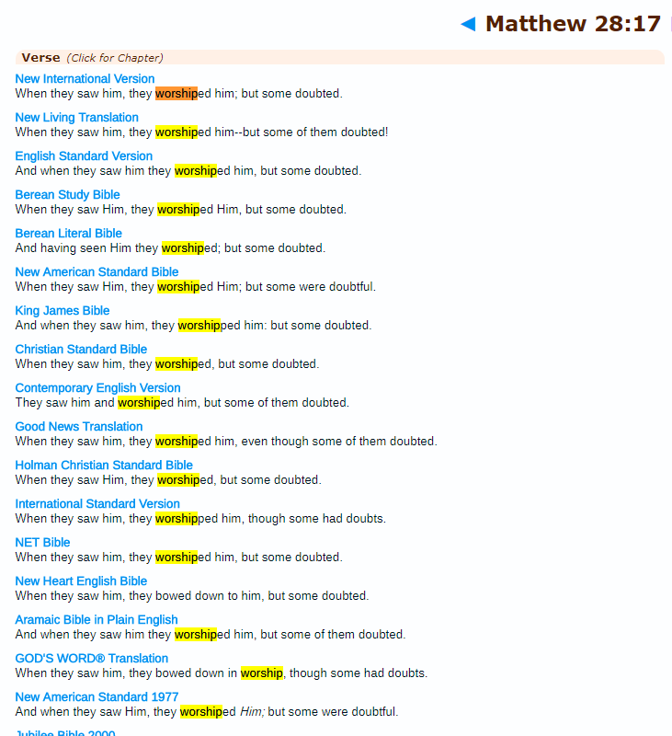
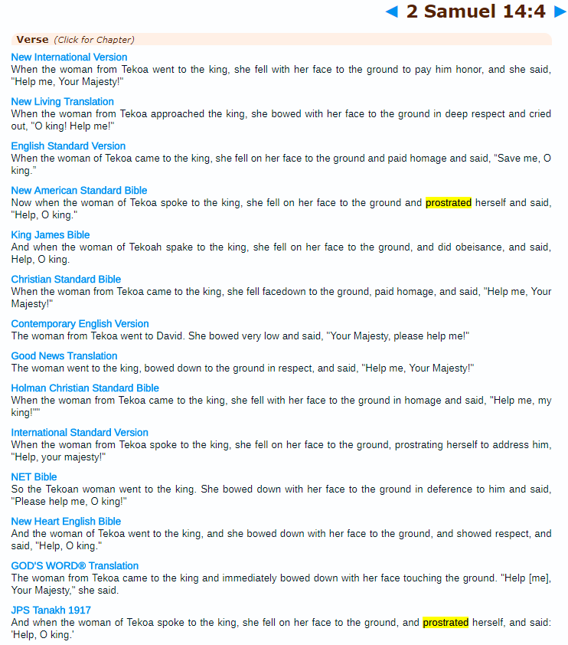
In nearly all the major versions of the Bible when the word proskuneo (προσεκυνησεν) is used, it is translated as “Worship” when in the context of Jesus (NT). However it is translated as “paid homage, respect, honor, prostrate, bowed” etc in every other context, especially in OT.

Slide 87
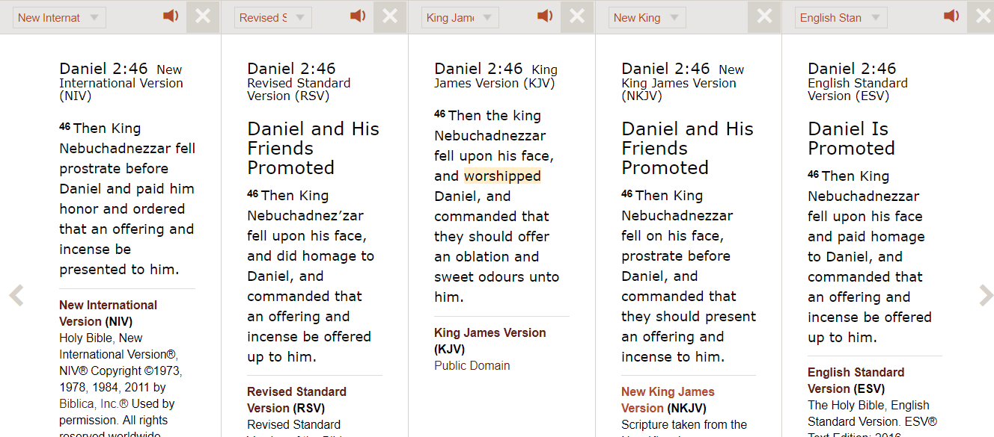
Here you can see in some versions it is translated as “worshipped” and in others as “paid homage” or “fell upon his face”.

Slide 88
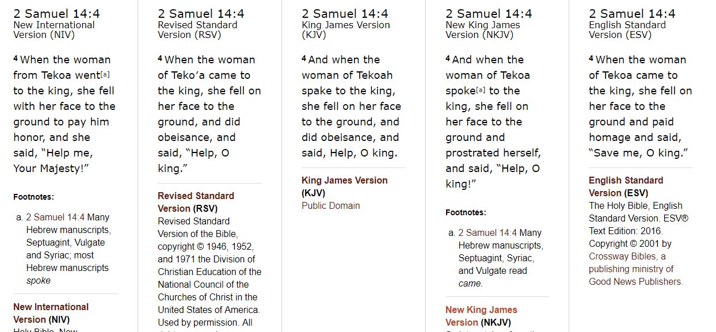
Here the same word (προσεκυνησεν) which should be translated as worshipped like in the NT scenarios related to Christ is translated as:
“Bowed down” or
“prostrated” or
“to pay honor”
in all major versions of the Bible.

Slide 89
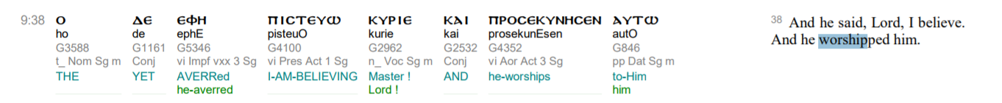
4. This word proskuneo (προσεκυνησεν) is also used in the Old Testament for other people and Prophets.
46 Then the king Nebuchadnezzar fell upon his face, and worshipped Daniel, and commanded that they should offer an oblation and sweet odours unto him. - Daniel 2:46
And when the woman of Tekoa spoke to the king, she fell on her face to the ground and prostrated herself, and said, “Help, O king!” - 2 Samuel 14:4
Does this then mean these other people should also be worshipped? Or does it mean this word was quite commonly used as a figure of speech or to mean paying respects/homage to someone.

Slide 90
1c. Analysis to: Jesus accepted divine entitlement

Slide 91
1c. Analysis to: Jesus accepted divine entitlement (God, Lord)
1. Jesus puts down the people that call him “Lord”.
“Not everyone who says to me, ‘Lord, Lord,’ will enter the kingdom of heaven, but only the one who does the will of my Father who is in heaven.
Many will say to me on that day, ‘Lord, Lord, did we not prophesy in your name and in your name drive out demons and in your name perform many miracles?’ Then I will tell them plainly, ‘I never knew you. Away from me, you evildoers!’
Matthew 7:21-22
2. Forget calling him “God”, he does not accept them to even call him “Good”. This is a sign of a humble servant/man of God and not someone who is God himself.
“And, behold,one came and said unto him, Good Master, what good thing shall I do, that I may have eternal life? And he said unto him, Why callest thou me good? there is none good but one, that is, God: but if thou wilt enter into life, keep the commandments.”
Matthew 19:16-17.

Slide 92
3. The word “Lord” (KYRIOS in greek) used, does not necessarily mean “Lord” in its original translation.
The Greek word KYRIOS is very frequent (80 Mt; 18 Mk; 104 Lk; 52 Jn; 107 Acts; 274 Paul; 717 total), with a variety of meanings.
It is used for many people. It sometimes refers to God or to humans.
It is sometimes translated as “Master” or “Sir” or “Lord”.
It is a word used as a “sign of respect” or reverence to someone.
1c. Analysis to Jesus accepted divine entitlement

Slide 93
4. Many people other than Jesus in the OT and NT were called “Lord”. Does this mean they were also God:
Reference in Old Testament to other men being called: “my lord” or “my master.”
  (a) Master: Ex. 21:5 (Covenant code) Gen. 24:12+, 44:5 (J, 20t.), 1 Sam. 30:13,15; 2 Kings 5:3,20,22; 6:15;
  (b) Husband: Gen. 18:12 (J);
  (c) Prophet: 1 Kings 18:7,13; 2 Kings 2:19; 4:16,28; 6:5; 8:5;
  (d) Prince: Gen. 42:10 (E), Gen. 23:6,11,15 (P), Gen 43:20; 44:18+ ; 47:18, + (J, 12t.); Judges. 4:18;
  (e) King: 1 Sam. 22:12+ (S&K 75t.);
  (f) Father: Gen. 31:5 (E);
  (g) Moses: Ex. 32:22; Num. 11:28; 12:11; 32:26,27 (J); Num. 36:2 (2x) (P);
  (h) Priest: 1 Sam. 1:15, 26 (2x);
  (i) Theophanic angel [an angel representing God]: Josh. 5:14; Judges. 6:13;
  (j) Captain: 2 Sam. 11:11;
  (k) General recognition of superiority: Gen. 24:18; 32:5+; 33:8+; 44:7+ (J 13t.), Ruth 2:13; 1 Sam. 25:24+ (15t.).(2
Some written examples will be shown:
1c. Analysis to Jesus accepted divine entitlement

Slide 94
Some Examples in Old Testament
Aaron calls Moses “Lord”
“He (Moses) said to Aaron, “What did these people do to you, that you led them into such great sin?” “Do not be angry, my lord,” Aaron answered. “You know how prone these people are to evil. ²³ They said to me, ‘Make us gods who will go before us. As for this fellow Moses who brought us up out of Egypt, we don’t know what has happened to him.’
Exodus 32:21-23
Sarah calls her husband “Lord”
“So Sarah laughed to herself as she thought, “After I am worn out and my lord is old, will I now have this pleasure?”
Genesis 18:12
1c. Analysis to Jesus accepted divine entitlement

Slide 95
Some Examples in New Testament
References to other people being called Master/Lord:
When the other servants saw what had happened, they were outraged and went and told their master everything that had happened. - Matthew 18:31
“After a long time the Lord of those servants returned and settled accounts with them. The man who had received five bags of gold brought the other five. ‘Lord,’ he said, ‘you entrusted me with five bags of gold. See, I have gained five more.’…His Lord said unto him, well done…” - Matthew 25:20-21
“The disciple is not above his master, nor the servant above his lord” - Matthew 10:24
“When evening came, the lord of the vineyard saith unto his steward…” - Matthew 20:8
“And when a convenient day was come, that Herod on his birthday made a supper to his lords, high captains and chief estates of Galilee” - Mark 6:21
1c. Analysis to Jesus accepted divine entitlement

Slide 96
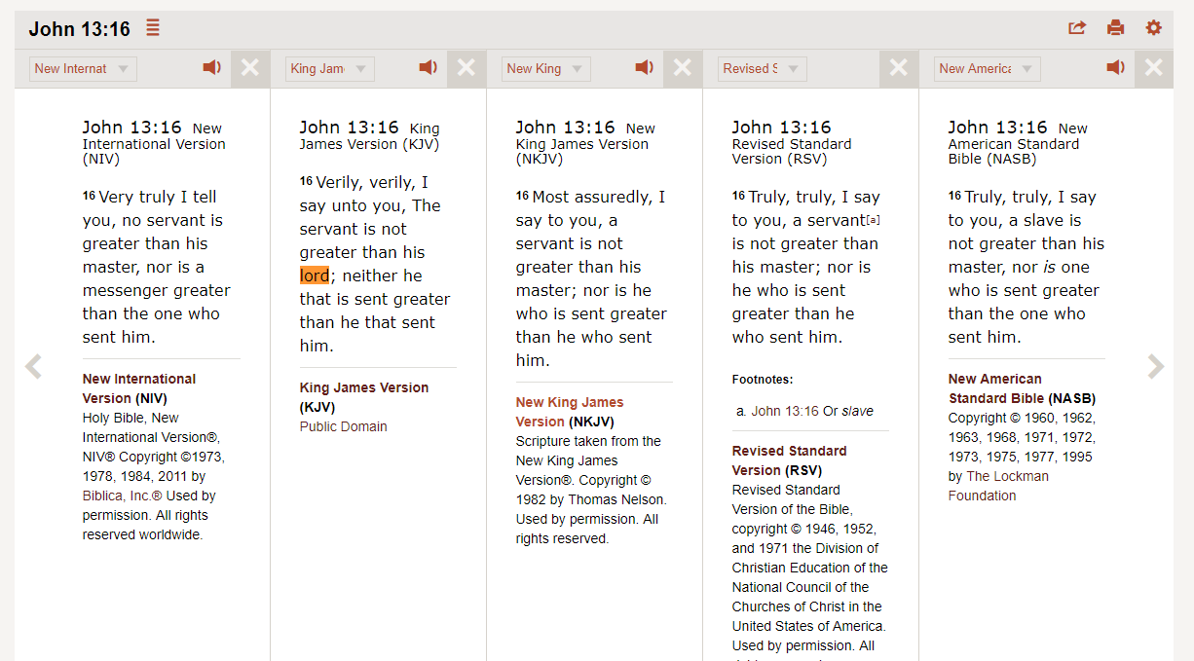
Here you can see in some versions it is translated as “Lord” and in others as “Master”
1c. Analysis to Jesus accepted divine entitlement

Slide 97
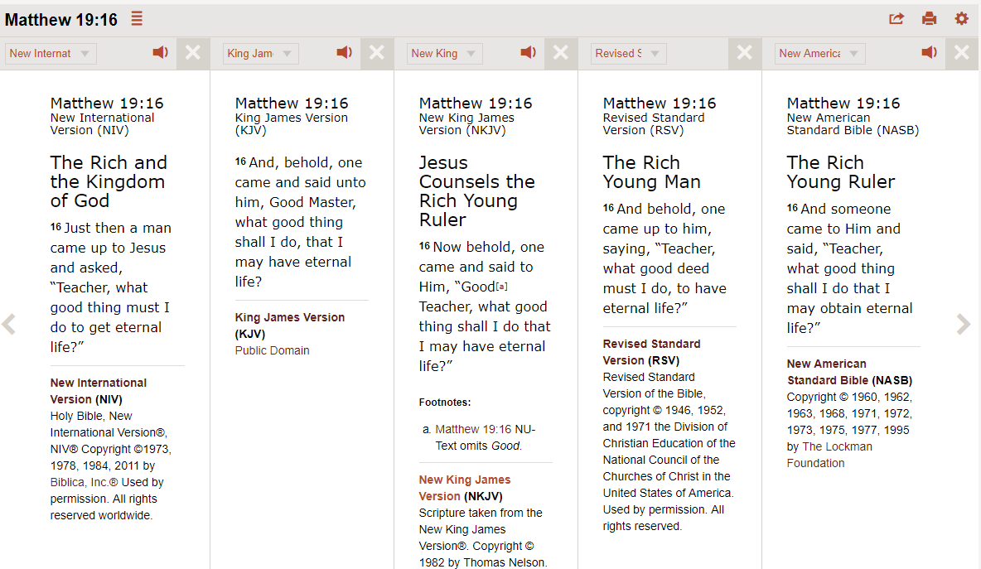
Here you can see in some versions it is translated as “Master” and in others as “Teacher”
1c. Analysis to Jesus accepted divine entitlement

Slide 98
Q: So what about the verse where Thomas clearly calls Jesus “My God and My Lord”!
5. The context of this verse makes it much clearer that he is not calling Jesus God but just remembering God. Let us have a look at the whole passage.
“The other disciples therefore said to him, “We have seen the Lord.” So he said to them, “Unless I see in His hands the print of the nails, and put my finger into the print of the nails, and put my hand into His side, I will not believe.” ²⁶ And after eight days His disciples were again inside, and Thomas with them. Jesus came, the doors being shut, and stood in the midst, and said, “Peace to you!” ²⁷ Then He said to Thomas, “Reach your finger here, and look at My hands; and reach your hand here, and put it into My side. Do not be unbelieving, but believing.” ²⁸ And Thomas answered and said to Him, “My Lord and my God!” ²⁹ Jesus said to him, “Thomas,^{[a]}because you have seen Me, you have believed. Blessed are those who have not seen and yet have believed.”
John 20:25-29
1c. Analysis to Jesus accepted divine entitlement

Slide 99
Q: So what about the verse where the Jews stone Jesus for saying he is God.
5. The context of this verse makes it much clearer that he is not calling Jesus God but just remembering God. Let us have a look at the whole passage.
“We are not stoning You for any good work,” said the Jews, “but for blasphemy, because You, who are a man, declare Yourself to be God.” Jesus replied, “Is it not written in your Law: ‘I have said ye are gods’? If he called them gods to whom the word of God came—and the Scripture cannot be broken” –
John 10:34
The Jews were always trying to catch Jesus out wherever they could. This was just another way to catch him out.
Jesus replies with the same verse that is in Psalms 82:6, in which God calls the Jews “gods”.
He is bringing to their attention that this is the way God speaks in the scriptures. It is a scriptural saying, and does not mean literally.
1c. Analysis to Jesus accepted divine entitlement

Slide 100
Conclusion to 1c.
Calling someone “Lord” or “Master” was a figure of speech used in those days and by the Jews and Christians of the past. It was not used to give someone divine entitlement but a sign of respect. In some places/nations/cultures/religions it is still used as a figure of speech.
Thomas was remembering God in shock as millions have done and are doing till this day when they see something amazing. Eg: “My God! That is amazing”. The context of the verses proves this.
1c. Analysis to Jesus was called God or Lord

Slide 101
1d. Analysis to: Jesus did many miracles like raising the dead etc
These prove he was divine

Slide 102
1. Numerous Miracles were performed by many Prophets throughout the Old Testament. Some examples below:
Miracle of Elijah and the Widow’s Son Raised From the Dead. - 1st Kings 17:17
Elisha Naaman cured of leprosy - 2 Kings 5:1
Elisha’s bones resurrect a dead man - 2 Kings 13:21
Moses’s rod becomes a serpent - Exodus 7:10-12
Moses smites the rock and water came out - Exodus 17:5
Elisha makes a whole army blind - 2 Kings 6:18
Elisha feeds 100 men with 20 loaves of bread – 2 Kings 4:42
Isaiah makes the sun go backwards - 2 Kings 20:9
Ezekiel raises a whole city from the dead! - Ezekiel 37:1-9
1d. Jesus did many miracles which proves he is god

Slide 103
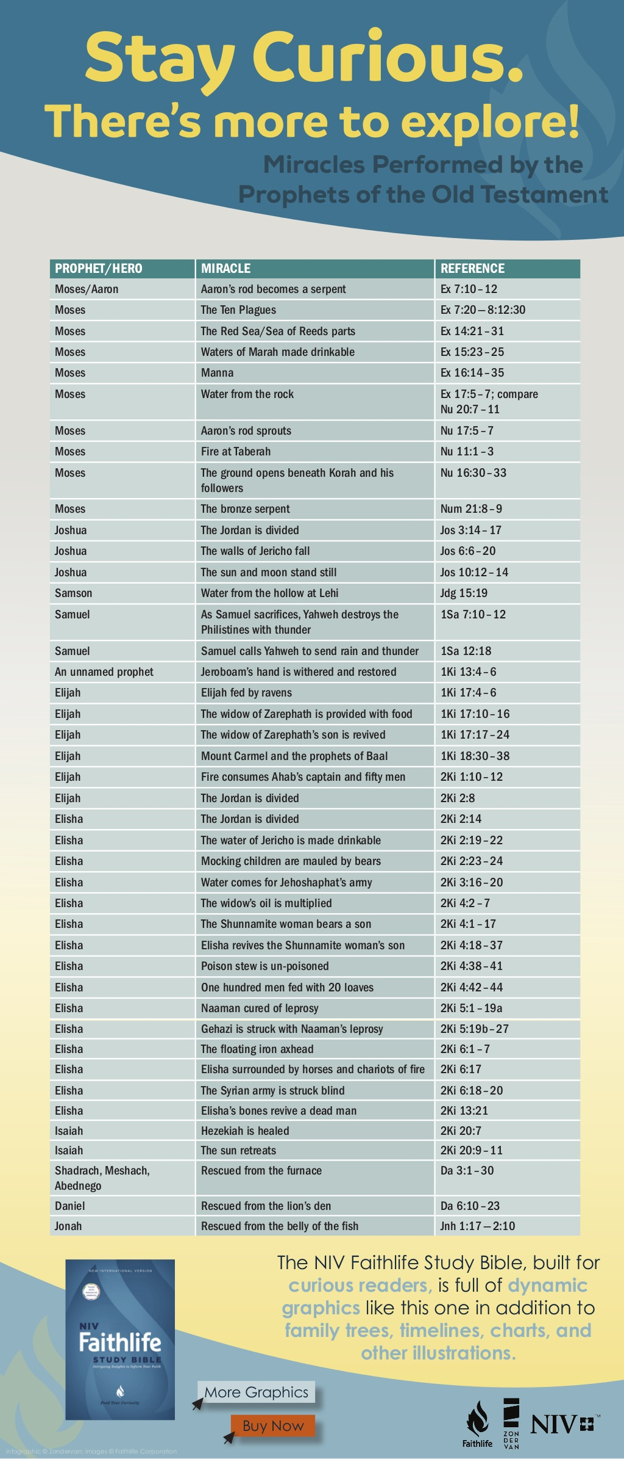
List of Miracles from various Prophets and other people in Bible
1d. Jesus did many miracles which proves he is god

Slide 104
Passage from 1 Kings 17:17
Some time later the son of the woman who owned the house became ill. He grew worse and worse, and finally stopped breathing. ¹⁸ She said to Elijah, “What do you have against me, man of God? Did you come to remind me of my sin and kill my son?”
¹⁹ “Give me your son,” Elijah replied. He took him from her arms, carried him to the upper room where he was staying, and laid him on his bed.²⁰ Then he cried out to the Lord, “Lord my God, have you brought tragedy even on this widow I am staying with, by causing her son to die?” ²¹ Then he stretched himself out on the boy three times and cried out to the Lord, “Lord my God, let this boy’s life return to him!”
²² The Lord heard Elijah’s cry, and the boy’s life returned to him, and he lived.
Muslim Scholars argue if miracles are a proof for divinity then all these Prophets should also be classed as divine, or none should be including Jesus.
1d. Jesus did many miracles which proves he is god

Slide 105
2. Jesus himself says he does the miracles by God’s will, not his own. He calls himself powerless without God.
“I can of My own self do nothing. As I hear, I judge; and My judgment is righteous, because I do not seek My own will but the will of the Father who sent Me.” - John 5:30
“But it is by the finger of God that I cast out demons” - Luke 11:20
“But if I cast out devils by the Spirit of God.” - Matthew 12:28
“the works that I do in my Father's name.” - John 10:25
“...I do nothing of myself; but as my Father hath taught me, I speak these things. - John 8:28-29
1d. Jesus did many miracles which proves he is god

Slide 106
3. The miracle of Lazarus shows a parallel scenario between Jesus and Elijah.
Some time later the son of the woman who owned the house became ill. He grew worse and worse, and finally stopped breathing. ¹⁸ She said to Elijah, “What do you have against me, man of God? Did you come to remind me of my sin and kill my son?”
¹⁹ “Give me your son,” Elijah replied. He took him from her arms, carried him to the upper room where he was staying, and laid him on his bed.²⁰ Then he cried out to the Lord, “Lord my God, have you brought tragedy even on this widow I am staying with, by causing her son to die?” ²¹ Then he stretched himself out on the boy three times and cried out to the Lord, “Lord my God, let this boy’s life return to him!”
²² The Lord heard Elijah’s cry, and the boy’s life returned to him, and he lived.
1 Kings 17:17
Therefore, when Jesus saw her weeping, and the Jews who came with her weeping, He groaned in the spirit and was troubled. ³⁴ And He said, “Where have you laid him?” They said to Him, “Lord, come and see.”…. Then Jesus, again groaning in Himself, came to the tomb. It was a cave, and a stone lay against it. ³⁹ Jesus said, “Take away the stone.”³⁵ Jesus wept……And Jesus lifted up His eyes and said, “Father, I thank You that You have heard Me. And I know that You always hear Me, but because of the people who are standing by I said this, that they may believe that You sent Me.”……
John 11:30-37
1d. Jesus did many miracles which proves he is god

Slide 107
1e. Analysis to: Jesus says he is not of this world and God is not of this world, which means he is God.
These prove he was divine

Slide 108
This statement is a figure of speech. Jesus uses this to describe his disciples. Does this make them God now? No as its metaphorical. If taken literally it could mean anyone who has denounced the world is not of this world.
“And he (Jesus) said unto them, Ye are from beneath; I am from above: ye are of this world; I am not of this world.”
John 8:23
Jesus said, "My kingdom is not of this world. If it were, my servants would fight to prevent my arrest by the Jewish leaders. But now my kingdom is from another place.“
John 18:36
Here Jesus uses it to describe others:
“I have given them thy word; and the world hath hated them, because they are not of the world, even as I am not of the world” – John 17:14
“They are not of the world, even as I am not of the world” -John 17:16
1d. Jesus did many miracles which proves he is god

Slide 109
1f. Analysis to: Jesus was created in God’s image and made before all things
These prove he was divine

Slide 110
1f. Jesus was created in God’s image and made before all things
⁵ The Son is the image of the invisible God, the firstborn over all creation. ¹⁶ For in him all things were created: things in heaven and on earth, visible and invisible, whether thrones or powers or rulers or authorities; all things have been created through him and for him. ¹⁷ He is before all things, and in him all things hold together.
Colossians 1:16
“I am the Alpha and the Omega, the First and the Last, the Beginning and the End.”
Revelation 22:13
1. Firstly these are the words of Paul and not of Christ or his direct disciples. There are many links to Pauls teachings and that of the Roman/Greek teachings.
Muslim Scholars say Paul is the reason why Christendom moved from a monotheistic approach to making Jesus into God or Son of God.
Many disciples rejected Paul and many Early Christian denominations also rejected his teachings and writings.
  “And Saul, having come to Jerusalem, did try to join himself to the disciples, and they were all afraid of him, not believing that he is a disciple” - Acts 9:26-31
This is why he went to propagate his message in Rome where his message would have been more accepted
Ebionites, Arians, Nazarenes (1st century Christian denominations) all rejected the doctrines of Paul.
This still does not prove that Jesus was given self-deification, but rather – Involuntary or Posthumous deification.

Slide 111
Analysis of the statements
⁵ The Son is the image of the invisible God, the firstborn over all creation. ¹⁶ For in him all things were created: things in heaven and on earth, visible and invisible, whether thrones or powers or rulers or authorities; all things have been created through him and for him. ¹⁷ He is before all things, and in him all things hold together.
Colossians 1:16
“I am the Alpha and the Omega, the First and the Last, the Beginning and the End.”
Revelation 22:13
2. Man itself was created in God’s image according to the Bible. This makes it very vague to use this as a proof.
“…image of the invisible God…”
  “…for God made humans in his own image.” - Genesis 9:6
“…the firstborn…”
  Exodus 4:22 "Thus saith Jehovah, Israel is my son, even my firstborn.“
  Jeremiah 31:9 "I am a father to Israel, and Ephraim is my firstborn.“
3. The rest of the analysis and for the other verse as well, will be given together in the explanation of 1g.

Slide 112
1g. Analysis to: Jesus was born without a father so as default God becomes his father

Slide 113
1. This point will be an analysis to points 1e,1f,1g
The Muslim perspective on this is if being born without a father, or being the firstborn, or first (alpha) and last (omega) does this make one God. If yes then the following personalities should also be given the same title:
Adam:
“…then God said, “Let us make man in our image, after our likeness. And let them have dominion over the fish of the sea…”
Genesis 1:26
“For Adam was formed first, then Eve”
1 Timothy 2:13
He was born without father
He was born without Mother
He was made in the image of God
Melchizedek:
“He is without father or mother or genealogy, having neither beginning of days nor end of life, but resembling the Son of God he continues a priest forever.”
Hebrews 7:3
He was born without father
He was born without Mother
Without a beginning
Without an end
Resembles the Son of God
Will remain forever
1g. Analysis to: Jesus was born without a father so as default God becomes his father

Slide 114
1h. Analysis to: Jesus is honoured just as the father was honoured.

Slide 115
Analysis of the statements
“that all may honour the Son, just as they honour the Father. Whoever does not honour the Son does not honour the Father who sent him…”
John 5:23
1. Muslim scholars agree, similar to Islam whoever honours the Prophet at the time obtains the honour of the father.
  Any person who does not believe in a prophet of God disbelieves in God also.
  Because God is commanding you to believe in those prophets, and God is sending them revelations…
  As a result to deny the prophet/messiah or Christ is to deny God.
  Meaning denying Jesus would be denying God and honouring Jesus would be honouring God.
The next verse (giving the context) demonstrates this:
“He that honoureth not the Son honoureth not the Father which hath sent him. Verily, verily I say unto you, He that heareth my word, and believeth on him that sent me, has everlasting life, and shall not come into condemnation; but is passed from death unto life.” - John 5:23-24
1h. Analysis to: Jesus is honoured just as the father was honoured

Slide 116
1i. Analysis to: Jesus is given authority over everything

Slide 117
Analysis of the statements
“Then Jesus came to them and said, "All authority in heaven and on earth has been given to me.”
Matthew 28:18
Here we see that all authority has been GIVEN to Jesus.
How can Jesus be God if he was GIVEN this authority?
So before Jesus was GIVEN this authority, what was he?
What kind of God was he before he was GIVEN all this authority?
If Jesus is co-equal with the Father then who gave the Father this authority? Plus why would Jesus need the Father to give him the authority? Couldn't the godly nature of Jesus given it to his man nature?
On the contrary Jesus says on many occasions:
“…for the Father is greater than I.” - John 14:28
I can of mine own self DO NOTHING . . ." – John 5:30
"But of that day and that hour knoweth no man, no, not the angels which are in heaven, NEITHER THE SON, but the Father." - Mark 13:32
The statements are in contradiction or too ambiguous or not enough to claim his divinity.
1h. Analysis to: Jesus is given authority over everything

Slide 118
REASONS GIVEN BY CHRISTIANS WHY JESUS IS GOD OR THE SON OF GOD.
Analysis to: Proofs of Jesus being God and to worship him
  Jesus himself claimed he is God.
  Jesus claimed people should “worship him”
  He accepted Divine entitlement (eg: people calling him God)
  He did many miracles like raising people from the dead, walking on water etc
  Jesus says he is not from this world and God is not also, which makes Jesus God.
  Jesus was made in God’s image and made before all things
  He was born without a father (no male intervention) so as default God becomes his father
  Jesus is honoured just as the father was honoured.
  He was given authority over everything.
Analysis to: Proofs of Jesus being the begotten Son of God
  God said “this is my beloved son” and called him his son
  Jesus calls himself the “Son of God”.
  Holy Ghost says “he will be the son of God”
  The apostles of Christ calls him the “Son of God”
  Jesus referred to God as “His father”
Analysis to: Proofs of Trinity
  Jesus himself claimed: him, the Father and the Holy Spirit are Three Gods in One.

Slide 119
2. Analysis to: Proofs for Jesus being the begotten Son of God
PART 3.2. Islamic Perspective
  God said “this is my beloved son” and called him his son
  Jesus calls himself the “Son of God”.
  Holy Ghost says “he will be the son of God”
  The apostles of Christ calls him the “Son of God”
  Jesus referred to God as “His father”

Slide 120
2a-2d. Analysis to: Jesus was called “Son of God” by: himself / God / Apostles

Slide 121
2a,2b,2c,2d, will all be analysed together as they all deal with Jesus being called “Son of God”
"This is My beloved Son with whom I am well-pleased”
2 Peter 1:17
“Are you the Messiah, the Son of the Blessssed One?” “I am,” said Jesus.
Mark 14:61-62
"For God so loved the world, that He gave His only begotten Son, that whoever believes in Him shall not perish, but have eternal life.”
John 3:16
Firstly Muslims do not object to people or prophets being called “Son or Children of God” in its metaphorical sense, however the main issue they have is with the whole definition of Jesus being called the “physical” or “BEGOTTEN” son of God. This means that there was some sort of physical or supernatural union between God and Mary, which then gave birth to a “God-Man” being. Jesus Being called the “Son” of God is nothing new in the Bible. Many prophets and people were called the “Son of God”.
EXAMPLE 1: Adam called the “Son of God”
"Which was the son of Enos, which was the son of Seth, which was the son of Adam, which was the SON OF GOD." - LUKE 3:38
EXAMPLE 2: Jacob (Israel) is God’s son and FIRSTBORN
“Israel is my son, even my firstborn” - Exodus 4:22
2a, 2b, 2c, 2d. Analysis to: the term “Son of God”.

Slide 122
EXAMPLE 3: Solomon is called God’s son
“He shall build an house for my name, and I will establish the throne of his kingdom for ever. I will be his father, and he shall be my son” - 2 Samuel 7:13-14
EXAMPLE 4: Ephraim is God’s Firstborn
“…for I am a father to Israel, and Ephraim is my firstborn.” - Jeremiah 31:9
EXAMPLE 5: Common people are called “Sons of God”.
“Ye are the children of the LORD your God” - Deuteronomy 14:1
“For as many as are led by the Spirit of God, they are the sons of God” - Romans 8:14
“…when the Sons of God saw the daughters of men…” - Genesis 6:2
BUT…Jesus is not a son like the examples above. He is different. Look at the verse:
“…He gave His only begotten Son, that whoever believes in Him shall not perish, but have eternal life.” - John 3:16
God is clearly calling Jesus “His only begotten Son”.
Let’s analyse…
2a, 2b, 2c, 2d. Analysis to: the term “Son of God”.

Slide 123
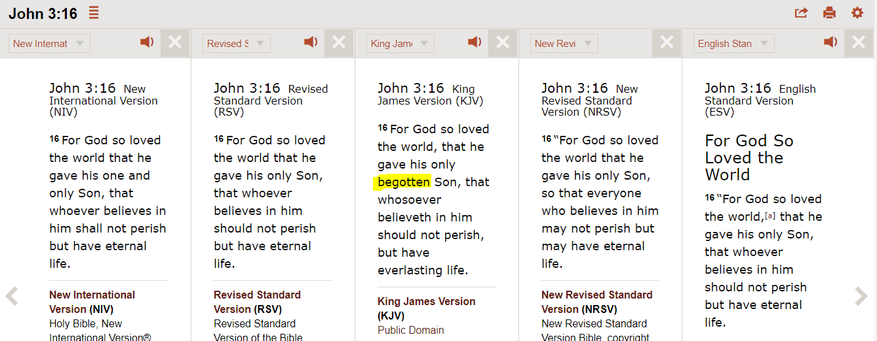
But…Jesus was the begotten “Son of God”. Begotten not made
2. The word “BEGOTTEN” in John 3:16 was actually taken out of many of the versions of the Bible as a fabrication or error in translation. As a result in some versions the word is replaced with “Unique or “Only” son. The word itself is unreliable.
2a, 2b, 2c, 2d. Analysis to: the term “Son of God”.

Slide 124
3. If this is the case then Jesus is not the only “Begotten son of God”.
I will declare the decree: the LORD hath said unto me (David the king), Thou art my Son; this day have I begotten thee.”
Psalms 2:7
4. Lets analyse the word “Son”. Many times it is translated as “Servant/Slave” in some versions instead of “Son”.
Is Jesus "God's Son" or "God's Servant (SLAVE)?"
"Servant" here is slave. Jesus was called ABD (SLAVE) in the OT, the
same word used for the Jews' slaves, and all slaves in general, throughout
the Bible. Jesus, the “abd of GOD”, is also the slave of GOD in the NT.
King James Version Acts 3:26 - Unto you first God, having raised up his Son Jesus, sent him to bless you, in turning away every one of you from his iniquities. | New King James Version Acts 3:26 - To you first, God, having raised up His Servant Jesus, sent Him to bless you, in turning every one of you away from his iniquities.

Slide 125
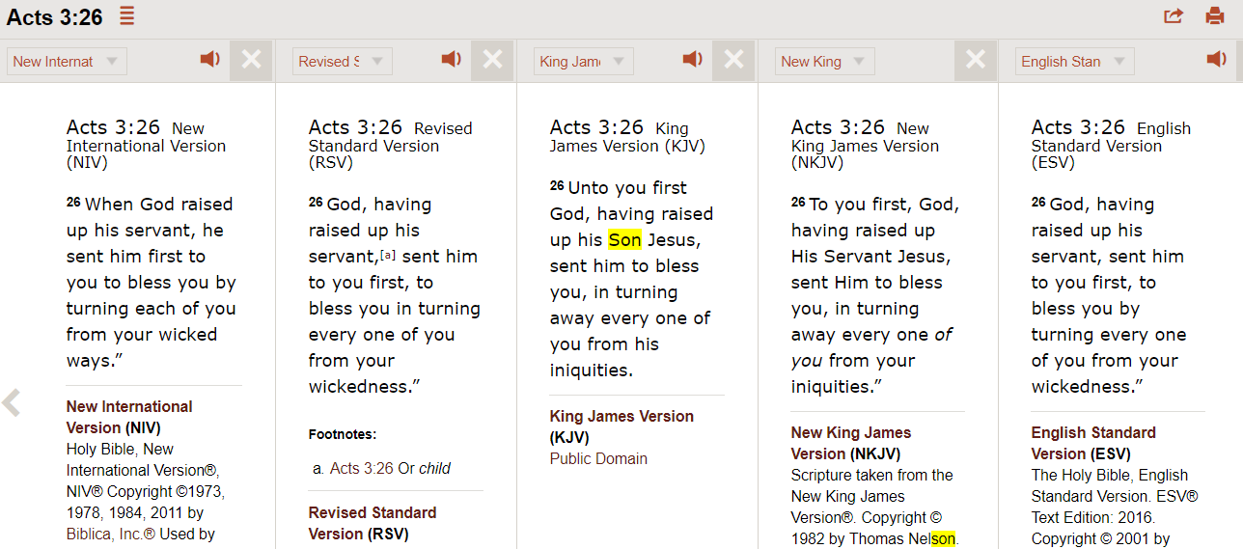
Examples showing the many versions it is translated as “servant” and in others as “Son”

Slide 126
4. Is Jesus the “Son of Man” or “Son of God”.
x24 References to “Son of God” in NT in relation to Jesus.
Only 3 of these references is when Jesus says “Son” himself in the same sentence.
All to be found in Gospel of John.
John 14:13, John 5:19, John 5:26
x15 References to Christ described as “Son of Man”
15 out of 15 of these are references to Jesus calling himself the “Son of Man”
Ref: https://bible.knowing-jesus.com/topics/Jesus-As-Son-Of-Man

Slide 127
Question: So if it I metaphorical senses or a figure of speech, then why was Jesus stoned by the Jews in Luke 22:70. Wasn’t it that he called himself the “Son of God”
Again the high priest asked him, “Are you the Messiah, the Son of the Blessssed One?” “I am,” said Jesus. “And you will see the Son of Man sitting at the right hand of the Mighty One and coming on the clouds of heaven.”
Mark 14:61-62
“Are You then the Son of God?” He replied, “You say that I am.” “Why do we need any more testimony?” they declared. “We have heard it for ourselves from His own lips.”.
Luke 22:70
ButJesus remained silent. Then the high priest said to Him, “I charge You under oath by the living God: Tell us if You are the Christ, the Son of God.” “You have said it yourself,” Jesus answered.
Matthew 26:63-64
The context here is quite clear. This scenario occurred during the trial.
Jesus has caused many problems for the Jews. They needed to get rid of him and did anything and everything to make this possible.
So like people do, they twisted the meaning or decided to apply a literal meaning to all his statements. Just to try and get him crucified.
Another example is when they took him to Pilate and this time they change the charge from “blasphemy” to more that of a “rebel”
  “Your own people and chief priests handed You over to me. What have You done?” Jesus answered, “My kingdom is not of this world; if it were, My servants would fight to prevent My arrest by the Jews. But now, My kingdom is not of this realm.” “Then You are a king!” Pilate said. “You say that I am a king,” Jesus answered.
Jesus, even though answers the same way when asked are you the “Son of God” was not charged by Pilate.
Pilate realises he is speaking metaphorically, so lets him go – “…I find no fault in this man.” (Luke 23:4)

Slide 128
Conclusion for “Son of God”
A main point to Note is:
The Bible is a Hebrew/Aramaic scripture which were languages of the Jews. Similar to many eastern languages calling someone “son” or “father” or “uncle” is quite common even if there is no relation to the person.
It is used as a sign of love and respect.
In the language of the Jews it is a very innocent term used to describe a loyal servant of god as it was used for everyone as well as high status people.

Slide 129
2e. Analysis to: Jesus referred to God as “his Father”

Slide 130
1. If Jesus calls God “The Father” and this makes him the “Son of the Father”, then what about other people who address God as “Father.”
“But now, O LORD, thou art our father; we are the clay, and thou our potter; and we all are the work of thy hand.” - Isaiah 64:8 (OT)
“Doubtless thou art our father, though Abraham be ignorant of us, and Israel acknowledge us not: thou, O LORD, art our father, our redeemer; thy name is from everlasting.” - Isaiah 63:16
“Do ye thus requite the LORD, O foolish people and unwise? is not he thy father that hath bought thee? hath he not made thee, and established thee?” - Deuteronomy 32:6
Wherefore David blessed the LORD before all the congregation: and David said, Blessed be thou, LORD God of Israel our father, for ever and ever. - 1 Chronicles 29:10
Have we not all one father? hath not one God created us? why do we deal treacherously every man against his brother, by profaning the covenant of our fathers? - Malachi 2:10

Slide 131
2. God declares He is the father of other people. And declares people to be his children.
GOD ADDRESSES HIMSELF AS THE FATHER
“for I am a father to Israel, and Ephraim is my firstborn.” - Jeremiah 31:9
“and I said, Thou shalt call me, My father; and shalt not turn away from me.” - Jeremiah 3:19
“A son honoureth his father, and a servant his master: if then I be a father, where is mine honour?” - Malachi 1:6
GOD ADDRESSES THE PEOPLE AS CHILDREN/SON/DAUGHTER
“and it shall come to pass, that in the place where it was said unto them, Ye are not my people, there it shall be said unto them, Ye are the sons of the living God.” - Hosea 1:10
“I have nourished and brought up children, and they have rebelled against me.” - Isaiah 1:2
“Ye are the children of the LORD your God” - Deuteronomy 14:1

Slide 132
3. Jesus calls God, not only his own Father but everyone's Father. This proves it is used as metaphorical.
“That ye may be the children of your Father which is in heaven...” - Matthew 5:45
“Be ye therefore perfect, even as your Father which is in heaven is perfect.” - Matthew 5:48
“And do not call anyone on earth your father; for One is your Father, He who is in heaven.” Matthew 23:9
  There are countless verses in the Bible to this effect. To understand what is meant by the
  reference to “father” we need only read the following verse:
“Jesus said unto them, If God were your Father, ye would love me: for I proceeded forth and came from God; neither came I of myself, but he sent me - John 8:42
  “Father” is being used in its metaphorical sense. Another example is the following verse where the devil is called “father”:
“Ye are of your father the devil, and the lusts of your father ye will do.” - John 8:44

Slide 133
Overall Conclusion to Part 2
Muslim Scholars argue that Christians are looking at the Bible from a perspective that is not Jewish or Eastern. Looking at the Bible from that perspective draws different conclusions
The bible was written around Jews and in the language of the Jews.
Today the bible has been translated into 100s of languages and is being looked at from different angles.
We need to look at the Bible from the perspective or language of the Jews. The ways they speak and express themselves may be different to the way you would express yourself in Greek or English.

Slide 134
REASONS GIVEN BY CHRISTIANS WHY JESUS IS GOD OR THE SON OF GOD.
Analysis to: Proofs of Jesus being God and to worship him
  Jesus himself claimed he is God.
  Jesus claimed people should “worship him”
  He accepted Divine entitlement (eg: people calling him God)
  He did many miracles like raising people from the dead, walking on water etc
  Jesus says he is not from this world and God is not also, which makes Jesus God.
  Jesus was made in God’s image and made before all things
  He was born without a father (no male intervention) so as default God becomes his father
  Jesus is honoured just as the father was honoured.
  He was given authority over everything.
Analysis to: Proofs of Jesus being the begotten Son of God
  God said “this is my beloved son” and called him his son
  Jesus calls himself the “Son of God”.
  Holy Ghost says “he will be the son of God”
  The apostles of Christ calls him the “Son of God”
  Jesus referred to God as “His father”
Analysis to: Proofs of Trinity
  Jesus himself claimed: him, the Father and the Holy Spirit are Three Gods in One.

Slide 135
3. Analysis to: Proofs for the Trinity
PART 3.3 Islamic Perspective
  Jesus himself claimed: Him, the Father and the Holy Spirit are Three Gods in One.

Slide 136
1. There are no direct verses dealing with the Trinity, that either put God, Son, Holy Spirit as one (co-equal) Physical entity or being. Or that clearly explain the physical union of these three beings. However the closest verse given is in John 5:7 (this will be analysed shortly)
2. God or the Bible throughout thousands of years of history preaches a ONE GOD ONLY concept which is prevalent in the whole Bible (OT and NT). Then Jesus comes and even then he preaches exactly the same thing. So why the sudden change is a foundational core belief?
1st Commandment in Old Testament
  “Hear, O Israel The Lord our God is one Lord” - (Deuteronomy 6:4)
1st Commandment in New Testament
  “And Jesus answered him, The first of all the commandments is, Hear, O Israel; The Lord our God is one Lord: And thou shalt love the Lord thy God with all thy heart, and with all thy soul, and with all thy mind, and with all thy strength: this is the first commandment.” - Mark 12:29-30

Slide 137
3. The word “Trinity” itself is a concocted word. It is not to be found anywhere in the Bible. Something that is not concrete cannot be doctrine or be a reason for one to be punished in the hereafter. It does not suit the “Justice” of God. (Please note: this is an Islamic principle).
4. Jesus on many occasions makes it clear that he is not equal or co-equal to God or the Holy Ghost. In fact he preaches the opposite.
Jesus not equal to the Father (in fact powerless without Him)
“…the father is greater than I” – John 14:28
“But of that day and that hour knoweth no man, no, not the angels which are in heaven, neither the Son, but the Father.” - Mark 13:32
“…because I seek not mine own will, but the will of the Father which hath sent me.” John 10:25
“I can of mine own self do nothing: as I hear, I judge…I do not seek my own will of Him who sent me” - John 5:30

Slide 138
Jesus not equal to the Holy Ghost
I tell you that any sinful thing you do or say can be forgiven. Even if you speak against the Son of Man, you can be forgiven. But if you speak against the Holy Spirit, you can never be forgiven, either in this life or in the life to come. - Matthew 12:31-32
Points derived from this:
The Holy Spirit may be Higher or Holier than Jesus.
The Holy Spirit may be much closer to GOD Almighty than Jesus.
We know in the OT, blaspheming GOD Almighty's Holy Name is punishable by death:
  “Whoever blasphemes the name of the Lord shall surely be put to death. All the congregation shall stone him.” - Leviticus 24:16
And Jesus said that he did not abolish or invalidate or nullify the Law of Moses. He only came to fulfil its Prophecies regarding him:
  “Do not think that I have come to abolish the Law or the Prophets; I have not come to abolish them but to fulfil them.” - Matthew 5:17

Slide 139
Analysis to the verses put forward in support of the Trinity
“therefore go and make disciples of all nations, baptizing them in the name of the Father and of the Son and of the Holy Spirit...”
(Matthew 28:19).
“There are different kinds of gifts, but the same Spirit. There are different kinds of service, but the same Lord. There are different kinds of working, but the same God works all of them in all men.”
(I Corinthians 12:4-6).
“May the grace of the Lord Jesus Christ, and the love of God, and the fellowship of the Holy Spirit be with you all.”
(II Corinthians 13:14).
“But you, dear friends, build yourselves up in your most holy faith and pray in the Holy Spirit. Keep yourselves in God' s love as you wait for the mercy of the Lord Jesus Christ to bring you to eternal life.”
(Jude 20-21).
5. These are all indirect verses and do not say anywhere that God, Jesus and Holy Ghost are one and the same being. In belief because it is so important (ie: difference between having salvation or not) Muslim Scholars argue it cannot be vague or indirect. God or Jesus MUST be clear about who is God, and whether He is 3in1 or 1in3 etc.
For example, if I say “Joe, Jim, and Frank speak one language” this is not the same as saying “Joe, Jim, and Frank are one person.”
Notes:
Refer to Question 6 of questionnaire here!

Slide 140
What about the verse where Jesus says “I and the Father are one” John 10:30
6. When you analyse the context of the verse and look at the whole passage, it becomes clear that the verse is not referring to Jesus and God being ONE in form but rather ONE IN AGREEMENT.
Does this verse mean In divinity? In a holy “trinity”? No! They are one in PURPOSE. Just as no one shall pluck them out of Jesus’ hand, so shall no one pluck them out of God’s hand.
Another example when Jesus speaks in the metaphorical sense:
“It says, ‘For this reason a man will leave his father and his mother and will live with his wife. The two will become one.’ ⁶ So they are no longer two but one. Let no man divide what God has put together.” - Matthew 19:5-6
The Jews who were there gathered around him, saying, “How long will you keep us in suspense? If you are the Messiah, tell us plainly.”
²⁵ Jesus answered, “I did tell you, but you do not believe. The works I do in my Father’s name testify about me,²⁶ but you do not believe because you are not my sheep. ²⁷ My sheep listen to my voice; I know them, and they follow me. ²⁸ I give them eternal life, and they shall never perish; no one will snatch them out of my hand. ²⁹ My Father, who has given them to me, is greater than all^{[c]};no one can snatch them out of my Father’s hand. ³⁰ I and the Father are one.”
John 10:24-30
Notes:
Refer to Question 6 of questionnaire here!

Slide 141
What about the verse where Jesus says “I and the Father are one” John 10:30
Does this mean that a man and woman have physically become one substance and now do not have a mind of their own? No. It is a metaphorical statement
Another example where it is used metaphorically
“Neither pray I for these alone, but for them also which shall believe on me through their word; That they all may be one; as thou, Father, art in me, and I in thee, that they also may be one in us: that the world may believe that thou hast sent me. And the glory which thou gavest me I have given them; that they may be one, even as we are one.” - John 17:20-22
Does this mean all of mankind is now also part of the “trinity”?
The Jews who were there gathered around him, saying, “How long will you keep us in suspense? If you are the Messiah, tell us plainly.”
²⁵ Jesus answered, “I did tell you, but you do not believe. The works I do in my Father’s name testify about me,²⁶ but you do not believe because you are not my sheep. ²⁷ My sheep listen to my voice; I know them, and they follow me. ²⁸ I give them eternal life, and they shall never perish; no one will snatch them out of my hand. ²⁹ My Father, who has given them to me, is greater than all^{[c]};no one can snatch them out of my Father’s hand. ³⁰ I and the Father are one.”
John 10:24-30
Notes:
Refer to Question 6 of questionnaire here!

Slide 142
What about the verse where which directly talks about the three entities as one.
6. This is the strongest verse Christian scholars have to back up the Trinity. It is very direct and summarises the Trinity well. Let’s analyse:
This verse is now universally recognized as being a later “insertion” of the Church and all recent versions of the Bible.
Who took the verse out?
32 Christian Scholars of the highest eminence, backed by 50 cooperating denomiations of Christianity, have agreed that this verse is NOT TO BE FOUND in the MOST ANCIENT MANUSCRIPTS.
7. Muslim Scholars now say this verse is UNRELIABLE and does not hold weight. It cannot be used in the argument for the Trinity.
“For there are three that bear record in heaven, the Father, the Word, and the Holy Ghost: and these three are one.”
1 John 5:7
Notes:
Get someone to read this verse out.

Slide 143
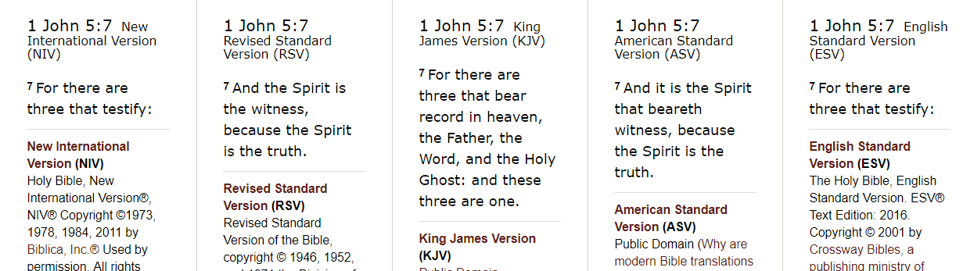
Here it can be seen the verse is taken out of all major translations except the KJV
Old Testament
“Do not add to what I command you and do not subtract from it, but keep the commands of the LORD your God that I give you.”
Deu 4:2
New Testament
“And if anyone takes words away from this scroll of prophecy, God will take away from that person any share in the tree of life and in the Holy City
Rev 22:19
New Testament
Jesus said…“Till heaven and earth pass, one jot or one tittle shall in no wise pass from the law,
Mat 5:18
Notes:
Get someone to read this verse out.

Slide 144
What do the translators of the Bible who took the verse out have to say:
The scripture translator to RSV: Benjamin Wilson gives the following explanation for the reason of removing the verse. He says in his“Emphatic Diaglott.”
“This text concerning the heavenly witness is not contained in any Greek manuscript which was written earlier than the fifteenth century. It is not cited by any of the ecclesiastical writers; not by any of early Latin fathers even when the subjects upon which they treated would naturally have lead them to appeal to it’s authority. It is therefore evidently spurious.”
Notes:
Get someone to read this verse out.

Slide 145
Not only Muslims have this opinion of Jesus as a Prophet but also many early Christian sects and today many academics and learned people of Christianity.
Grolier’s encyclopedia, under the heading “Jesus Christ,” says:
“During his earthly life Jesus was addressed as rabbi and was regarded as a prophet. Some of his words, too,place him in the category of sage. A title of respect for a rabbi would be “my Lord.” Already before Easter his followers, impressed by his authority, would mean something more than usual when they addressed him as “my Lord.”.... it is unlikely that the title “Son of David” was ascribed to him or accepted by him during his earthly ministry.
“Son of God,” in former times a title of the Hebrew kings (Psalms 2:7), was first adopted in the post-Easter church as an equivalent of Messiah and had no metaphysical connotations (Romans 1:4). Jesus was conscious of a unique filial relationship with God, but it is uncertain whether the Father/Son language (Mark 18:32; Matt. 11:25-27 par.;John passim) goes back to Jesus himself”.

Slide 146
Earliest Christian Sects and denominations of Christianity with similar beliefs:
Most nontrinitarians take the position that the doctrine of the earliest form of Christianity was nontrinitarian, but that early Christianity was either strictly Unitarian
For them, early Christianity eventually changed after the edicts of Emperor Constantine I and his sentence pronounced on Arius
Arianism,
  declared by the Council of Nicaea to be heresy, denied the full divinity of Jesus Christ, and is so called after its leader Arius
Ebionites:
  Most historical sources agree that the Ebionites denied many of the central doctrines of mainstream Christianity such as the trinity of God,
Nestorians
  Belief that Jesus Christ was a natural union between the Flesh and the Word, thus not identical, to the divine Son of God.
Adoptionism
  Belief that Jesus was born as a mere (non-divine) man, was supremely virtuous and that he was adopted later as "Son of God" by the descent of the Spirit on him.
All of these mentioned above had big followings in the first 3 centuries of Chirstianity. It was later in the 4th century that Contstantine killed many of the learned men and burnt their books, which is why we do not have many (if not any) of their books/teachings left.

Slide 147
Modern Christian groups that reject the trinity
American Unitarian Conferences

Slide 148
According to Bible Study Tools (Christian based website)
2. Purely a Revealed Doctrine:
In point of fact, the doctrine of the Trinity is purely a revealed doctrine. That is to say, it embodies a truth which has never been discovered, and is indiscoverable, by natural reason. With all his searching, man has not been able to find out for himself the deepest things of God. Accordingly, ethnic thought has never attained a Trinitarian conception of God, nor does any ethnic religion present in its representations of the divine being any analogy to the doctrine of the Trinity.
Triads of divinities, no doubt, occur in nearly all polytheistic religions, formed under very various influences. Sometimes, as in the Egyptian triad of Osiris. Isis and Horus, it is the analogy of the human family with its father, mother and son which lies at their basis. Sometimes they are the effect of mere syncretism, three deities worshipped in different localities being brought together in the common worship of all. Sometimes, as in the Hindu triad of Brahma, Vishnu and Shiva…..
3. No Rational Proof of It:
As the doctrine of the Trinity is indiscoverable by reason, so it is incapable of proof from reason. There are no analogies to it in Nature, not even in the spiritual nature of man, who is made in the image of God. In His trinitarian mode of being, God is unique; and, as there is nothing in the universe like Him in this respect, so there is nothing which can help us to comprehend Him. Many attempts have, nevertheless, been made to construct a rational proof of the Trinity of the God head.
REF: https://www.biblestudytools.com/dictionary/trinity-1/

Slide 149
Monotheistic or Polytheistic
Because of the similarities between the Trinity and other Polytheistic faiths such as Hinduism and Taoism etc
For these reasons some classify Christianity as a Polytheistic faith (Belief in more than one God) and some classify it as Monotheistic faith (Belief in One God only).
For example Hinduism believe in One ultimate God whom they call Bramah or Eshwar. They also have a similar foundation teaching which they call “The Trimūrti (/trɪˈmʊərti/; Sanskrit: त्रिमूर्तिः trimūrti, "three forms") is the trinity of supreme divinity in Hinduism in which the cosmic functions of creation, maintenance, and destruction are personified as a triad of deities, typically 1.Brahma the creator, 2.Vishnu the preserver, and 3.Shiva the destroyer .

Slide 150
References
Online Resources
http://www.newworldencyclopedia.org/entry/Ebionites
http://www.scripture4all.org/OnlineInterlinear/Greek_Index.htm
http://www.ntslibrary.com/PDF%20Books%20II/The%20Septuagint.pdf
http://corpus.quran.com/translation.jsp?chapter=3&verse=31
https://www.biblestudytools.com/dictionary/trinity-1/
http://biblehub.com/
https://www.biblegateway.com/passage
www.answering-islam.org/
http://www.answering-christianity.com
https://bible.knowing-jesus.com/
http://catholic-resources.org/Bible/Christological_Titles.htm
Books:
Is Jesus God – Ahmed Deedat
Christ in Islam – Ahmed Deedat
What did Jesus say really say – By Misha’al Al-Kadhi
Holy Quran
Holy Bible – Various versions
“Jesus a Prophet of Islam,” by Muhammad `Ata ur-Rahim,
Dr Shabbir Ally Lectueres
Shaikh Ahmed Deedat Lectures

Slide 151
Those who have seen Jesus have seen God
Well, what about the verse “He that hath seen me hath seen the father.” Let us look
at the context: John 14:8-9 “Philip saith unto him, Lord, shew us the Father, and it
sufficeth us. Jesus saith unto him, Have I been so long time with you, and yet hast
thou not known me, Philip? he that hath seen me hath seen the Father; and how
sayest thou then, Shew us the Father?” Philip wanted to see God with his own eyes, but
this is impossible since no one can ever do that (John 1:18 “No man hath seen God at
any time,” see also 1 John 4:12...etc.), so Jesus simply told him that his own actions and
miracles should be a sufficient proof of the existence of God without God having to
physically come down and let himself be seen every time someone is doubtful. This is
equivalent to for example John 8:19: “Then said they unto him, Where is thy Father?
Jesus answered, Ye neither know me, nor my Father: if ye had known me, ye should
have known my Father also.” If we want to insist that when Philip saw Jesus (pbuh), he
had actually physically seen God “the father,” then this will force us to conclude that John
1:18, 1 John 4:12, ..etc. are all lies.

Slide 152
Proof of Jesus being God:
God called Jesus God
“Behold, the virgin shall be with child, and bear a Son, and they shall call His name Immanuel,” which is translated, “God with us.”
Matthew 1:23

Slide 153
Notes
Gospel of John is only gospel out of the 4 that address Jesus ass the begotton son of God. If so important why did not the others mention them.
Me and my father are one – only in Gospel of John
If these statements were made by Jesus then why have the rest skipped the most important phrases of Christ
According to Christian because Jesus was the ultimate sacrifice then sacrifice is no longer needed. But we find that many disciples sacrificed and even Paul carries out sacrifices.

Slide 154
Proof of Jesus being God.
Jesus said unto them, I am the way, the truth and the life: no man cometh unto the father, but by me.
John 14:6
Analysis by Muslim scholars

Slide 155
COMMON QUESTIONS

Slide 156
Q: was Jesus God because he was filled with the Holy Ghost?
Well then was Jesus (pbuh) the son of God because he was filled with the Holy Ghost?
Let us read Luke 1:67 “Zacharias was filled with the Holy Ghost.” Also, Luke 1:41
“Elisabeth was filled with the Holy Ghost.” And, Acts 4:8 “Then Peter, filled with the
Holy Ghost said.” Also Acts 13:9 “Then Paul, filled with the Holy Ghost, set his eyes
on him..” How about Acts 2:4 “And they were all filled with the Holy Ghost, and began
to speak.”

Slide 157
Jesus denying to worship Satan and saying ONLY God has the right to be worshipped
Mathew 4:8-10 "Again the devil took him along to an unusually high mountain, and showed him all the kingdoms of the world and their glory, and he said to him: All these things I will give you if you fall down and do an act of worship to me. Then Jesus said to him: God away Satan! For it is written, It is Jehovah your God you must worship, and it is to him alone, you must render sacred service.“
1- Notice how satan told Jesus "if you will bow down and worship me." It is crystal clear that satan knew Jesus as a Messenger from GOD Almighty, and not GOD Almighty Himself. Otherwise, he wouldn't dare to tell his Creator that.
2- Notice Jesus' response to satan: "Away from me satan! For it is written 'Worship the LORD your God, and serve Him only". Jesus here was clearly directing satan to GOD Almighty; a being other than Jesus. Jesus did not tell satan "worship me".

