Slide 1
Muhammad(saw) in World Scriptures
The Study of Prophecies in world religious scriptures
By: Moneeb Minhas

Slide 2
Disclaimer
This lecture was requested from a non-muslim audience (attendees of the weekly prophetic biography course), merely out of curiosity on “The prophecies about the arrival of the last Messenger in religious world scriptures– Prophet Muhammad”
This lecture is not a debate, or in any way to put down any other opinion, but merely an academical study of religious texts or comparative religion.
Those present are here voluntarily and have the right to leave whenever they will.
We acknowledge that we are all coming from different backgrounds, cultures and religions. We understand that we all differ on certain views and this should not instil hatred or intolerance for one another, but rather as teachers, professionals, academics and humans we should practice, preach and promote tolerance, love and respect for one another.
This lecture series may contain views that are contrary to others and we apologise if anything is taken offensively. Any offence occurred is purely unintentional.
This lecture series will try and give the attendees an insight into the various religious texts, prophecies and how Islamic scholars analyse them academically.
This lecture series is in no means designed to convert or enforce an opinion on someone else. It is just one the analysis of religion from a perspective.

Slide 3
PART 3:
Muhammad in
Hindu Scriptures
(Vedas, Upanishads, Puranas)

Slide 4
Contents to Lecture Series
PART 1 - Introduction to Prophecies
PART 2 - Muhammad (s) in Judeo-Christian Scriptures
PART 3 - Muhammad (s) in Hindu Scriptures
PART 4 - Muhammad (s) in Zoroastrian & Buddhist Scriptures

Slide 5
The Hindu Scriptures
Introduction

Slide 6
Hindu Scriptures
Shrutis
(That which is heard/revealed/undertstood) – word of God
Smritis
(That which is remembered)
Vedas
Upanishads
Itihaas
Puranas
Bhavishya Purana
Rigved Samved
Atharvaved Yajurved
Ramayana Mahabarata
Bhagvad Gita

Slide 7
PART 3a:
Muhammad (saw) in
Puranas

Slide 8
Prophecies of Muhammad (saw) in the Puranas

Slide 9
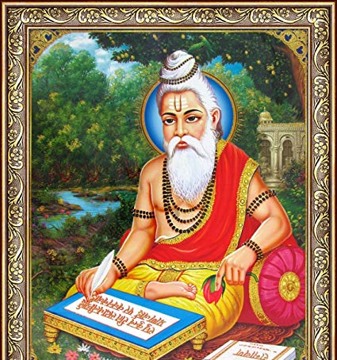
Compiler of the Puranas
Mahrishi Vyasa is the compiler of the Puranas
He is revered as a rishi (Prophet), God-fearing and pious man.
He also wrote the Gita. Mahabarat.
Among the 18 volumes of Puranas there is one called the Bhavishya Puranas which talks about prophecies of things to come.

Slide 10
Prophecy 1
Bhavishya Purana

Slide 11
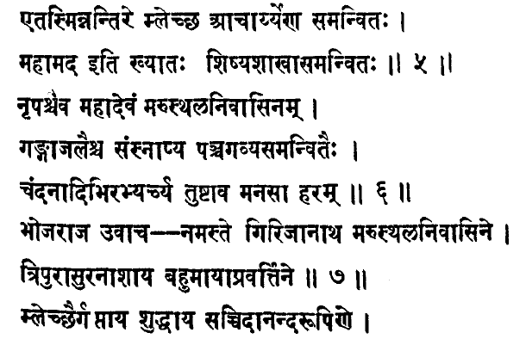
Prati Sarg, Parv 3, Adhyay 3, Shloka 5-8

Slide 12
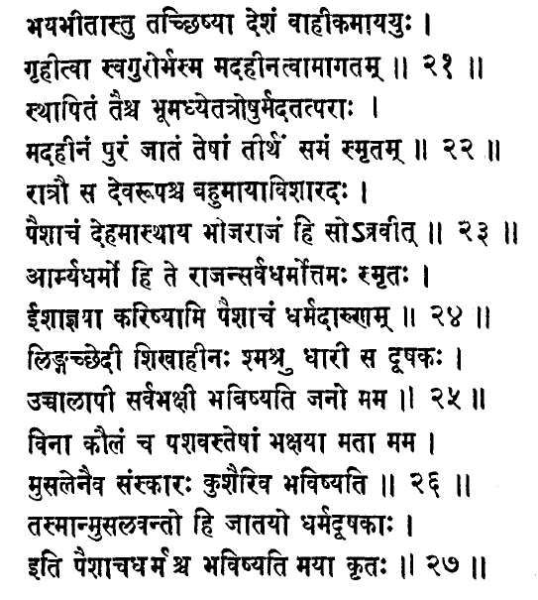

Slide 13
Prati Sarg, Parv 3, Adhyay 3, Shloka 5-8
“A Melchha Acharya will appear with his companions. His name will be Mahamad. Raja (Bhoj) after anointing this Mahadev Marusthal with bath in the Panchgavya and the Ganga water offered him the present of his sincere devotion and showing him all reverence said. 'I make obeisance to thee.' 'O Ye! the pride of mankind, the dweller in Arabia, Ye have collected a great force to kill the Devil and you yourself have been protected from the malechha opponents (idol worshipers, pagans).' ‘O Ye! the image of the Most Pious God the biggest Lord, I am a servant to thee, take me as one lying on thy feet.'

Slide 14
Defining some key words:
Melchha - A foreigner (belonging to foreign country and speaking forieign language
Acharya – Spiritual/Religious teacher
Mahamad – The name of the one being described
Mahadev
Marusthal- this is the Sanskrit word meaning “sandy tract” or “desert land” – ie: Arabia.
Panchgavya – This is a paste misture made from 5 products of the cow (milk, butter etc). Used to anoint people with like Sandal wood in Arabian tradition or Frankincense in Judeo-Christian tradition.
Ganga – Ganga is the Sanskrit word for the River Ganges or Holy Water.

Slide 15
Prati Sarg, Parv 3, Adhyay 3, Shloka 5-8
“A Foreign spiritual teacher will appear with his companions. His name will be Mahamad. Raja (Bhoj) after anointing this Great man from Arabia with bath in the Panchgavya (anointment milk) and the Holy/pure water offered him the present of his sincere devotion and showing him all reverence said. 'I make obeisance to thee.' 'O Ye! the pride of mankind, the dweller in Arabia, Ye have collected a great force to kill the Devil and you yourself have been protected from the foreign opponents (idol worshipers, pagans).' ‘O Ye! the image of the Most Pious God the biggest Lord, I am a servant to thee, take me as one lying on thy feet.'

Slide 16
Analysis of the Prophecy
The name of the man has been stated clearly as Mohammad/Mahamad/Muhamammd (saw).
He will belong to Arabia. The Sanskrit word Marusthal means a sandy track of land o a desert.
Special mention is made of the companions of the Prophet as “a great force” i.e. the Sahabas. (Historically no other Prophet in history or claimant to Prophethood has had as many companions as Prophet Muhammad (he had over 100,000).
He is referred as the pride of mankind (Parbatis nath). The Glorious Qur’an reconfirms this - "And thou (standest) on an exalted standard of character" [Al-Qur'an 68:4] and "You will find, indeed in the Messenger of Allah, a beautiful pattern (of conduct)". [Al-Qur’an 33:21]
He will be purified (Could be referring to the incident of the opening of the chest).
He will kill the devil, i.e. abolish worship of other gods and evil actions.
He will be given protection against his enemy.
He will be an image of God (eg: meaning speak only from revelation and uphold God’s law)
The Maharishi revers him by calling himself his servant and “sitting at his feet”.

Slide 17
Prophecy 2
Bhavishya Purana

Slide 18
Bhavishya Purana in the Pratisarag Parv 3, Khand Adhay 3, Shloka 10 - 27
"The Malecha (foreigners) have spoiled the well-known land of the Arabs. Arya Dharma (true religion) is not to be found in the country. Before also there appeared a misguided fiend whom I had killed; he has now again appeared being sent by a powerful enemy.
To show these enemies the right path and to give them guidance, the renowned Mahamad, is busy in bringing the Pishachas (evil-doers) to the right path. O Raja, You need not go to the land of the foolish Pishachas (evil-doers), you will be purified through my kindness even where you are...

Slide 19
Continued…
….At night, he of the angelic disposition, the shrewd man, in the disguise of Pishacha (evil-doer) said to Raja Bhoj, "O Raja! Your Arya Dharma has been made to prevail over all religions, but according to the commandments of Ishwar Parmatma (All-mighty God), I shall enforce the strong creed of the meat-eaters. My followers will be men circumcised, without a shandy (tail on his head), keeping a beard, creating a revolution, they will give the call to prayer and will be eating all lawful things. They will eat all sorts of animals except swine. They (him and his followers) will not seek purification from the holy shrubs, but will be purified through warfare, on account of their fighting the irreligious nations, they will be known as Musalmaans (Muslim). I shall be the originator of this religion of the meat-eating nations."

Slide 20
Analysis of the Prophecy
The evil doers have corrupted the Arab land.
Arya Dharma is not found in that land.
The Indian Raja need not go the Arab land since his purification will take place in India after the musalmaan will arrive in India.
The Prophet is mentioned by name “Mahamad”
The coming Prophet will attest the truth of the Aryan faith, i.e. Monotheism and will reform the misguided people.
The Prophet’s followers will be circumcised.
They will be without a tail on the head

Slide 21
Analysis of the Prophecy
They will have a beard and will create a great revolution.
They will announce the Call to prayer.
He (Muhamamd) will only eat lawful things and animals but will not eat pork.
The companions will not purify themselves with shrubs (meaning, they won’t be vegetarians) like the Hindus but by means of warfare they will fight their irreligious people.
They will be called musalmaan (meaning Muslims or “those that submit”)
They will be a meat-eating nation.
The Religion shall be divine (originated by God).

Slide 22
Prophecy 3
Bhavishya Purana

Slide 23
Bhavishya Purana, Parv 3, Khand 1, Adhay 3, Shloka 21-23:
"Corruption and persecution are found in seven sacred cities of Kashi, etc. India is inhabited by Rakshas, Shabor, Bhil and other foolish people. In the land of Malechhas, the followers of the Malechha dharma (foreign religion) are wise and brave people. All good qualities are found in Musalmaans and all sorts of vices have accumulated in the land of the Aryas. His dharma will rule in India and its islands. Having known these facts, O Muni, glorify the name of thy lord".

Slide 24
Analysis of the Prophecy
At the time of the advent of this Malecha Rishi (foreign Prophet) the land of India will be inhabited by evil-doers, corruption and persecution.
The followers of the Malecha are wise and brave people.
All good qualities are found in them.
The Religion will rule India and nearby islands

Slide 25
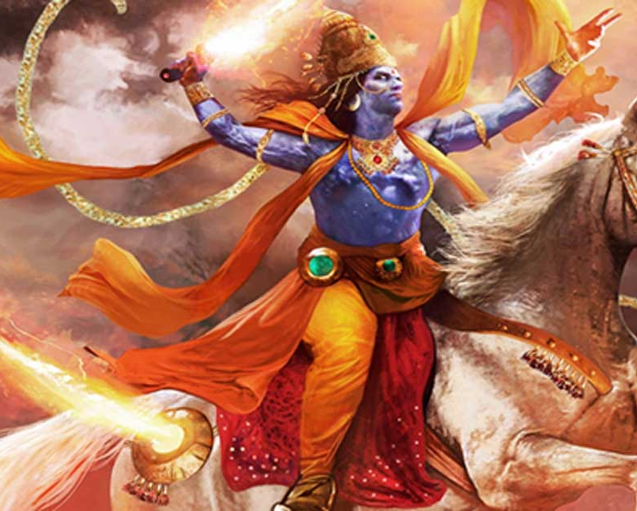
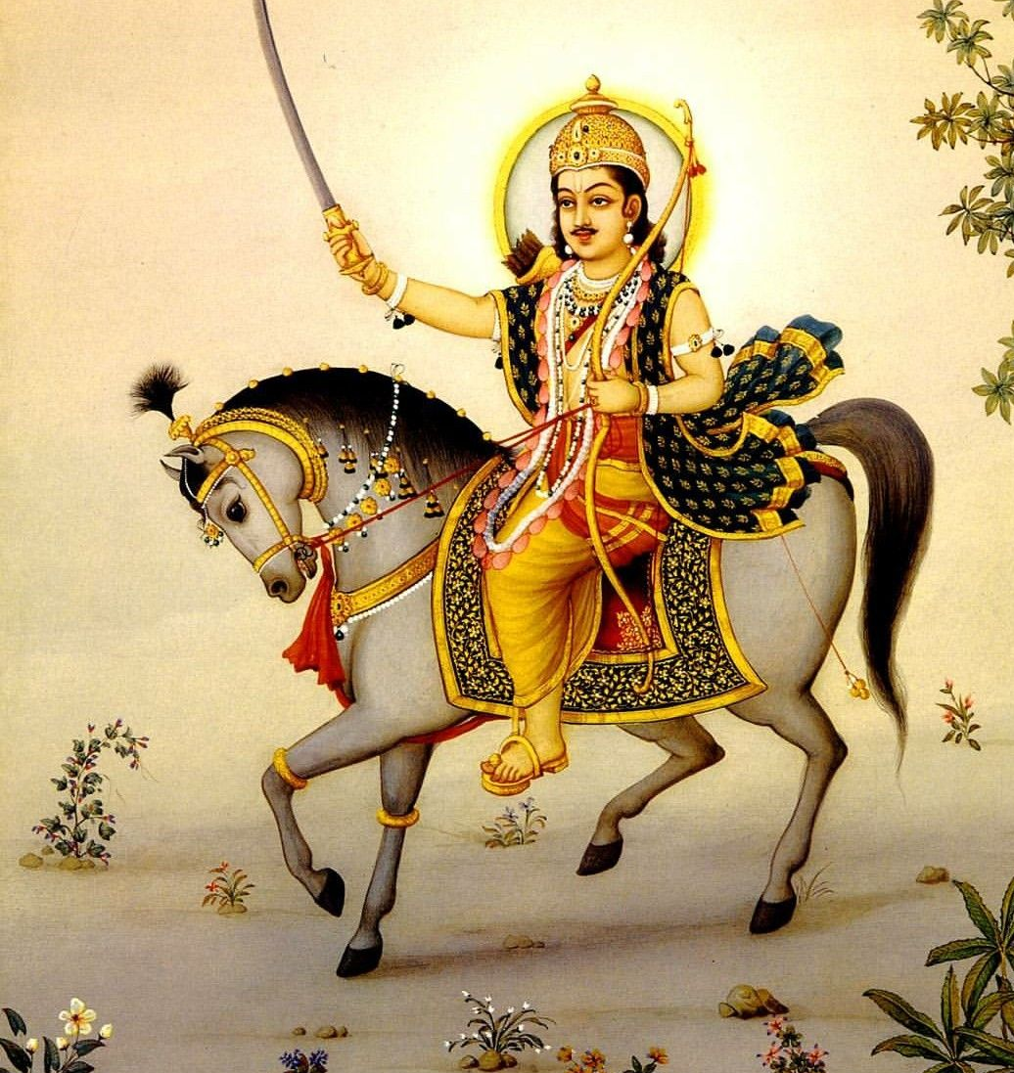
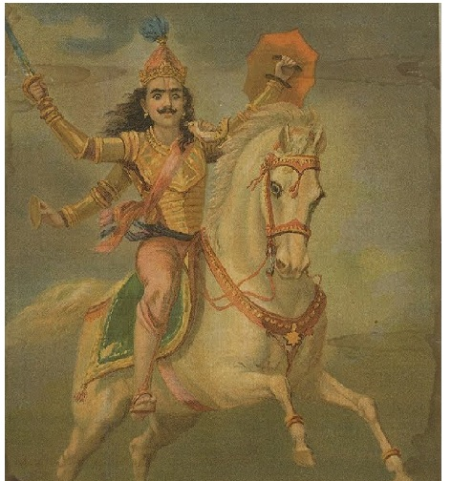
PART 3b
Prophecies of the
Kalki Avatar

Slide 26
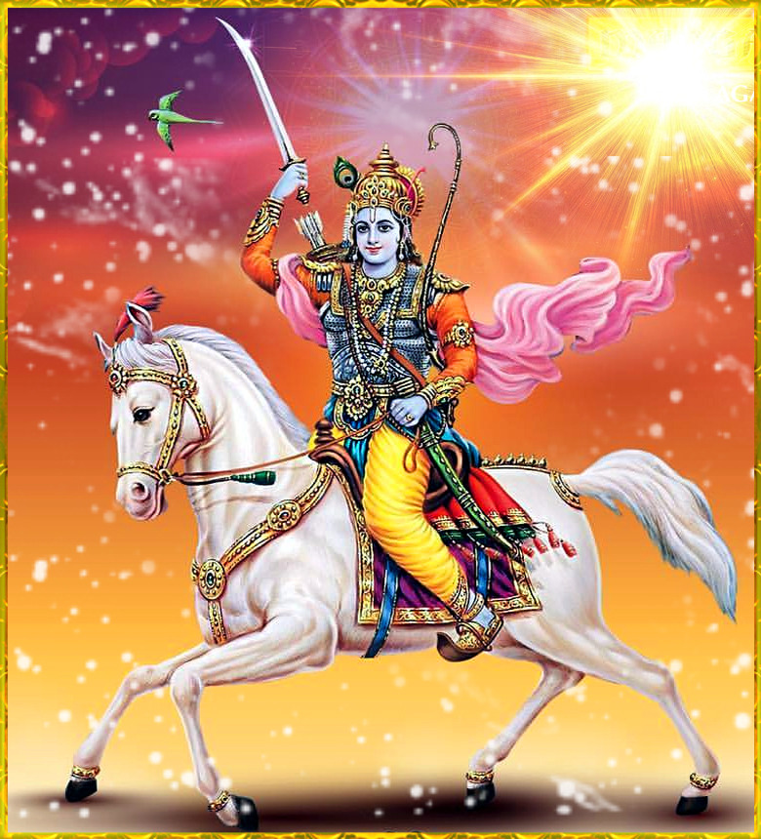
What is Kalki Avatar?
Oxford Dictionary: “In Hindu belief, a manifestation of a deity or released soul in bodily form on earth; an incarnate divine teacher. The word comes from Sanskrit avatāra ‘descent’.
Kalki means final or Last – So Kalki Avatar means “Final one sent down”

Slide 27
Prophecy 4a
Bhagvat Geeta (12:2:17)
"Adorned with eight qualities and riches, riding a swift white horse given to him by the Angels, and with a sword in his hand, the savior of the world will subdue all the mischief makers."

Slide 28
Prophecy 4b
Kalki Purana (2:25)
“….He will be born on the twelfth of the bright fortnight, of the month of Madhav."

Slide 29
Prophecy 4c
Bhagvata Purana Khand 12 Adhyay 2 shlokas 18-20:
“It is in the house of Vishnuyash, the noble soul Brahmana chief of the village called sambhala that Lord Kalki will be incarnated”.
Kalki Purana,2:4 and 11 –
“He will be born to Sumati”

Slide 30
Prophecy 4d
Kalki Purana 2 :4- 15
“the Kalki Avatar will go to the mountain, where he will receive knowledge from Parshuram, then go towards the North, then come back”
With the help of four companions he will disarm Kali (Devil).
He will be assisted by angels in the battlefield-

Slide 31
Prophecy 4e
Kalki Purana 3:16:10
“Thereafter, he (Kalki Avatar) duly entertained all those who were born again, with all kinds of food that can be chewed, sucked, sipped, or drunk, food that are baked and cakes and food made of grains, and fresh meat, and fruits and vegetables”

Slide 32
Prophecy 4f
Kalki Purana 3:16:2-4
2:“When he mounts the throne of the King, everyone will be delighted and everything will be well taken care of, viz. the Vedas, religion, the Sages of the Age of Truth, all other Sages, and all living beings both mobile and fixed.
3: In the previous age, the born-again worshippers used to decorate the statues of gods (idol worship) with precious jewels and used to charm people by casting magical spells on them. He will come to stop all that.
4: When Kalki assumes the role of the King, nowhere will be seen the crafty rogues, creating the illusion of saints with tilak (marks of sandal paste] on their foreheads."

Slide 33
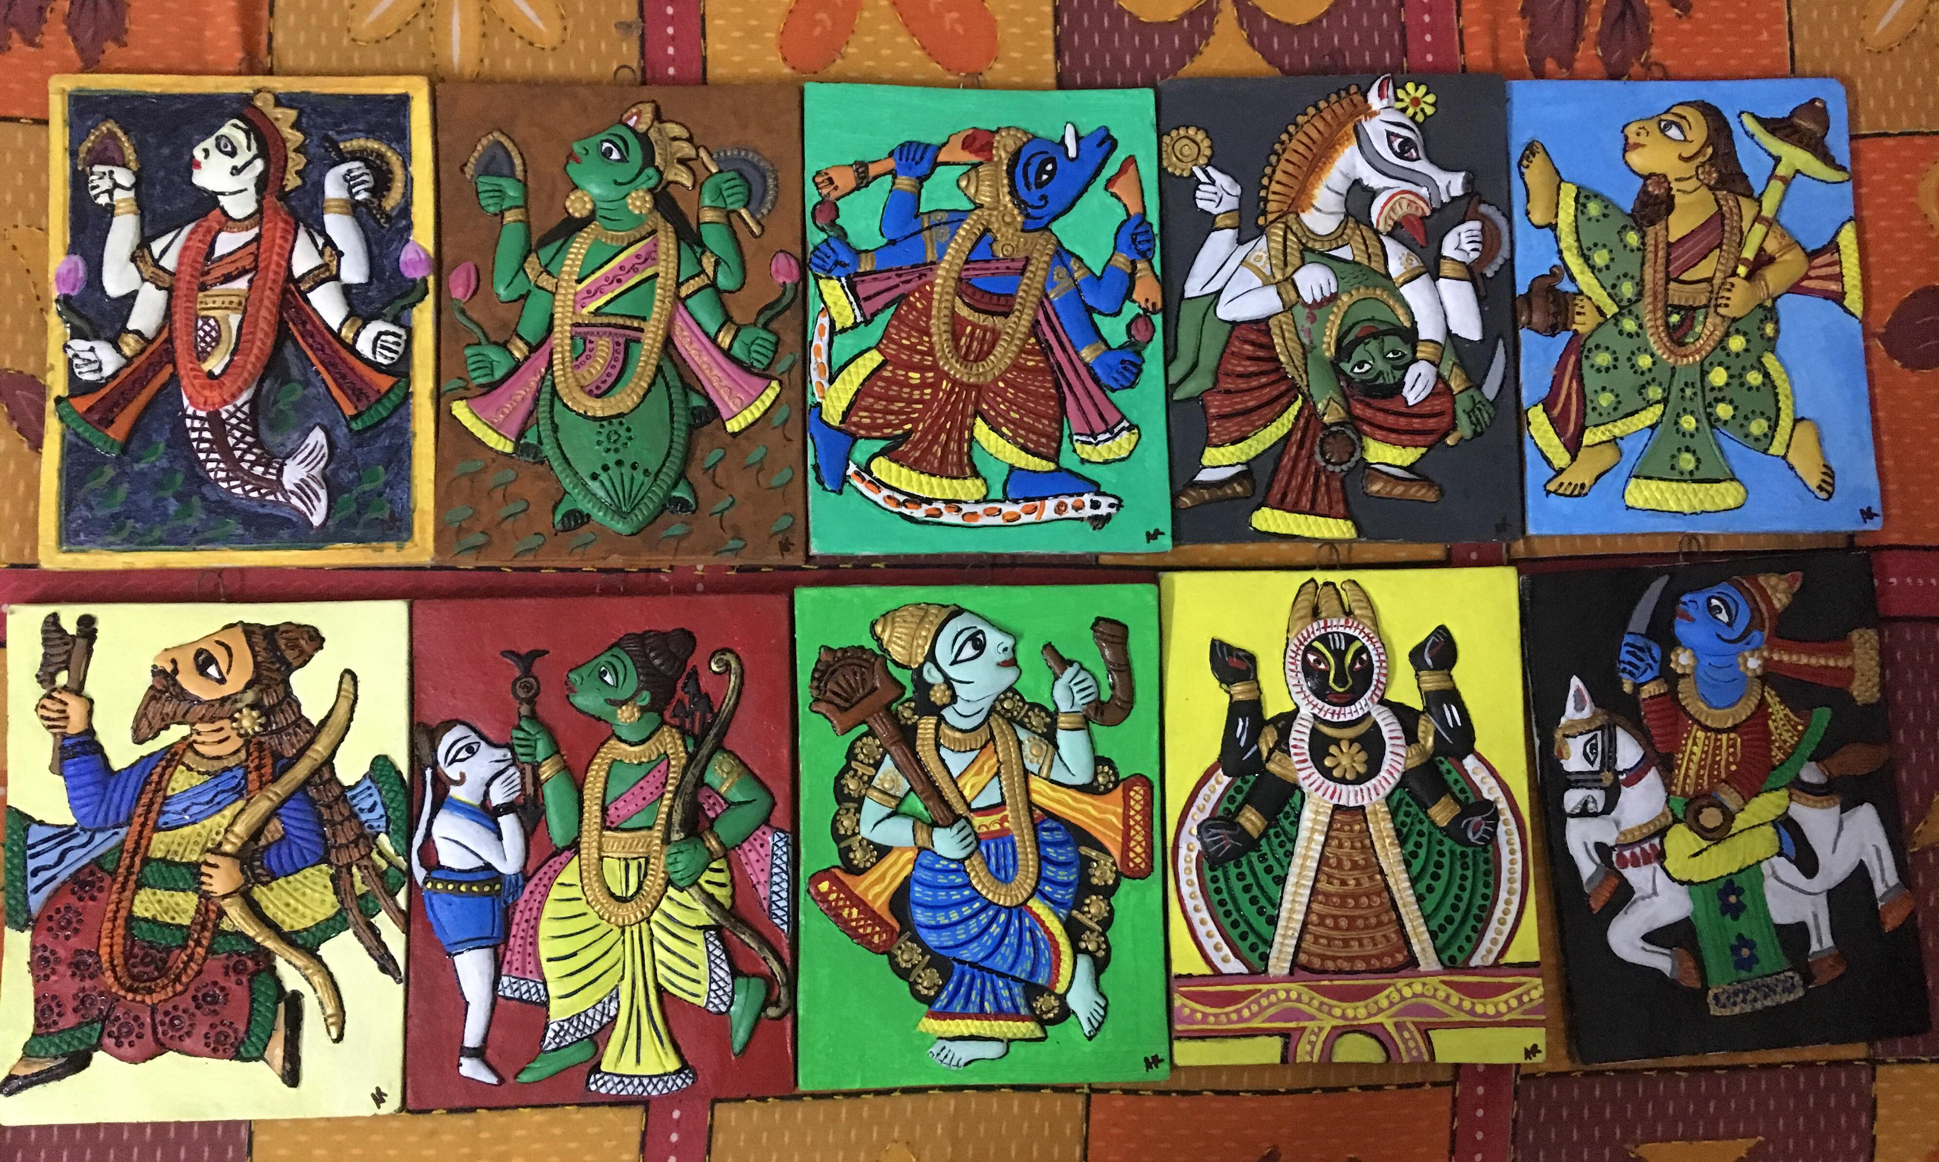
The paintings of the 10 Avatars

Slide 34
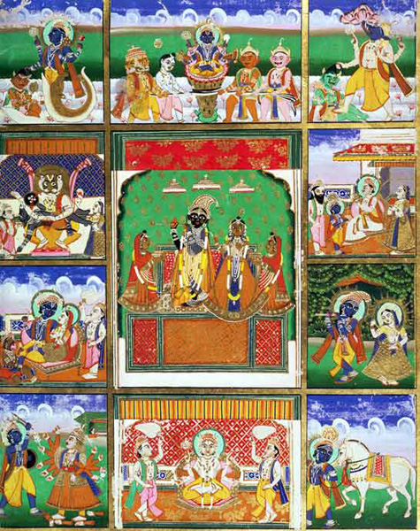
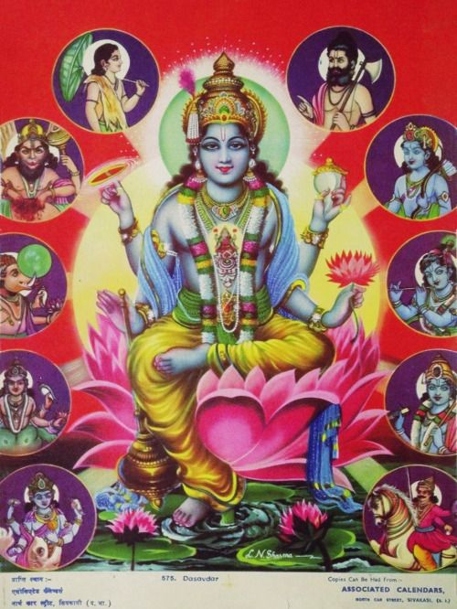

Slide 35
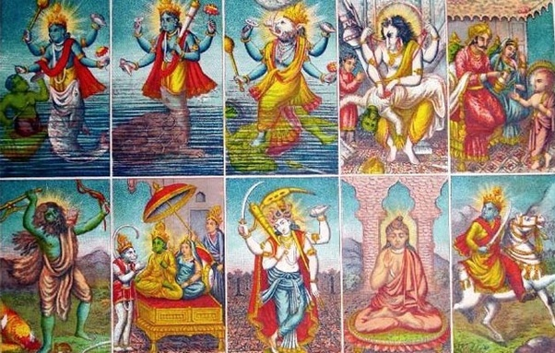

Slide 36
PART 3C
Muhammad prophesized with his common titles

Slide 37
Prophecies 5
Prophesized by name “Ahmad”

Slide 38
Vedas Samveda Yajurveda Rigveda Atharvaveda
Samveda Uttararchika, mantra 1500
(Samveda Part 2 Book 7 chapter 1 section 5 verse 1) and
Samveda Indra chapter 2 mantra 152
(Samveda Book 2 chapter 2 decade 1 verse 8)
Yajurveda chapter 31 verse 18
Rigveda Book 8 hymn 6 verse 10
Atharvaveda Book 8 chapter 5 verse 16
Atharvaveda Book 20 chapter 126 verse 14
Part II, Book 7 chapter 1 section 5 verse 1 and Samved Indra chapter 2 mantra 152 Book 2 chapter 2 decade 1 verse 8)
“Ahmad acquired from his Lord the knowledge of eternal law. I received light from him just as from the sun”.

Slide 39
Prophecies 6
Prophesized as Narashansah

Slide 40
Atharvaveda (20:9:31)
Mantra 1
He is narashansah
He is Kaurama the prince of peace or the emigrant, who is safe even amongst a host of 60,090 enemies.
Mantra 2.
He is a camel-riding Rishi, whose chariot touches the heaven.
Mantra 3.
He is Mamah Rishi.
Mantra 4
Vachyesv rebh (‘Oh! Ye who glorifies.’)

Slide 41
Atharvaveda (20:9:31)
Mantra 5
“The followers of, of the “one who praises” are marching ahead with praise of the Lord on their lips; while back home their children are waiting anxiously for their return”
Mantra 6
“Oh Rishi Reva arm yourself with Wisdom and Hyms of Praise
Mantra 7
He will assume the power of a king and establish peace among the people. His message of peace and justice will be for mankind.
Mantra 11
“the one who praises (the Lord)”
Mantra 14
We glorify or praise the great hero with a song of praise and a prayer. Please accept this praise so that evil may not befall us.

Slide 42
Prophecies 7
Prophesized as Narashansah in
Rigveda / Samveda / Yajurveda

Slide 43
“Narashansa” (Praised one)
Rigveda Book 1 hymn 13 verse 3
Rigveda Book 1 hymn 18 verse 9
Rigveda Book 1 hymn 106 verse 4
Rigveda Book 1 hymn 142 verse 3
Rigveda Book 2 hymn 3 verse 2
Rigveda Book 3 hymn 29 verse 11
Rigveda Book 5 hymn 5 verse 2
Rigveda Book 7 hymn 2 verse 2
Rigveda Book 10 hymn 64 verse 3
Rigveda Book 10 hymn 182 verse 2
Samveda Uttararchik mantra 1349
Yajurved chapter 29 verse 27
Yajurved Book 1 chapter 6 verse 4
Yajurved Book 1 chapter 7 verse 4
Yajurved chapter 20 verse 37
Yajurved chapter 20 verse 57
Yajurved chapter 21 verse 31
Yajurved chapter 21 verse 55
Yajurved chapter 28 verse 2
Yajurved chapter 28 verse 19
Yajurved chapter 28 verse 42

Slide 44
Prophecies 8
Kabah described in Atharvaved

Slide 45
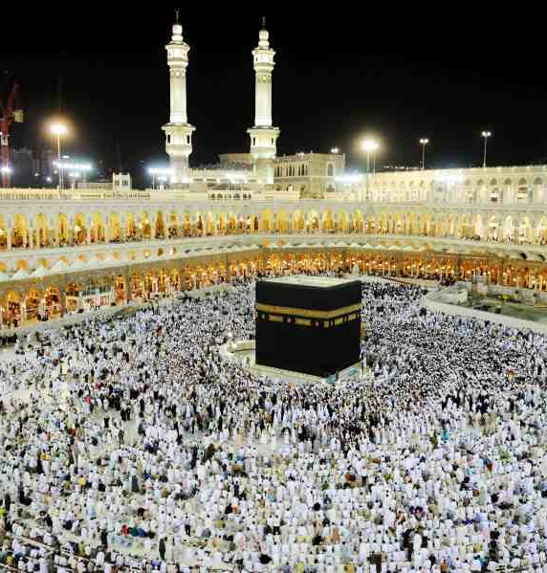
"Whether it is built high, its walls are in a straight line or not, but God is seen in every corner of it. He who knows the House of God, knows it because God is remembered there. This abode of the angels has eight circuits and nine gates. It is unconquerable, there is eternal life in it and it is resplendent with Divine light."
"Brahma (Abraham) stayed in this abode which is illumined by heavenly light and covered with Divine blessings. It is the place that gives (spiritual) life to the people and is unconquerable."

Slide 46
END OF PART 3

Slide 47
References
Abdul Haque Vidyarthi. (1940). Mohammad in world scriptures. Lahore: Dar-ul-Kutub Islamia.
Upaddhay, V., Alamgir, M. and Bandhopaddhay, A. (n.d.). Muhammad in the Hindu scriptures.
https://www.youtube.com/watch?v=nTu7YLSustw
https://www.islamawareness.net/Hinduism/ZakirNaik/part6.html
https://www.jagatgururampalji.org/en/articles/post/bhagavad-purana-kalki-avatar-prophet-muhammad
https://www.islamawareness.net/Hinduism/hindu.html
http://www.cyberistan.org/islamic/prophhs.html#mahamad
https://www.sacred-texts.com/hin/

