Slide 1
Muhammad(saw) in World Scriptures
The Study of Prophecies in world religious scriptures
By: Moneeb Minhas

Slide 2
Disclaimer
This lecture was requested from a non-muslim audience (attendees of the weekly prophetic biography course), merely out of curiosity on “The prophecies about the arrival of the last Messenger in religious world scriptures– Prophet Muhammad”
This lecture is not a debate, or in any way to put down any other opinion, but merely an academical study of religious texts or comparative religion.
Those present are here voluntarily and have the right to leave whenever they will.
We acknowledge that we are all coming from different backgrounds, cultures and religions. We understand that we all differ on certain views and this should not instil hatred or intolerance for one another, but rather as teachers, professionals, academics and humans we should practice, preach and promote tolerance, love and respect for one another.
This lecture series may contain views that are contrary to others and we apologise if anything is taken offensively. Any offence occurred is purely unintentional.
This lecture series will try and give the attendees an insight into the various religious texts, prophecies and how Islamic scholars analyse them academically.
This lecture series is in no means designed to convert or enforce an opinion on someone else. It is just one the analysis of religion from a perspective.

Slide 3
PART 2:
Muhammad in Judeo-Christian Scriptures
(Old Testament & New Testament)

Slide 4
Contents to Lecture Series
PART 1 - Introduction to Prophecies
PART 2 - Muhammad (s) in Judeo-Christian Scriptures
PART 3 - Muhammad (s) in Hindu Scriptures
PART 4 - Muhammad (s) in Zoroastrian & Buddhist Scriptures

Slide 5
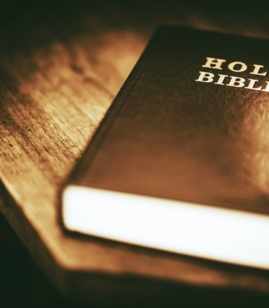
The Bible

Slide 6
Bible
Old Testament
New Testament

Slide 7
Books and Authors of the Bible
OLD TESTAMENT
NEW TESTAMENT

Slide 8
“Those who follow the Messenger, the unlettered Prophet whom they find written in the Torah and the Gospel with them. He enjoins upon them that which is right and forbids for them that which is evil.”
Quran 7:157

Slide 9
“And [mention] when Jesus, the son of Mary, said, "O children of Israel, indeed I am the messenger of Allah to you confirming what came before me of the Torah and bringing good tidings of a messenger to come after me, whose name is Ahmad."
Muhammad
the Praisworthy
Ahmad
much praised
Mahmoud
the praised one
Quran 61:6

Slide 10
Question
Do you think Prophet Muhammad (saw) is mentioned in the Bible?

Slide 11
God and Jesus warn the Jews in a few places, preparing them for the new Prophet, or new people
(OT) Deuteronomy 31:27
“They have provoked Me to jealousy by what is not God; They have moved Me to anger by their foolish idols. But I will provoke them (Jews) to jealousy by those who are not a nation; I will move them to anger by a foolish nation.”
(NT) Matthew 21:43
“Therefore I say unto you (Jews), the Kingdom of God shall be taken away from you (Jews), and shall be given to a nation bringing the fruits thereof.”

Slide 12
PART 2A
Muhammad (saw) prophesied in the Old Testament

Slide 13
Prophecy 1
Old Testament

Slide 14
John 1:19-20
“And this is the record of John (the Baptist), when the Jews sent priests and Levites from Jerusalem to ask him, Who art thou? And he confessed, and denied not; but confessed, I am not the Christ. And they asked him, What then? Art thou Elias? And he saith, I am not. Art thou that Prophet? And he answered, No.”

Slide 15
Deuteronomy 18:18
“I (God) will raise them up a Prophet from among their brethren, like unto thee (Moses), and will put my words in his mouth; and he shall speak unto them all that I shall command him.”

Slide 16
The Promised Prophets description
Among their brethren
Someone similar to Moses
God will dictate his words to him

Slide 17
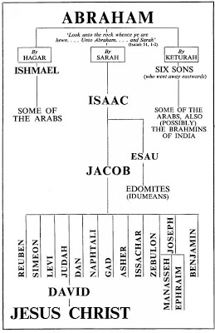
Among their brethren
Genesis 16:12
'AND HE (ISHMAEL) SHALL DWELL IN THE PRESENCE OF ALL HIS BRETHREN.'

Slide 18
A Prophet like Moses
Deuteronomy 34:10
“And there arose NOT a prophet since in Israel LIKE unto Moses.”

Slide 19
Moses (peace be upon him) | Jesus (peace be upon him) | Muhammad (peace be upon him)
Natural Birth | X | /
Had a Father and Mother | X | /
Married | X | /
Had Children | X | /
Died naturally | X | /
Prophet | X | /
Brought New law | X | /
Ruled as King | X | /
Had a worldly kingdom | X | /
Forced to migrate | X | /
Fought with enemies | X | /
Revelation written at his time | X | /
Rejected first then accepted by his people | X | /
Born in the House of Israel | / | X

Slide 20
Words in his mouth
114 chapters of the Quran and 113 of them begin with:
“In the name of God…”

Slide 21
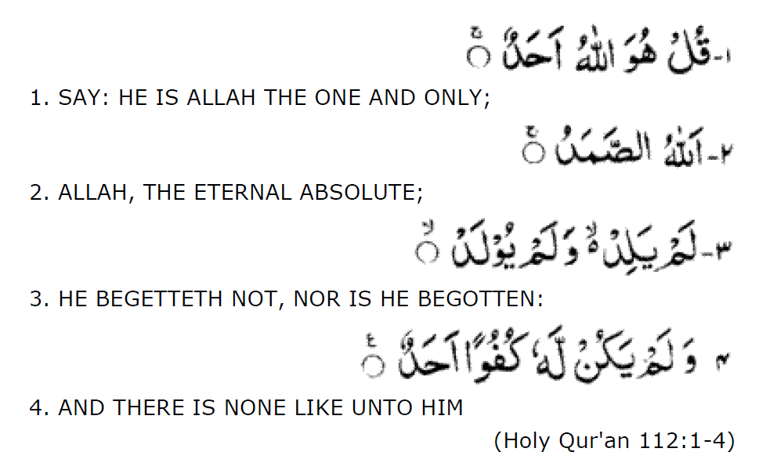
Words in his mouth

Slide 22
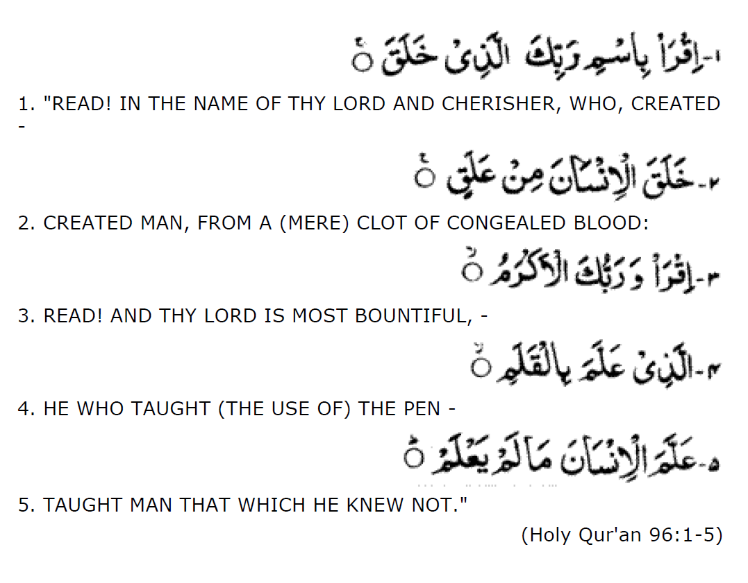
Words in his mouth
First verses to be revealed to Muhammad:
READ
RECITE
REPEAT

Slide 23
Prophecy 2
Old Testament

Slide 24
Isaiah 29:12
“And the book is delivered to him who is unlearned, saying read, I pray thee; and he replied I am not learned”

Slide 25
Prophecy 3
Old Testament

Slide 26
Isaiah 21:7
Isaiah’s vision:
“And he saw a chariot [with] a couple of horsemen, a chariot of asses, [and] a chariot of camels.”
Horsemen…to represent Solomon’s reign
Donkeys…to represent reign of Jesus Christ
Camels…to represent reign of Prophet Muhammad.

Slide 27
Prophecy 4
Old Testament

Slide 28
Isaiah 42
“Here is my servant, whom I uphold, my chosen one in whom I delight; I will put my Spirit on him, and he will bring justice to the Gentiles.
He will not raise his voice in the marketplace…. In faithfulness he will bring forth justice; he will not falter or be discouraged till he establishes justice on earth…In his teaching the islands will put their hope.” I will give you for a covenant of humanity, for a light of the Gentiles…sing unto the Lord a new song (law)…the villages that Kedar inhabits, let the people of Sela sing for joy…I will not forsaken them…They will be greatly ashamed, those who trust in idols and carved images and say ‘You are our gods!”

Slide 29
Titles of Prophet Muhammad mentioned
Servant of God - Abdullah
Chosen one - Mustafah

Slide 30
Gentiles
Anyone who is non-Jew. This includes
Arabians
Persians
Indians
etc

Slide 31
He will not raise his voice in the marketplace
Direct description of Prophet Muhammad (saw) if you read his biography and the trips he took during trading. People described him as:
Al Amin (The trustworthy) truthful during selling
The one who does not raise his voice during selling

Slide 32
Islands
Could refer to Saudi Arabia as its an island off the coast

Slide 33
New song (Law)
Quran which is a new law and book of guidance.

Slide 34
Meaning of Kedar

Slide 35
Kedar is a person from the sons of Ishmael According to the Bible
Genesis 25:13
These are the names of the sons of Ishmael, listed in the order of their birth: Nebaioth the firstborn of Ishmael, Kedar, Adbeel, Mibsam, Mishma, Dumah, Massa, Hadad, Tema, Jetur, Naphish and Kedemah

Slide 36
Meaning of Kedar
Ezekiel 27:21
Arabia and all the princes of Kedar were your favored dealers in lambs, rams, and goats; in these they did business with you.
Charles Foster (Famous Bible Scholar) locates Kedar in Arabia.

Slide 37
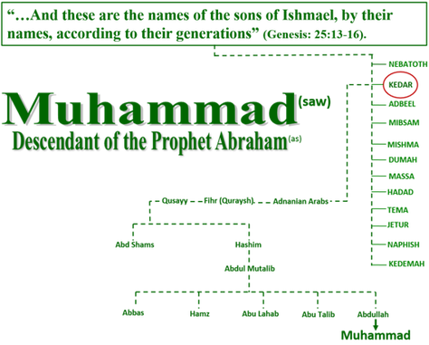
Kedar is also in the family tree of the Prophet.

Slide 38
Meaning of Sela

Slide 39
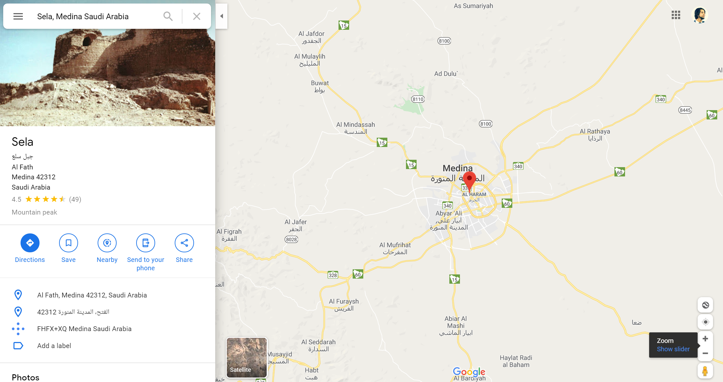
Sela – A Mountains name in Medina

Slide 40
Those who believe in idols will be put to shame
This is referring to the time of Prophet Muhammad where all the inhabitants of Makkah and Arabia worshipped idols that were kept in the Kaba.
There were over 300+ idols in the Kaaba. All were considered diety and given the title of gods.

Slide 41
Prophecy 5
Old Testament

Slide 42
Habakkuk 3:3
“God (his guidance) came from Teman, and the Holy One from mount Paran. Sela. His glory covered the heavens, and the earth was full of his praise.”
Again a mention of Paran and Sela, in the same text and context.

Slide 43
Prophecy 6
Old Testament

Slide 44
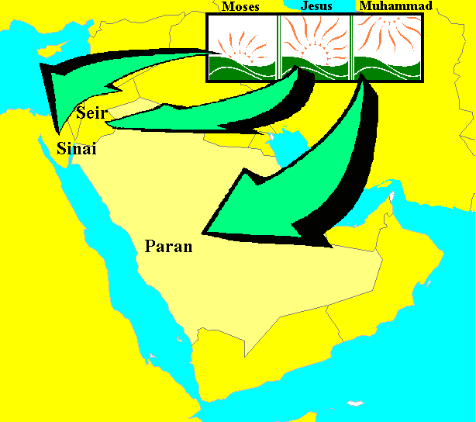
Deuteronomy 33:1
“And this [is] the blessing, wherewith Moses the man of God blessed the children of Israel before his death. And he said, The LORD came from Sinai, and rose up from Seir unto them; he shined forth from mount Paran, and he came with ten thousands of saints: from his right hand [went] a fiery law for them.”

Slide 45
Location of Paran

Slide 46
Location of Paran
According to the Bible - The wilderness of Paran is where Abraham's wife Hagar and his eldest son Ishmael, the father of the Arabs, settled (Genesis 21:21) in the Arabian desert. The Old Testament tells us that Ishmael dwelt in a place called Paran:
Genesis 21:21 –
“Then God opened her eyes, and she saw a well of water (zamzam). And she went and filled the skin with water, and gave the boy a drink. So God was with the boy; and he grew and dwelt in the desert, and became an archer. He (Ishmael) dwelt in the Desert of Paran, his mother got a wife for him from Egypt.

Slide 47
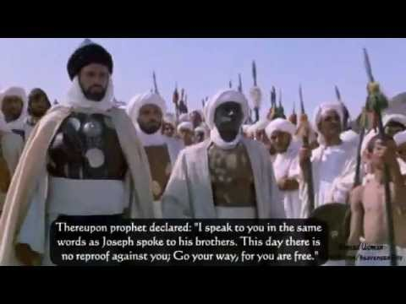
Shined from Mount Paran.
(Paran is the location in Arabia, Makkah)
Came with 10,000 saints
(In the conquest of Makkah, when Prophet Muhammad returned back with his army of companions into Makkah, he came with 10,000 of his companions)
Came with a new fiery Law
(He brought with him the new law which he called the Holy Quran)

Slide 48
Prophecy 7
Old Testament

Slide 49
God speaks about Arabia and Ishmael
Ishmael is Abraham’s son
“And Abraham took Ishmael his son.” Genesis 17:23
Abraham will be made father to many great nations
“As for me, behold, my covenant [is] with thee, and thou shalt be a father of many nations.” Genesis 17:4
Ishmael’s progeny will be made into a great nation
Also, “And also of the son (Ishmael) of the bondwoman (Hagar) will I make a nation, because he [is] thy seed. ......... I will make him a great nation.” Genesis 21:13
The divine message will also go through Isaiah
“The burden upon Arabia” – Isaiah 21:13
What does the word "burden" mean? Let us ask the Scofield Study Bible:
"…which also means an oracle is a word sometimes used in the prophetical writings to indicate a divine message of judgment" (Scofield Study Bible New King James Version, note 1, p. 792)

Slide 50
PART 2B
Muhammad (saw) prophesied in the New Testament

Slide 51
Prophecy 8
Old Testament

Slide 52
John 14:16
“And I will pray the Father, and he shall give you another Comforter, that he may abide with you forever”
John 14:26
“But the Comforter, the Holy Spirit, whom the Father will send in my name, he shall teach you all things, and bring all things to your remembrance, whatsoever I have said unto you.”
John 15:26
“But when the Comforter is come, whom I will send unto you from the Father, [even] the Spirit of truth, which proceedeth from the Father, he shall testify of me”

Slide 53
John 16:7-14
“Nevertheless I tell you the truth; It is expedient for you that I go away: for if I go not away, the Comforter will not come unto you; but if I depart, I will send him unto you…….I have many things to say unto you, but You cannot bear them now, howbeit when he, the Spirit of truth, is come, he will guide you into all truth: for he shall not speak of himself; but whatsoever he shall hear, [that] shall he speak: and he will show you things to come. He shall glorify me: for he shall receive of mine, and shall declare it to you.”

Slide 54
Analysis of the prophecies in NT
Jesus calls him Spirit of truth (the word Holy is not in the original manuscripts)
Jesus says “Another”.
Jesus must go away for him to come.
He will teach new things and tell things to come
He will bring things to peoples remembrance
He will testify of Jesus
He will glorify Jesus
He will not speak of himself, but what he hears.
Masculine “He” has been used x9.
Jesus calls him Paracletos (Greek for Comforter/ Advocate/ Counselor/ Helper/ Companion / Friend)

Slide 55
Jesus calls him Spirit of truth
We learn from the Bible itself that the word Spirit can apply to a human and not always the Holy Spirit:
Example: “Beloved, believe not every Spirit, but try the Spirits whether they are of God; because many false Prophets are gone out into the world. - 1 John 4:1

Slide 56
2. Jesus uses the words “Another”
The use of the word “Another” means a lot. As it means that one is already been and another will come similar to him.
In Epistle of John, John uses the same word “Parakletos” for Christ. –
“My little children, these things write I unto you, that ye sin not. And if any man sin, we have an advocate (parakletos) with the Father, Jesus Christ the righteous.” - 1 John 2:1

Slide 57
3. Jesus must go away for him to come.
“Nevertheless, I tell you the truth: It is expedient for yout hat I go: for If I Go Not Away, The Comforter Will Not Come unto you, but if I depart, I will send him to you” – John 16:7
This being (Spirit or Man) cannot be present if Christ is there.

Slide 58
4. He will teach new things and tell things to come
From Prophet Muhammad (saw) came: - Quran and Hadith
Both give guidance to mankind on many issues:
Past
Present
Concept of God (Theology)
Concept of Prophets
Universality of religion
Science
Laws
Spirituality
Cleanliness
Daily lives
Ruling in different contexts
How to eat, slaughter, avoid illness, cook etc
Marriage, divorce
Death
Numerous prophecies on the future events and

Slide 59
Holy Ghost was there before Christ’s birth
Example 1.
“...and he (John the Baptist) shall be filled with the Holy Ghost, even from his mother's womb”. - Luke 1:15
Example 2.
“...and Elizabeth was filled with the Holy Ghost”. - Luke 1:41
Example 3.
“And his father Zacharias was filled with the Holy Ghost.” - Luke 1:67

Slide 60
Holy Ghost was there during Christ’s time
Example 1.
...and the Holy Ghost was upon him (Simeon) -Luke 2:26
Example 2.
And the Holy Ghost descended in a bodily shape like a dove upon him (Jesus).- Luke 3:22

Slide 61
5. He will bring things to peoples remembrance
Quran speaks about many of the Prophet stories mentioned in the Old and New Testament.
It clarifies things and concepts that have changed overtime in Biblical texts.
Quran says on many occasions
“Recall to them (Oh Muhammad) the events of …..”
“They ask you about……tell them…”

Slide 62
6. He will testify of Jesus 7. He will glorify Jesus
Quran has a full chapter dedicated to the story of Christ (as), his mother Mary and the father of Mary (as). – Surah Maryam
Jesus is mentioned over 25x all in positive glorification. It says about him:
He raised people from the dead
He cured the blind, lepers and sick
He performed many miracles
He was born miraculously
He was a prophet of God
He was the anointed one (Masih / Messiah / Christ)
He was kind to his mother
Mentions his mother in a way no other woman in Bible or Quran has been mentioned – “…O Maryam, (Mary) surely Allah has chosen you and purified you and has chosen you over all the women of the worlds.” Quran 3:42

Slide 63
8.He will not speak of himself, but what he hears.
Revelation was given to Prophet Muhammad (saw). Called the Holy Quran
Quran testifies:
“Nor does he speak from (his own) inclination. It is not but a revelation revealed” – Quran - 53:3

Slide 64
9. Masculine pronoun “He” has been used x9.
Points towards a human figure or man and not a “spirit”.

Slide 65
10. Jesus calls him Paracletos
This Greek word “Paracletos” has been translated into so many different words: - Comforter/ Advocate/ Counselor/ Helper/ Companion / Friend)
See Soure: Showing different translations - https://www.biblestudytools.com/john/14-16-compare.html

Slide 66
Jesus speaks about the coming of: Paraclete/Paracletos Comforter / Spirit of Truth
Periclytos
Praised one - Ahmad/Muhammad

Slide 67
Prophecy 8
Old Testament

Slide 68
John uses the same word “Paracletos” when speaking about Jesus
“My little children, these things write I unto you, that ye sin not. And if any man sin, we have an advocate (paracletos)
with the Father, Jesus Christ the righteous.”
1 John 2:1
This word could be translated slightly wrong from the original. But because we only have the Greek we cannot judge this.
The word, regardless can

Slide 69
Prophecy 9
Old Testament

Slide 70
The Prophet test
1 John 4:2
“Beloved, do not believe every spirit, but test the spirits, whether they are of God; because many false prophets have gone out into the world. By this you know the Spirit of God: Every spirit that confesses that Jesus Christ has come in the flesh is of God, and every spirit that does not confess that Jesus Christ has come in the flesh is not of God. And this is the spirit of the Antichrist, which you have heard was coming, and is now already in the world.”

Slide 71
PART 2C
Muhammad (saw) mentioned by name in the Bible

Slide 72
Song of Solomon 5:16
“His mouth is most sweet, and he is altogether lovely. This is my beloved, and this is my friend, O daughters of Jerusalem”
Can you see the name Muhammad or Ahmad or Mahmoud there?
(Let’s listen in Hebrew)

Slide 73
Hebrew original text

Slide 74
In Original Hebrew
חִכּוֹ, מַמְתַקִּים, וְכֻלּוֹ, מַחֲמַדִּים; זֶה דוֹדִי וְזֶה רֵעִי, בְּנוֹת יְרוּשָׁלִָם
Source:
https://www.mechon-mamre.org/p/pt/pt3005.htm
Hebrew translation website
https://www.doitinhebrew.com/Translate/default.aspx?kb=IL+Hebrew+Phonetic
Google Translate
https://www.google.com/search?safe=strict&source=hp&ei=6dzeXe3AAbOxmgfFxbHQDg&q=hebrew+to+english+&oq=hebrew+to+english+&gs_l=psy-ab.3..0l10.2382.4302..4592...0.0..0.156.2458.0j19......0....1..gws-wiz.....0..0i131.q642IUpUr8o&ved=0ahUKEwit2crynYvmAhWzmOYKHcViDOoQ4dUDCAY&uact=5

Slide 75
Meaning of “im”
“im” are letters added at the end of words in Hebrew that require utmost respect. It makes the word plural, but plural of respect and grandeur.
Another example is gods name in bible is used about 70 times in the Old Testament as “Elah” or “Eloh” or “El” but it appears as “Elohim” in the Bible

Slide 76
Other descriptions in Song of Solomon
Song of Solomon also calls him:
“The beloved one of God”. (Habibullah)
“My beloved is white and ruddy”.(his complexion)
“Chief among then thousands”. - He lead a conquest of 10,000 to Makkah.

Slide 77
END OF PART 2

Slide 78
Muhammad in Bible Links
https://www.youtube.com/watch?v=-_gF_maxocY
This links goes through Isaiah and his prophecy about Muhammad to come to Arabia.

Slide 79
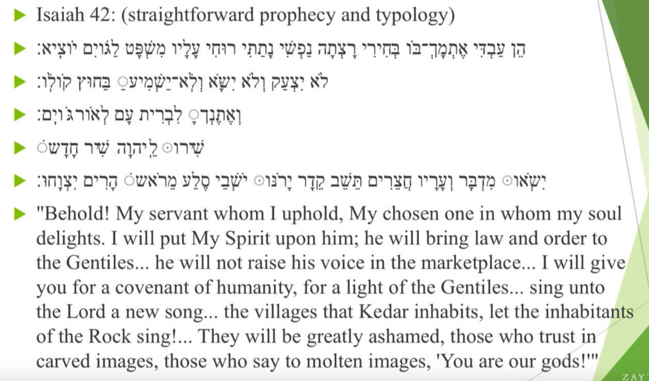
Muhammad in Bible

Slide 80
https://www.youtube.com/watch?v=hfLJmJSrppY
1.07

Slide 81
Types of prophecy studies within Christianity
Prophecies or verses in Bible and Quran and other religious texts have an Exoteric and Esoteric aspects.
Give examples of both. Mention the parameters of it though.

Slide 82
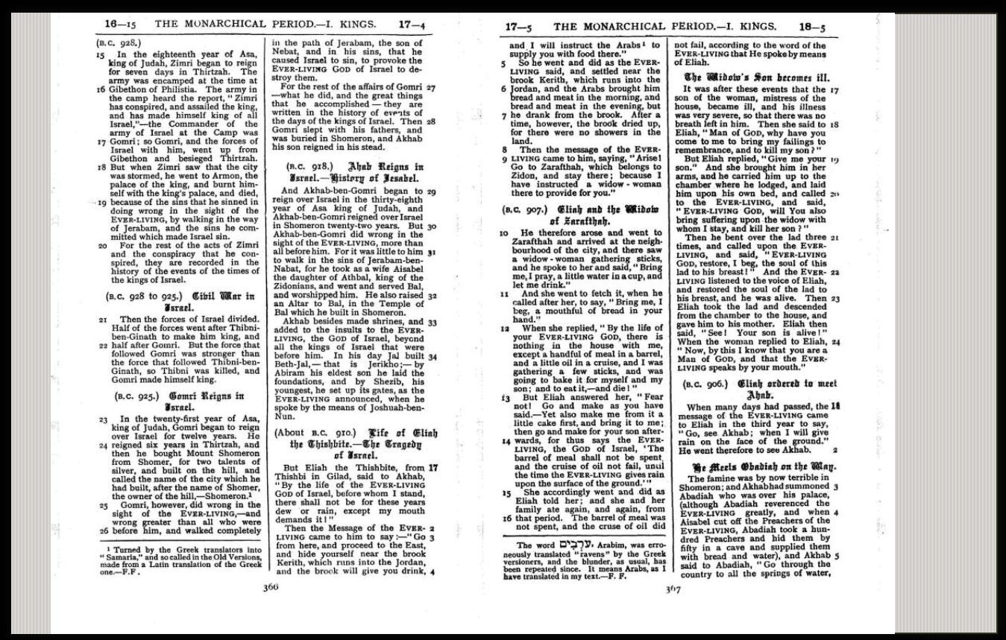
1 Kings 17:6 – Mentions word Arab.

Slide 83
Muhammadim

Slide 84
References
Abdul Haque Vidyarthi. (1940). Mohammad in world scriptures. Lahore: Dar-ul-Kutub Islamia.
COMPARING BIBLES: https://www.biblestudytools.com/1-kings/17-4-compare.html
Lectures of Dr Shabir Aly
Lectures of Sheikh Ahmed Deedat
Lectures of Dr Zakir Naik

