Slide 1
Muhammad(saw) in World Scriptures
The Study of Prophecies in world religious scriptures
By: Moneeb Minhas

Slide 2
Disclaimer
This lecture was requested from a non-muslim audience (attendees of the weekly prophetic biography course), merely out of curiosity on “The prophecies about the arrival of the last Messenger in religious world scriptures– Prophet Muhammad”
This lecture is not a debate, or in any way to put down any other opinion, but merely an academical study of religious texts or comparative religion.
Those present are here voluntarily and have the right to leave whenever they will.
We acknowledge that we are all coming from different backgrounds, cultures and religions. We understand that we all differ on certain views and this should not instil hatred or intolerance for one another, but rather as teachers, professionals, academics and humans we should practice, preach and promote tolerance, love and respect for one another.
This lecture series may contain views that are contrary to others and we apologise if anything is taken offensively. Any offence occurred is purely unintentional.
This lecture series will try and give the attendees an insight into the various religious texts, prophecies and how Islamic scholars analyse them academically.
This lecture series is in no means designed to convert or enforce an opinion on someone else. It is just one the analysis of religion from a perspective.

Slide 3
PART 4:
Muhammad in
Buddhist and Zoroastrian Scriptures

Slide 4
Contents to Lecture Series
PART 1 - Introduction to Prophecies
PART 2 - Muhammad (s) in Judeo-Christian Scriptures
PART 3 - Muhammad (s) in Hindu Scriptures
PART 4 - Muhammad (s) in Zoroastrian & Buddhist Scriptures

Slide 5
PART 4a:
Prophet Muhammad (saw) in
Buddhist Scriptures

Slide 6
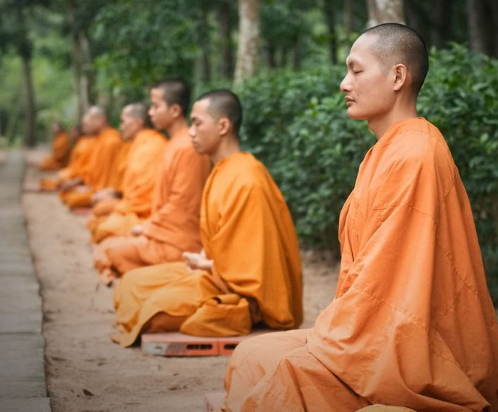
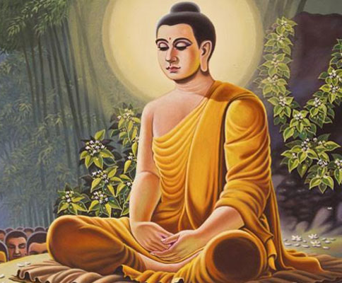
Introduction

Slide 7
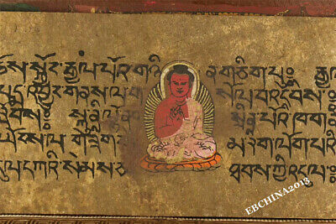
The Buddhist Scriptures
Introduction

Slide 8
Buddhist Scriptures
Vinaya Pitaka
Rules and disciplines
Sutta Pitaka
Teachings and Dharma
Abidhamma Pitaka
(That which is remembered)
Digha Majjhima Samyutta Angutta Shorter texts
Consists of 7 books

Slide 9
Prophecies of Muhammad (saw) in the Buddhist Scriptures

Slide 10
Prophecy 1
Prophecies of another Buddha –
Maitreya

Slide 11
Chakkavatti Sinhnad Suttanta D. III, 76:
"There will arise in the world a Buddha named Maitreya (the benevolent one) a holy one, a supreme one, an enlightened one, endowed with wisdom in conduct, auspicious, knowing the universe:
"What he has realized by his own supernatural knowledge he will publish to this universe. He will preach his religion, glorious in its origin, glorious at its climax, glorious at the goal, in the spirit and the letter. He will proclaim a religious life, wholly perfect and thoroughly pure; even as I now preach my religion and a like life do proclaim. He will keep up the society of monks numbering many thousands, even as now I keep up a society of monks numbering many hundreds".

Slide 12
Prophecy 2
Another Buddha

Slide 13
Sacred Books of the East volume 35 pg. 225:
"It is said that I am not an only Buddha upon whom the leadership and order is dependent. After me another Buddha maitreya of such and such virtues will come. I am now the leader of hundreds, he will be the leader of thousands."

Slide 14
Prophecy 3
Bhavishya Purana

Slide 15
Gospel of Buddha by Carus pg. 217 and 218 (From Ceylon sources):
"Ananda said to the Blessed One, ‘Who shall teach us when thou art gone?'
And the Blessed one replied, 'I am not the first Buddha who came upon the earth nor shall I be the last. In due time another Buddha will arise in the world, a holy one, a supremely enlightened one, endowed with wisdom in conduct, auspicious, knowing the universe, an incomparable leader of men, a master of angels and mortals. He will reveal to you the same eternal truths, which I have taught you. He will preach his religion, glorious in its origin, glorious at the climax and glorious at the goal. He will proclaim a religious life, wholly perfect and pure such as I now proclaim. His disciples will number many thousands while mine number many hundreds.'
Ananda said, 'How shall we know him?'
The Blessed one replied, 'He will be known as Maitreya'."

Slide 16
Analysis of the Prophecies (1-3)
The Buddha calls him Maitreya (the Merciful one)
Buddha says his message will be published to the universe
Buddha says he is not the first or last Buddha.
The buddha says he will be enlightened
He Maitreya will “Know knowledge of the universe
He will be “an incomparable leader”
He will be a “Master of men and angels”
He will reveal the same eternal truths that the Buddha revealed
Buddha says he will preach “…his (own) religion”.
The religion will be glorious at the beginning and the climax and the end.
His disciples will be in the thousands.

Slide 17
Prophecy 4
Identification of Maitreya

Slide 18
Gospel of Buddha by Carus pg. 217 and 218 (From Ceylon sources):
"The promised one will be: Mercy for the whole creation, A messenger of peace, a peace-maker, The most successful in the world.

Slide 19
Analysis of the Prophecies (1-3)
Mercy for mankind – Quran calls Muhammad this explicitly – “Qur’an 21:107” – “We have sent thee (Oh Muhammad) as a mercy to the whole of mankind”
Most successful man in the world.

Slide 20
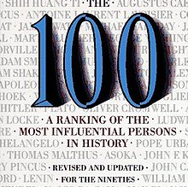
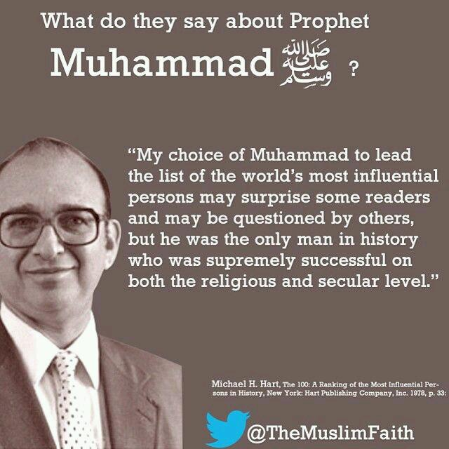
Most successful person/leader in his mission
The 100: A Ranking of the Most Influential Persons in History is a 1978 book by Michael H. Hart, an astrophysicist, alien life researcher and white separatist. It was the first book of Hart, which was reprinted in 1992 with revisions. It is a ranking of the 100 people who, according to Hart, most influenced human history.

Slide 21
Prophecy 5
Similarities to the Buddha
(Doctrine that is Exoteric and Esoteric)

Slide 22
Sacred Books of the East, volume 11, pg. 36 Maha-Parinibbana Sutta chapter 2 verse 32:
"I have preached the truth without making any distinction between exoteric and esoteric doctrine, for in respect of truths, Ananda, the Tathagata has no such thing as the closed fist of a teacher, who keeps something back".

Slide 23
Prophecy 6
Similarities to the Buddha
(Buddhas have a devoted Servitor)

Slide 24
Sacred Books of the East volume 11 pg. 97 Maha-Parinibbana Sutta Chapter 5 verse 36:
"Then the Blessed one addressed the brethren, and said, ‘Whosoever, brethren have been Arahat-Buddhas through the long ages of the past, they were servitors just as devoted to those Blessed ones as Ananda has been to me. And whosoever brethren shall be the Arahat-Buddhas of the future, there shall be servitors as devoted to those Blessed ones as Ananda has been to me’."

Slide 25
Prophecy 7
Similarities to the Buddha
(Buddha gives 6 criteria to identify a Buddha)

Slide 26
Gospel of Buddha by Carus pg. 214:
"The Blessed one said, ‘There are two occasions on which a Tathagata’s appearance becomes clear and exceedingly bright. In the night Ananda, in which a Tathagata attains to the supreme and perfect insight, and in the night in which he passes finally away in that ultra-passing which leaves nothing whatever of his earthly existence to remain.’ "

Slide 27
According to Gautam Buddha, following are the six criteria for identifying a Buddha:
A Buddha attains supreme and perfect insight at night-time.
On the occasion of his complete enlightenment he looks exceedingly bright
A Buddha dies a natural death.
He dies at night-time.
He looks exceedingly bright before his death.
After his death a Buddha ceases to exist on earth.
Leaves nothing earthly behind

Slide 28
Analysis of the Prophecy
Muhammad (saw) attained his revelation in the night –
Muhammad (pbuh) says after revelation he instantly felt his heart and understanding illumined with celestial light.
Muhammad (pbuh) died a natural death.
According to Ayesha (r.a.), Muhammad (pbuh) expired at night-time. We know this as in the narration it states…When he (saw) was dying there was no oil in the lamp and his wife Ayesha (r.a.) had to borrow oil for the lamp.
According to hadith traditions: Anas (r.a.) says, The Prophet (pbuh) looked exceedingly bright in the night of his death
After the burial of Prophet Muhammad (pbuh) he was never seen again in his bodily form on this earth.
[Another similarity] - Buddha was offered his kingship and decided to follow his message instead. P.Muhammad (Saw) also was offered rulership of Makkah and instead he decided to stick to his message.
According to tradition Prophet Muhammad left nothing worldly behind.

Slide 29
PART 4b:
Prophet Muhammad (saw) in
Zoroastrian Scriptures

Slide 30
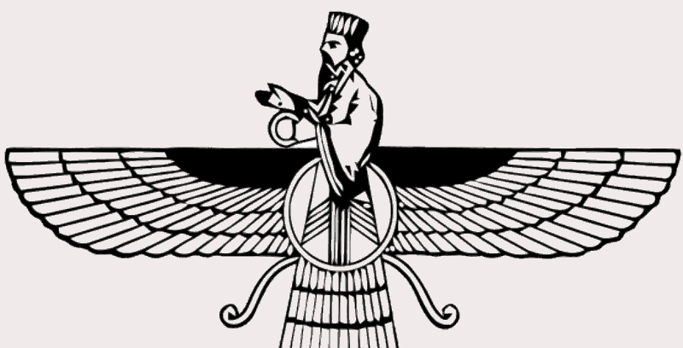
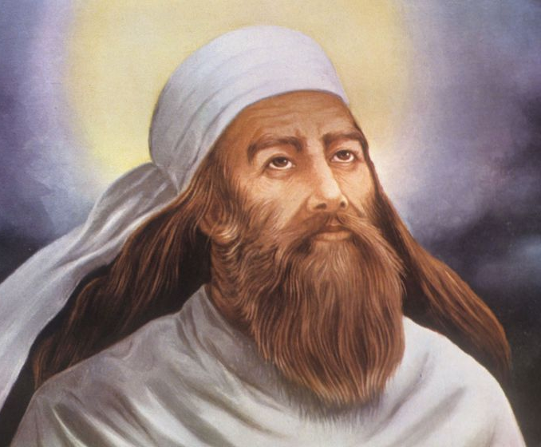
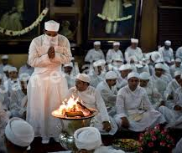
Introduction

Slide 31
Zoroastrian Scriptures
Dasatir
Zend Avesta
Khurda Dasatir Kalan Dasatir
Khurda Avesta Kalan Avesta

Slide 32
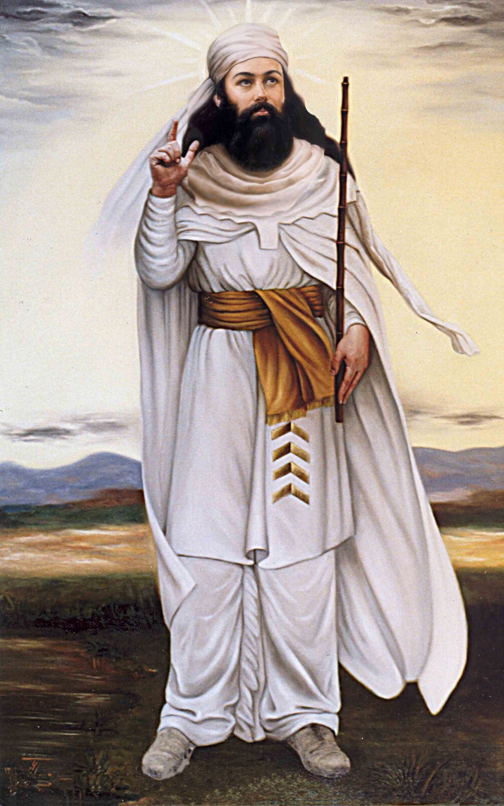
Zoroaster, Zarathustra, Zarantuštra……
Zoroastrians are considered a monotheistic religion.
They call their God as 'Ahurmazda ', Ahur means Master and Mazda means Wise, the name of their God thus means the ' Wise Master'.

Slide 33
Prophecy 1
Prophecies in Dasatir
(Prophecy of the Holy One)

Slide 34
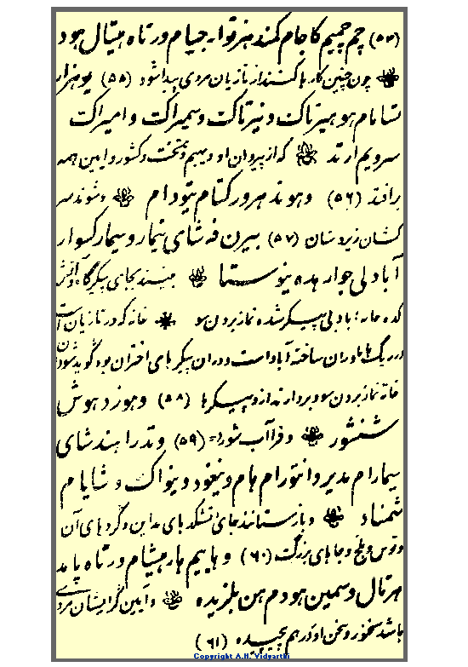
Epistle of Sasan 1
“When the Persians will do such deeds, a man from among the Arabs will be born whose followers shall overthrow and dissolve the kingdom and religion of the Persians.
And the arrogant people (Persians) will be subjugated. Instead of the temple of fire and the house of idols they will see the House of Abraham without any idols as their Qibla.
“And they will be a mercy to the worlds. And they will capture the places of temples of fire, Madain (Ctesiphon), nearby lands, Tus and Balkh, and other eminent and sacred places (of Zoroastrians). And their leader will be an eloquent man whose words and message will be clear and far-reaching.”

Slide 35
Prophecy 2
Prophecies in Zend Avesta
(Prophecy of the holy one)

Slide 36
Farvardin Yasht. 13 :17.
"The most powerful amongst the Companions of the faithful, O Zaratushtra, are those of the men of the primitive law, or those of the 'Soeshyant' (merciful one), who are not yet born, who are to restore the world."

Slide 37
Prophecy 3
Prophecies in Zend Avesta
(Prophecy of the one to stand against he idolaters)

Slide 38
Farvardin Yasht., 28 : 129
"The most powerful amongst the Companions of the faithful, O Zaratushtra, are those of the men of the primitive law, or those of the 'Soeshyant' (merciful one), who are not yet born, who are to restore the world."

Slide 39
Prophecy 4
Prophecies in Zend Avesta
(Prophecy of the great companions of the promised prophet)

Slide 40
Zamyad Yasht, 95.
"AND there shall his friends come forward, the friends (companions) of Astvat-ereta, who are fiend-smiting, well-thinking, well-speaking, well-doing, following the good law and whose tongues have never uttered a word of falsehood"

Slide 41
Prophecy 5
Prophecies in Zend Avesta
(Prophecy of the fire cooling down)

Slide 42
Atash Nyayish : 9
The prophet Zoroaster remarked : “Mayest thou burn in this house ! Mayest thou ever burn in this house ! Mayest thou blaze in this house! Mayest thou increase in this house ! Even for a long time, till the powerful restoration of the world, till the time of the good, powerful restoration of the world."

Slide 43
+25 Extra Prophecies
There are over 25 statements and prophecies other than the ones given that speak about the Soeshyant and Astvat-ereta and the companions of this promised prophet to come. They praise him and talk highly of him and his companions.

Slide 44
References
Abdul Haque Vidyarthi. (1940). Mohammad in world scriptures. Lahore: Dar-ul-Kutub Islamia.
Buddha in the Quran? – Shaykh Hamza Yusuf
http://www.avesta.org/ka/yt13sbe.htm
https://www.islamawareness.net/Zoroastrianism/scriptures.html
http://www.cyberistan.org/islamic/parsi1.html
https://www.sacred-texts.com/hin/

Slide 45
END OF PART 4

