Slide 1
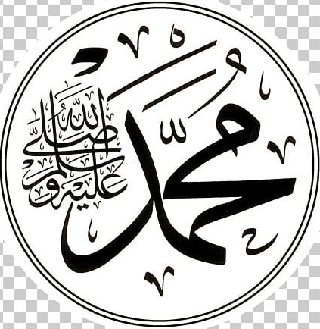
Muhammad(saw) in World Scriptures
The Study of Prophecies in world religious scriptures
By: Moneeb Minhas

Slide 2
Disclaimer
This lecture was requested from a non-muslim audience (attendees of the weekly prophetic biography course), merely out of curiosity on “The prophecies about the arrival of the last Messenger in religious world scriptures– Prophet Muhammad”
This lecture is not a debate, or in any way to put down any other opinion, but merely an academical study of religious texts or comparative religion.
Those present are here voluntarily and have the right to leave whenever they will.
We acknowledge that we are all coming from different backgrounds, cultures and religions. We understand that we all differ on certain views and this should not instil hatred or intolerance for one another, but rather as teachers, professionals, academics and humans we should practice, preach and promote tolerance, love and respect for one another.
This lecture series may contain views that are contrary to others and we apologise if anything is taken offensively. Any offence occurred is purely unintentional.
This lecture series will try and give the attendees an insight into the various religious texts, prophecies and how Islamic scholars analyse them academically.
This lecture series is in no means designed to convert or enforce an opinion on someone else. It is just one the analysis of religion from a perspective.

Slide 3
PART 1:
Introduction to Prophecies

Slide 4
Contents to Lecture Series
PART 1 - Introduction to Prophecies
PART 2 - Muhammad (s) in Judeo-Christian Scriptures
PART 3 - Muhammad (s) in Hindu Scriptures
PART 4 - Muhammad (s) in Zoroastrian & Buddhist Scriptures

Slide 5

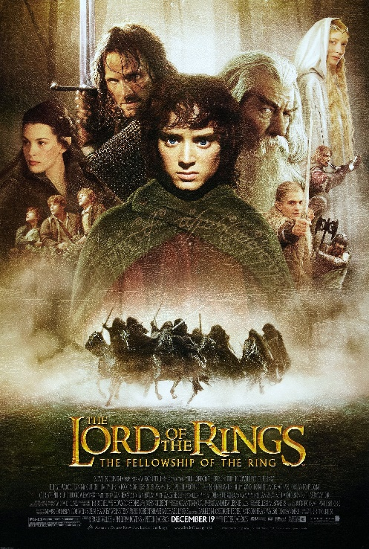







What do all these blockbuster movies have in common?

Slide 6


Meaning of “Prophecy”

Slide 7


Britannica
A prophecy is a message that is claimed by a prophet, soothsayer oracle, seers, diviners to have been communicated to them by a deity.
Such messages typically involve inspiration, interpretation, or revelation of divine will, concerning the prophet's social world and events to come. All known ancient cultures had prophets who delivered prophecies.

Slide 8

The Etymology of the word
The English noun "prophecy", in the sense of "function of a prophet" appeared from about 1225, from Old French profecie (12th century), and from prophetia, Greek propheteia "gift of interpreting the will of God", from Greek prophetes. The related meaning, "thing spoken or written by a prophet",
dates from 1300 century, while the verb "to prophesy" is recorded by 1377.

Slide 9
7
Principles of
Prophecies
The Meaning needs someone of intellect to decipher
Names are not necessarily personal
Dates are not always as they seem
A prophecy can be interpreted as the science of dreams
Places, names and countries can be attributive
Symbolism Myths and legends that are contrary to logic or true knowledge
Statements and prophecies can have an exoteric and esoteric dimension

Slide 10
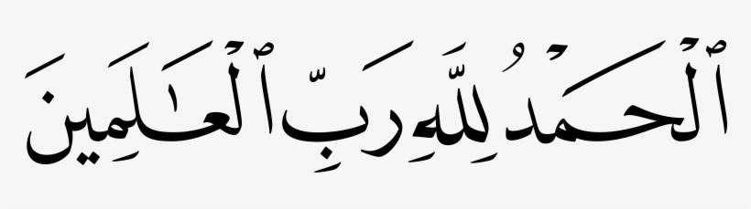
Universality of Religion
“All praise is to God the Lord of the Worlds”

Slide 11
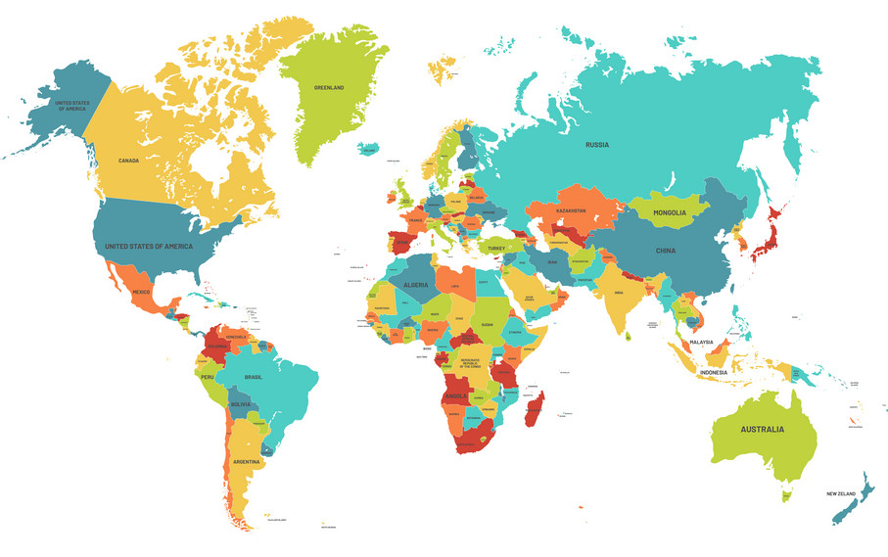
Christianity
Confucianism
Buddhism
Universality of Religion
Hinduism
Islam
Jainism
Judaism

Slide 12
John S. Hoyland writes in his book A Brief History of Civilization:
“The God whom the Jews worshipped had at first been conceived
of as the tribal Deity of a nomadic people … for many centuries the
Jews continued to conceive this God of righteousness as their God
only … But this idea that their own national God was also the God
of all other men was never welcomed and adopted by the mass of
the Jewish population.”
Ref: Oxford University Press, 1925, p. 72.

Slide 13
Muhammad (s) brings about a religion termed “Peace” or “Islam” in his mother tongue that he says is:
A religion for all”
One God/Creator that is the Creator of everyone and everything
A message that is universal and promotes universality of religion (Quran)
Christianity
Confucianism
Buddhism
Universality of Religion
Hinduism
Islam
Jainism
Judaism

Slide 14
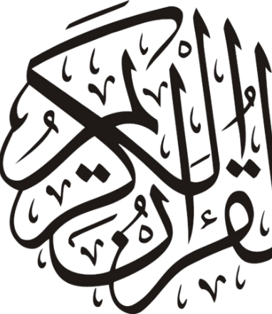
Quran
The scripture given to Prophet Muhammad (s) as a universal guidance for mankind, calling for the unification, universality, acceptance and a unified message.

Slide 15
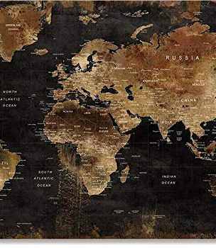
God gave a Prophet for every nation.
Point 1:

Slide 16
Quran -10:47
"To every nation (was sent) an apostle: when their apostle comes (before them on the day of judgement), the matter will be judged between them with justice, and they will not be wronged.”

Slide 17
Quran -13:38
"We did send apostles before you (Oh Muhammad), and appointed for them wives and children: and it was never the part of an apostle to bring a sign except as God permitted (or commanded). For each period is a Book (revealed). "

Slide 18
Quran -23:44
“Then We sent Our Messengers in succession, every time there came to a nation their Messenger, they denied him, so We made them follow one another (to destruction), and We made them as tales (the true stories for mankind to learn a lesson from them).”

Slide 19
Quran -14:4
-"We sent not an apostle except (to teach) in the language (culture, traditions etc) of there (own) people, in order to make (things) clear to them.”

Slide 20
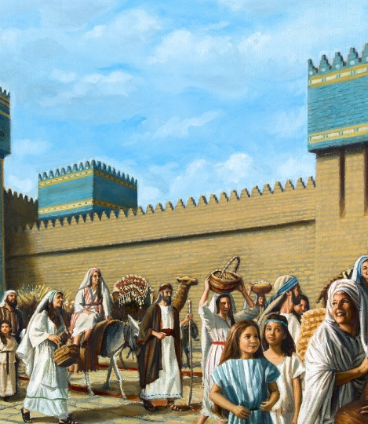
Prophets from Adam (1st) to Muhammad (Last)
Point 2:

Slide 21
Quran -42:13
“He has made plain to you of the religion what He enjoined upon Nuh (Noah) and that which We have revealed to you (Muhammad) and that which We enjoined upon Ibrahim (Abraham) and Musa (Moses) and Isa (Jesus) that keep to obedience and be not divided therein; hard to the unbelievers is that which you call them to; Allah chooses for Himself whom He pleases, and guides to Himself him who turns (to Him), frequently.”

Slide 22
Hadith (Musnad Imam Ahmad)
Narrated by Abu Dharr
I asked the messenger "O Messenger of Allah, how many Prophets were there (sent previously)?"
He replied "One hundred and twenty four thousand…"

Slide 23
Hadith (Musnad Imam Ahmad)
Narrated by Abu Dharr
I asked the messenger "O Messenger of Allah, how many Prophets were there (sent previously)?"
He replied "One hundred and twenty four thousand…"

Slide 24
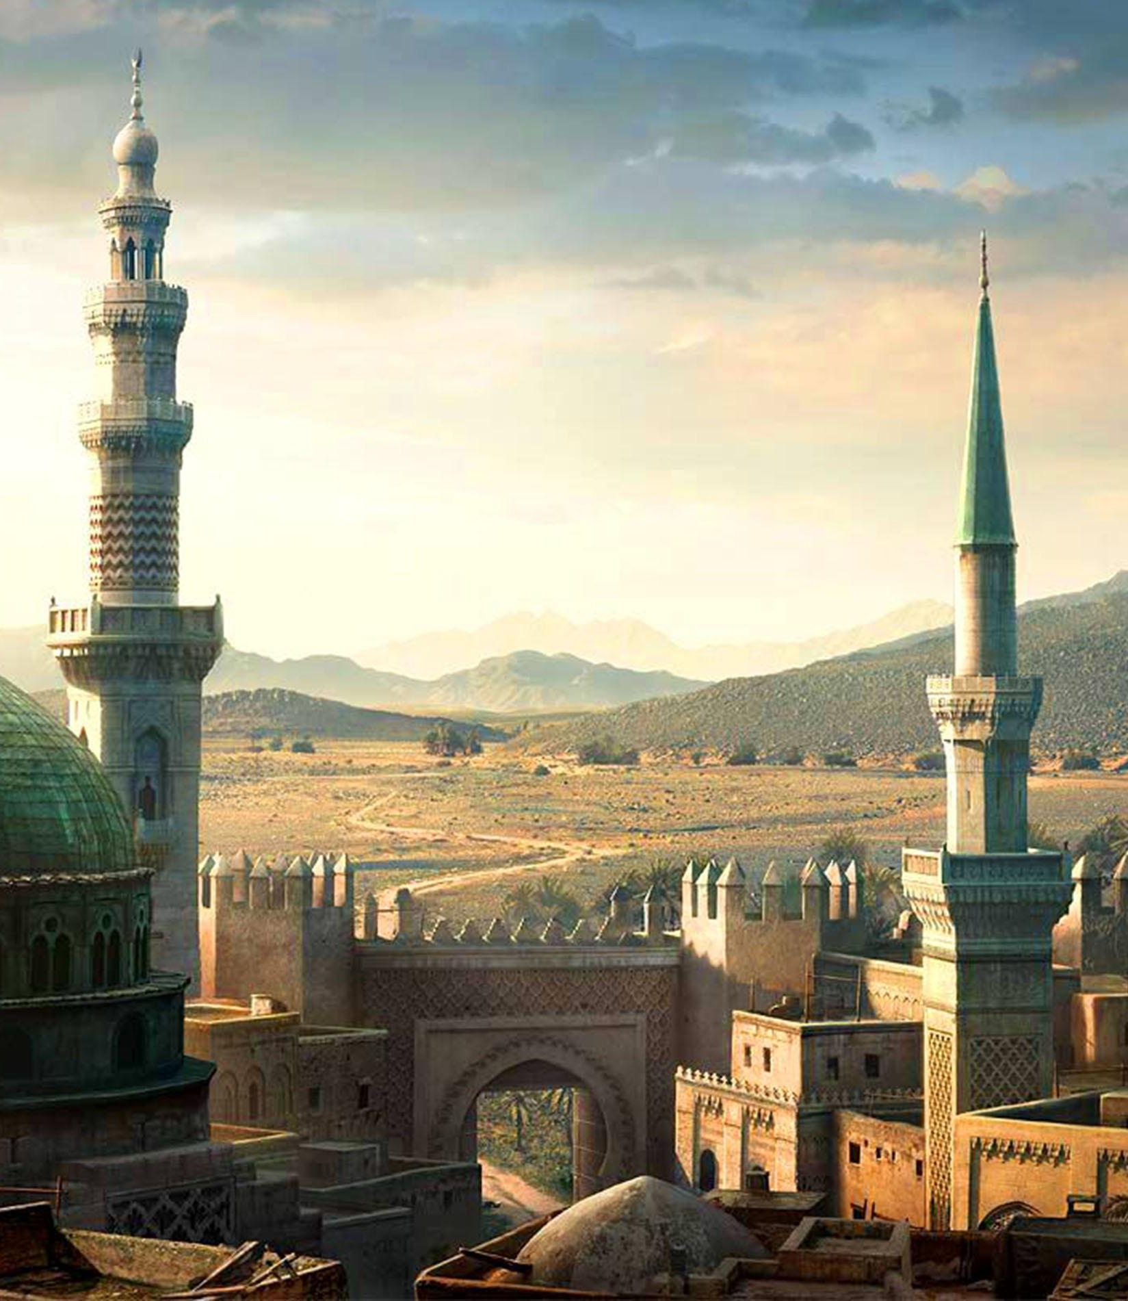
Prophet Muhammad (s)is similar to the previous Prophets sent all over the world.
Point 3:

Slide 25
Quran 35:24
"Verily We have sent thee (Oh Muhammad) in truth, as a bearer of glad tidings, and as a warner: and there never was a people, without a warner having lived among them (in the past)."

Slide 26
Quran 40:78
“And, indeed We have sent Messengers before you (O Muhammad); of some of them We have related to you their story and of some We have not related to you their story, and it was not given to any Messenger that he should bring a sign (eg: miracle, revelation, book) except by the permission of Allah.”

Slide 27
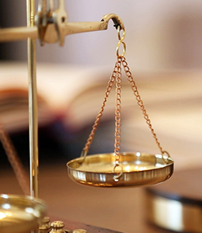
Justice of God explained and clarified
Point 5:

Slide 28
Quran 10:47
“And for every nation there is a messenger. So when their messenger comes, the matter is decided between them with justice, and they are not wronged.”

Slide 29
Quran 4:165
“So that the people may have no plea against God after the coming of messengers.”
Quran 17:15
“Nor do We chastise until We raise a messenger.”

Slide 30
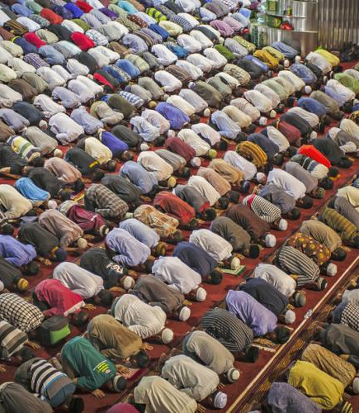
God says Muslims MUST believe and respect all previous Prophets.
Point 6:

Slide 31
Quran 3:84
“Say (Oh Believers): We believe in Allah and what has been revealed to us, and what was revealed to Ibrahim and Ismail and Ishaq and Yaqub (Jacob) and the tribes (thereafter), and what was given to Musa (Moses) and Isa (Jesus) and to (all the) prophets from their Lord; we do not make any distinction between any of them, and to Him do we submit.”

Slide 32
Quran 2:4
“And those who believe in that which has been revealed to you (O Muhammad) and that which was revealed before you (in previous scriptures).”

Slide 33

QUESTION
If the source is the same, why so many differences?
My personal opinion after doing comparative studies is “what do you mean differences? There are so many striking similarities what about them? so maybe the difference is in us… and our perceptions of how we see things.
The differences could be in religious laws
Some differences in fundamental beliefs could also be due to changes made by the adherents overtime,
The interpretation of people on scripture differs, causing differences.
It is a known fact that all major religions unanimously agree on certain basic concepts, beliefs and laws.

Slide 34
QUESTION
Why the terms “Muslim” and “Islam” and “Allah”
A valid question to pose is if it’s the same religion passed down overtime and throughout the ages, then why has everyone got different names including Islam.

Slide 35
The term…
“MUSLIM”
Arabic for:
“the one who peacefully submits (to God)”.
“the peaceful submitters”.

Slide 36
The term…
“ISLAM”
Comes from:
SaLaMa (Meaning peace)
Arabic for:
“PEACE”
“peaceful submission to God”.
“Do Gods will and promote Peace”

Slide 37
The term…
“ALLAH”
Some scholars say it originates from the Arabic Al-Ilah – “The God”
Other deriviations:
Al, El, Eloh, Elohim, Elai, Aloi
Quran 7:180
“The most beautiful names belong to Allah (God): so call on him by them; but shun such men as use profanity in his names: for what they do, they will soon be requited.”
Quran 17:110
“Say, "Call upon Allah or call upon the Most Merciful. Whichever [name] you call - to Him belong the best names."

Slide 38
Summary
        That the God (Allah) mentioned can be called any name as long as its beautiful, so Hindus can still call him Baghwan and Israelites can still call him Yahweh or Jehovah or the Father and it wouldn’t affect God and you can still be included in the house of God.
        True Prophets or guides were sent to every nation, meaning the religions or teachings they came with were true and from the same source (ie: God). Demonstrating why every religion has some sort of link and connection either to do with teachings, laws or beliefs.
        God does not leave a nation or tribe or people without guidance and if he does he does not chastise or punish them for it. Demonstrating the justice of God.
        Muhammad was sent to all mankind and not just his people or Arabs or Israelites, or indus etc. Eradicating the concept of a chosen people or chosen nation as such, or only one community obtaining salvation and all others destined for hell or left in the dark without guidance.
        The reason for differences are mainly due to us people and not the source sending the information.

Slide 39

Drawing some links

Slide 40
Adam – First man
Christianity/Judaism/Islam
Adam / Aadam
Hinduism
Adami

Slide 41


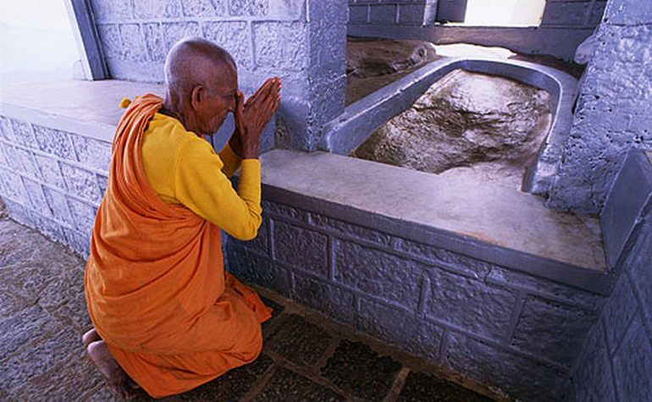
Adam’s peak
(Sri Lanka)
Sacred place to Buddhists and Hindus

Slide 42
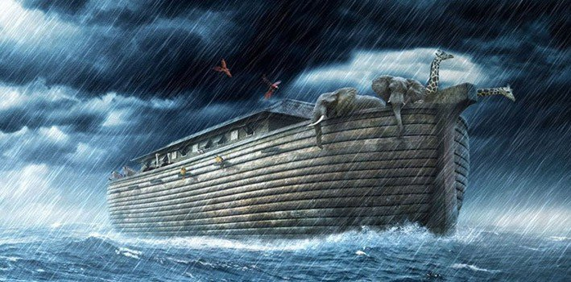

Slide 43
NOAH
NUH

Slide 44
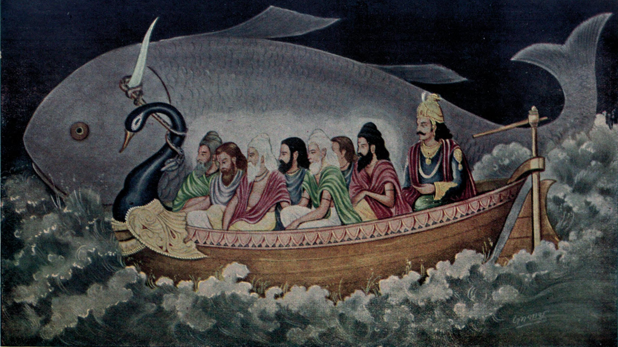

Slide 45
Ma
Nuh

Slide 46
Startling resemblance between the two stories
Quranic-Biblical
Noah / Nuh
Story contains flood and animals
Builds an ark
Ark comes to rest at mountains (Ararat).
Had 3 sons: Ham, Shem and Japeth
Called the second father of mankind
Hinduism
Manuh
Story contains flood and animals
Builds an ark
Ark comes to rest at mountains (Himalayas)
Had 3 sons: Charma, Sharma, Yapeti
Called the “father of all mankind”

Slide 47
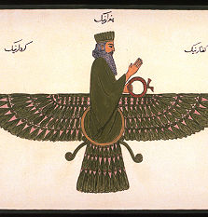
Zoroastarianisnm
A figure in history who has an almost identical story to Noah exists in the scriptures under the name of YIM.

Slide 48
BRAHMA

Slide 49
ABRAHM

Slide 50
Some striking similarities between
Abraham and Brahma
Abraham
Abraham means “multitude” and “Father of creation” – Has title of Patriarch.
Abraham has children in old age
Abraham has two wives – Sara and Hagar/Hajara (means a rock/hill)
Each wife bears one son.
Brahma
Brahma means to “spread forth or gains strength” – Brahma is title (real name is Parjapati – “Father of creation”)
Brahma bares children in old age
Brahma has two wives – One called Saraswati the other Parvati (means a rock/hill)
Each wife bears one son.

Slide 51
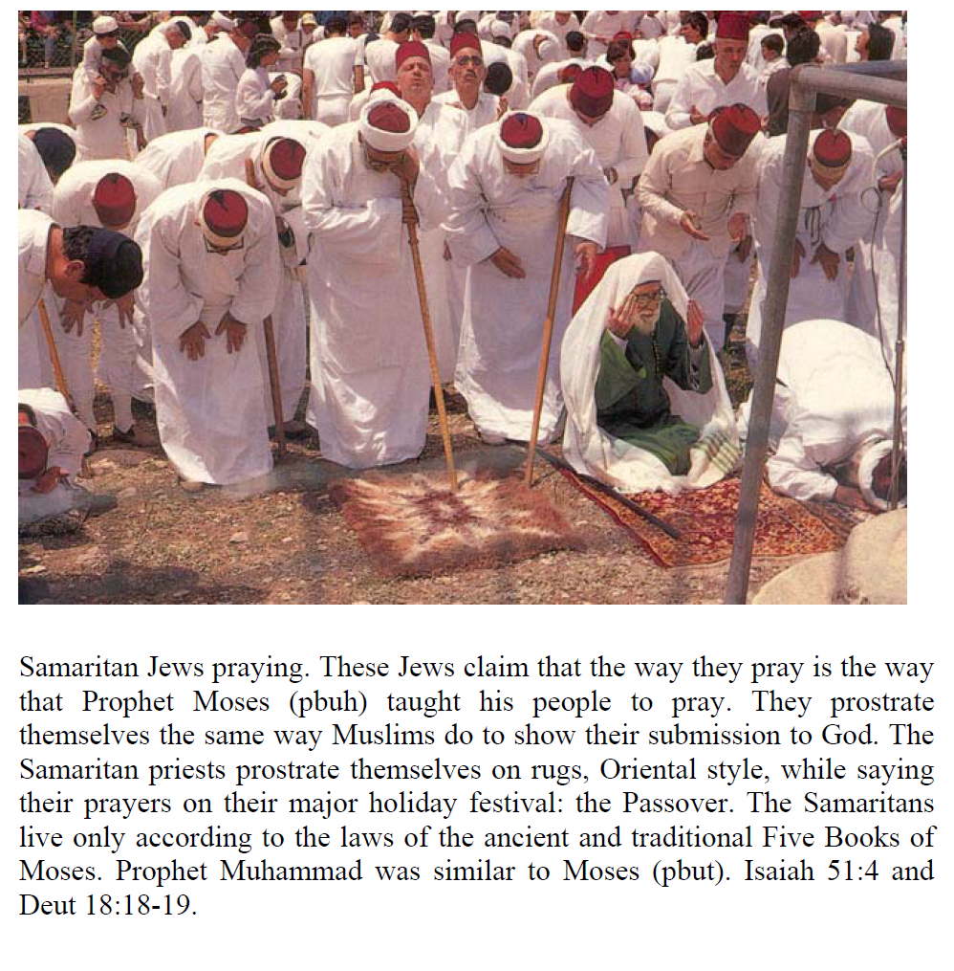
Jews and Muslims pray in a similar manner

Slide 52
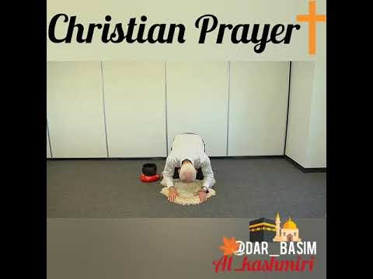
Similarities between Muslim, Jews and Orthodox Christians praying

Slide 53
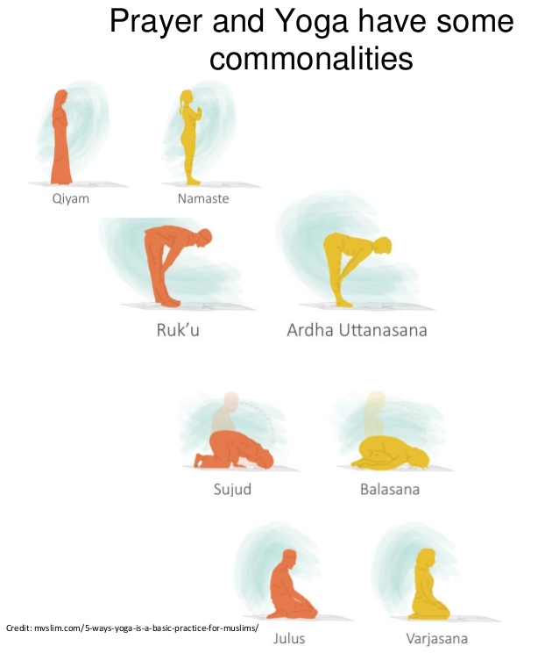
Muslims – Hindus also pray in similar manner

Slide 54
END OF PART 1

Slide 55
Islam – Christianity
HALLALU’YA!

Slide 56
Islam – Christianity
YA HALLALU’!
Ya Allah hu

Slide 57
Muhammad in Bible Links
https://www.youtube.com/watch?v=-_gF_maxocY
  This links goes through Isaiah and his prophecy about Muhammad to come to Arabia.

Slide 58
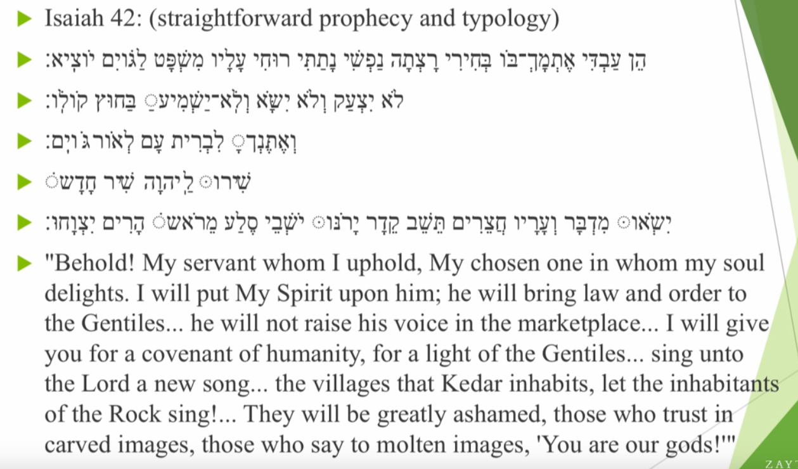
Muhammad in Bible

Slide 59
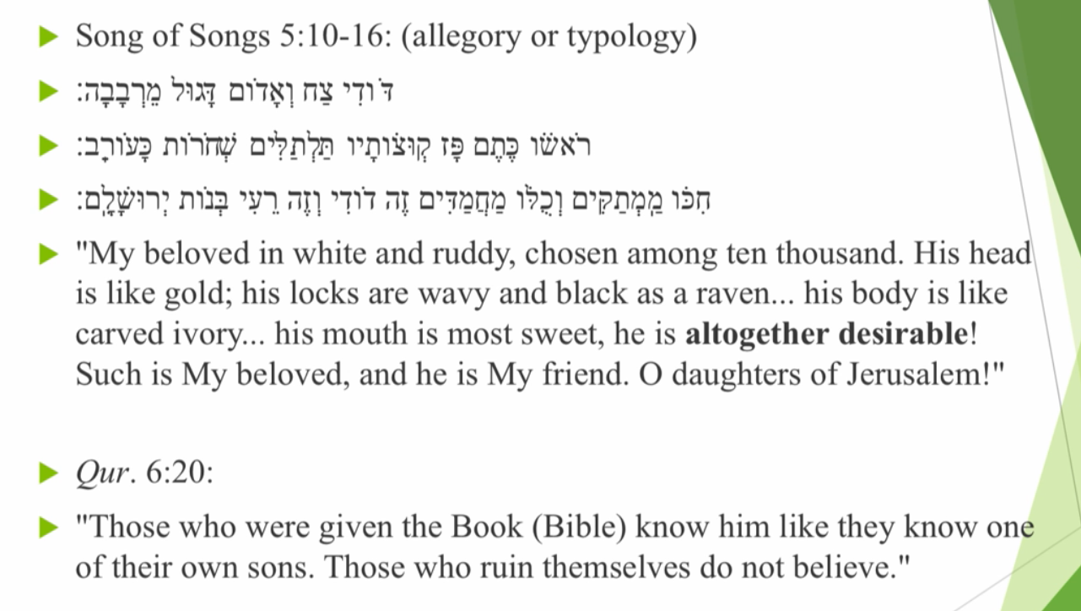
https://www.youtube.com/watch?v=hfLJmJSrppY
1.07

Slide 60
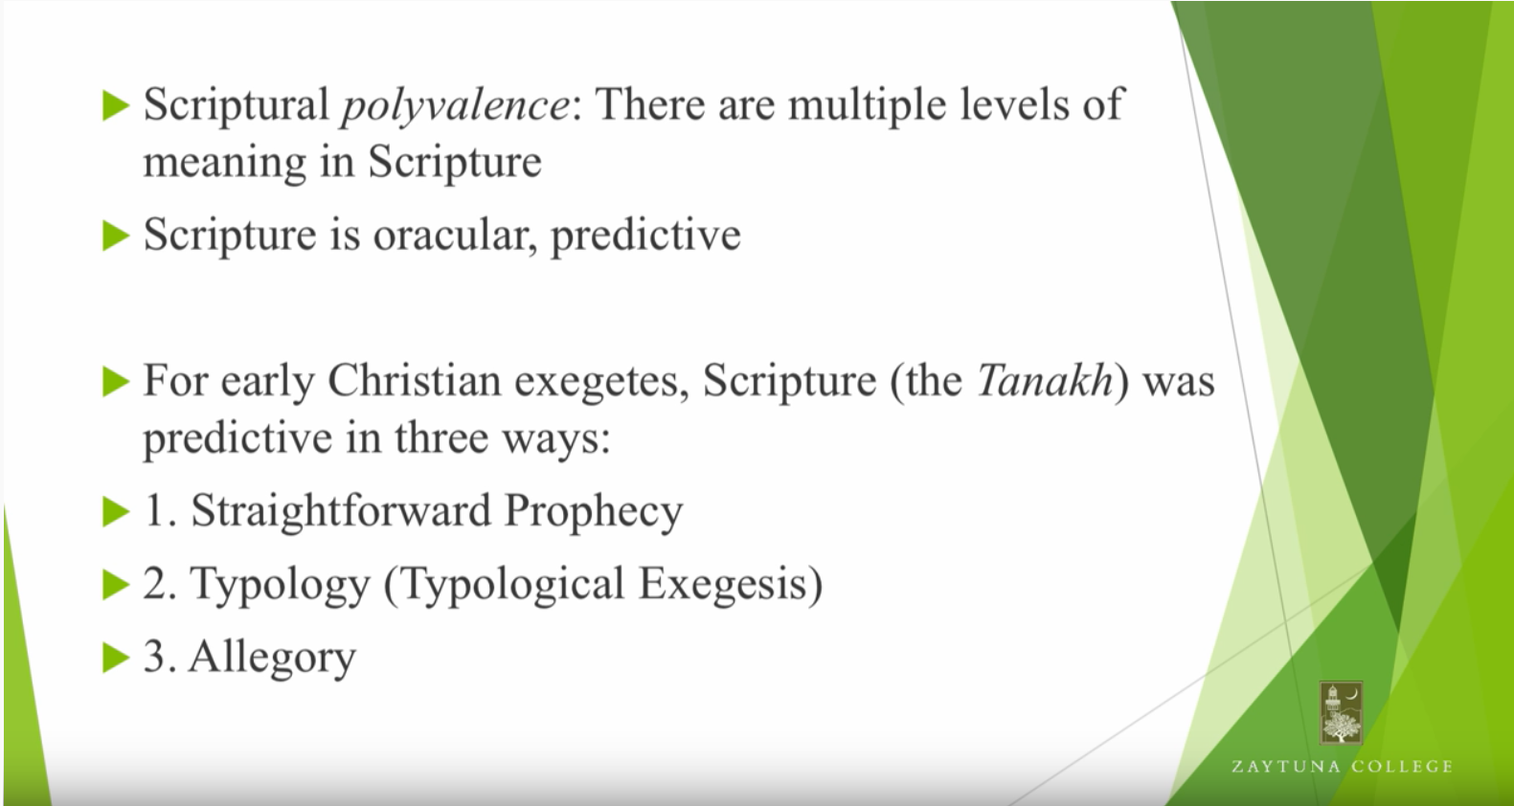
Types of prophecy studies within Christianity
Prophecies or verses in Bible and Quran and other religious texts have an Exoteric and Esoteric aspects.
Give examples of both. Mention the parameters of it though.

Slide 61
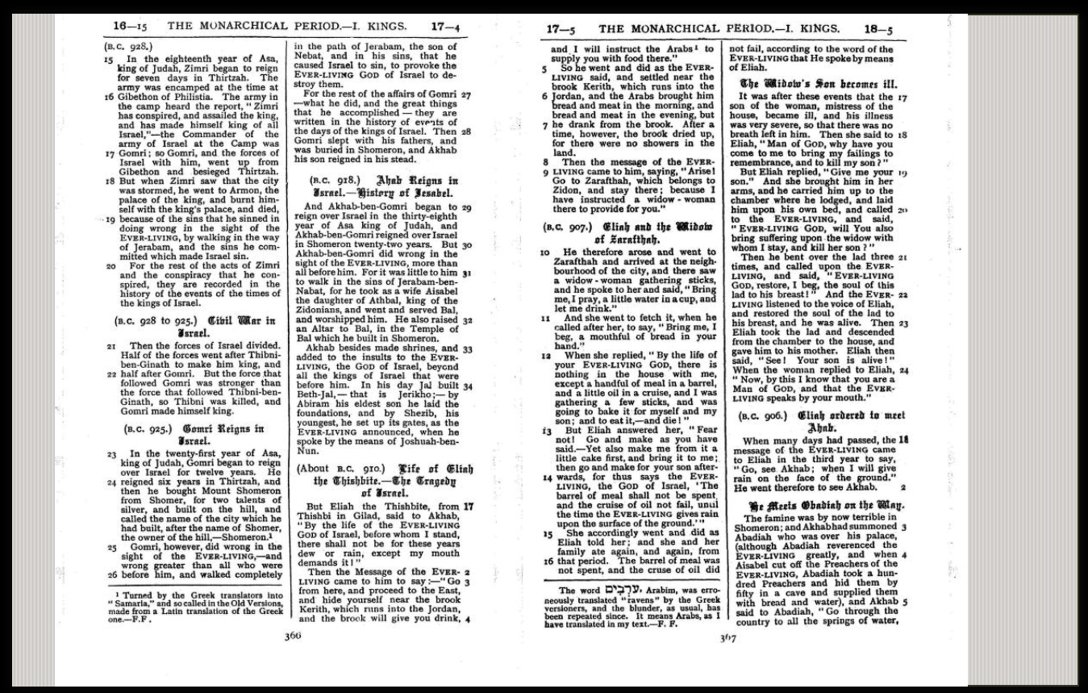
1 Kings 17:6 – Mentions word Arab.

Slide 62
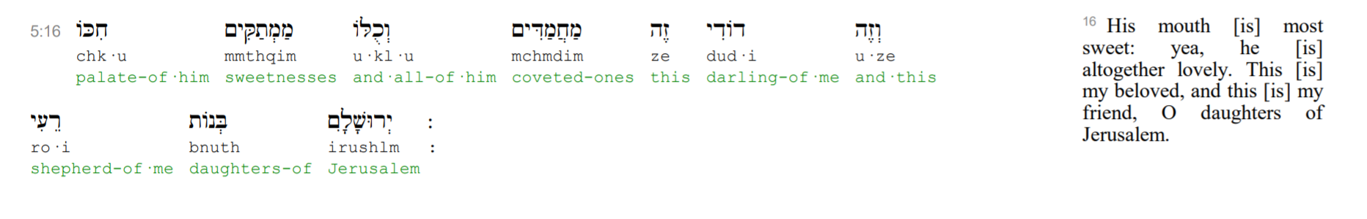
Muhammadim

Slide 63
End of Lecture

